Slide 1

Science Note Booking and Using
Phenomena Based Investigations
Presenters: Dr. Sal Fernandez and Ms. Kelli List Wells

Slide 2
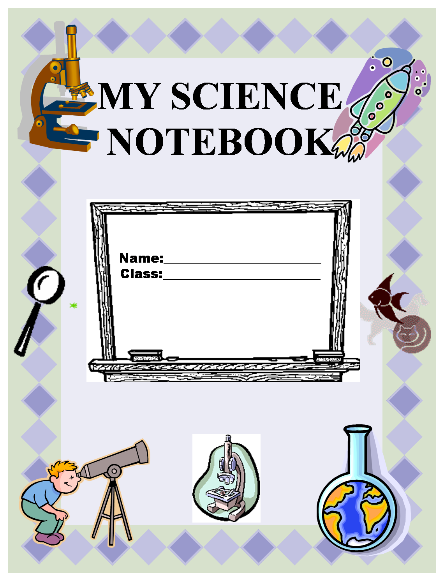
Setting Up a Science Notebook
Composition Books, Interactive and On-line Notebooks could all be utilized

Slide 3
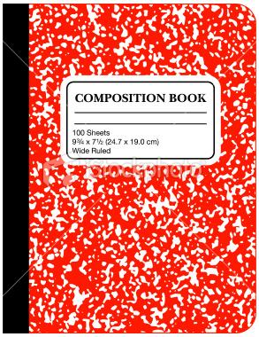






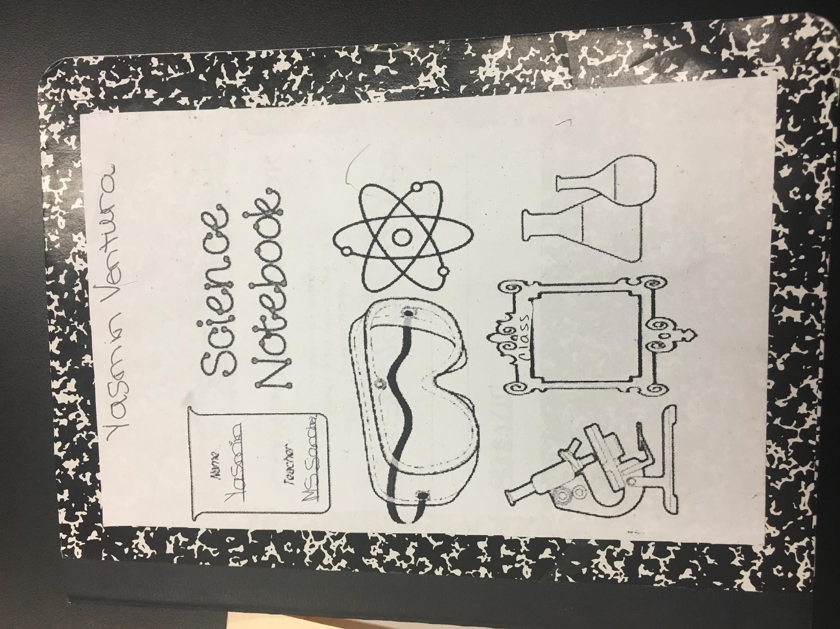
LET’S GET STARTED…
Add your name to the Cover
Don’t forget to let your notebook reflect your…
Add clip art for on-line notebooks or stickies for in school notebooks
ARTISTIC
PERSONALITY
Why do we want to make the notebook personal?
Notes:
The Cover will emerge for you as you take this notebook with you from place to place. Some people will doodle, some will cover the cover, some will leave it just the way it is, some will add stickers. Perhaps do the camouflage activity now.
Cover decorating activity. Camouflage Frog.
It is yours and you can express yourself through the cover, if you so desire.

Slide 4
TABLE OF CONTENTS
Use the first 1 to 2 pages for the Table of Contents
DATE ACTIVITY PAGE #
Notes:
The Table of Contents, IF YOU AS A TEACHER DECIDE TO USE ONE, can appear in a number of forms from teacher generated to student generated…
NOTE: The Table of Contents should be the first thing done before moving to the daily page.

Slide 5
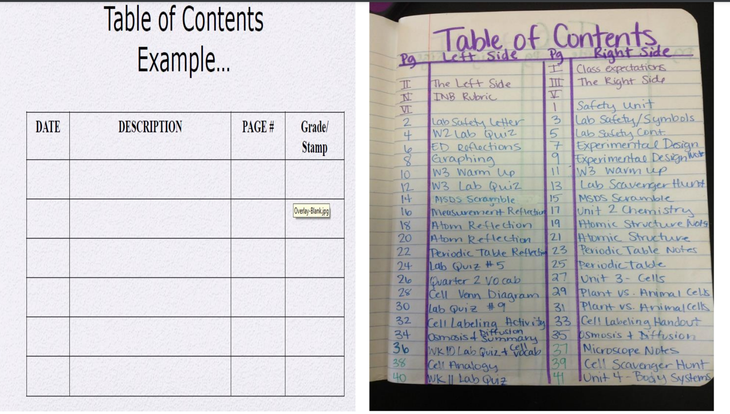
A Student’s Table of Contents Sample

Slide 6
Student Contract and/or
Safety Contract
Front Cover of the Book
How Do I Know I Did A Good Job?
*I respected myself and others.
*I was prepared to learn and think.
*I listened to and followed directions.
*I worked hard and did my very best.
*I stayed focused on my work.
*I cooperated and shared with my partners.
*I took chances in thinking and shared my thoughts.
*I listened to the answers of other students.
*I filled out all parts of my notebook:
  Table of Contents
  Title
  Started with a topic sentence
  Vocabulary words entered in the index.
*I made careful and thorough observations.
*I wrote, drew, and labeled my observations.
*I reread and checked my writing for errors and made corrections.
*I protected the animals in the lab.
*I used science materials carefully and left my table clean and the way I found it.
*I learned and had fun!

Slide 7
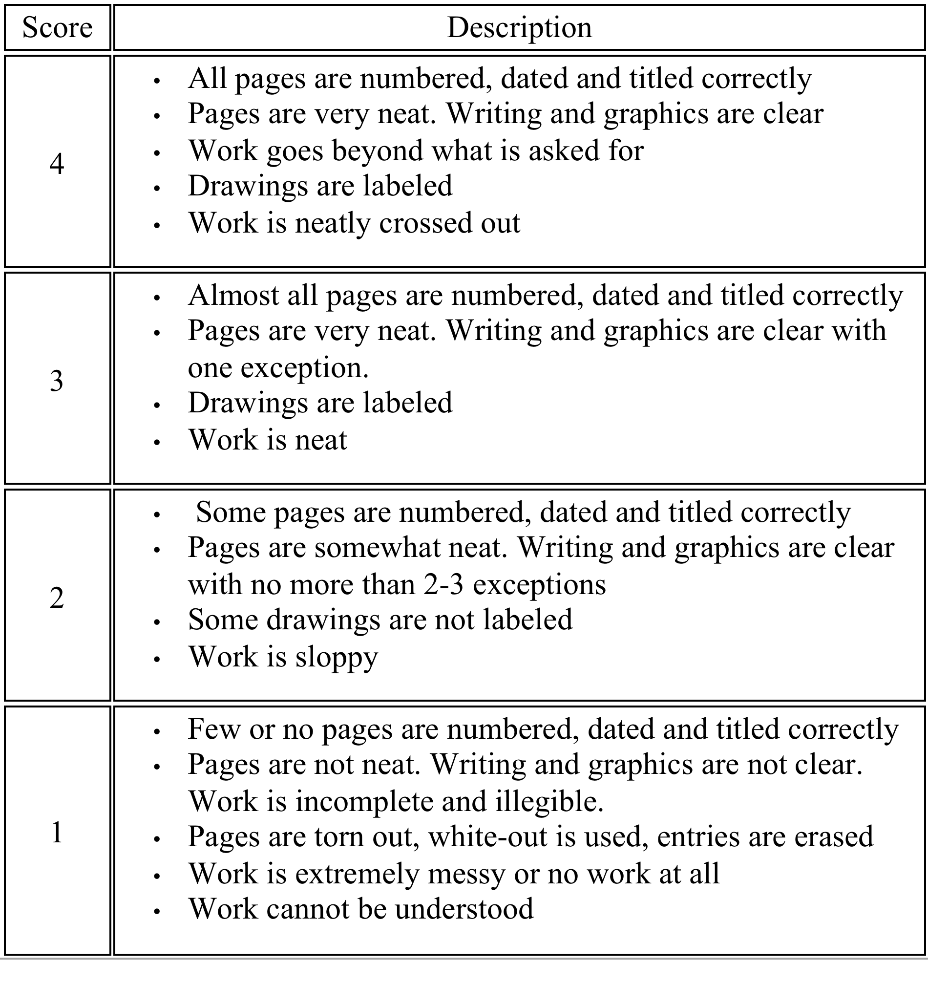
Science Notebook Rubric

Slide 8
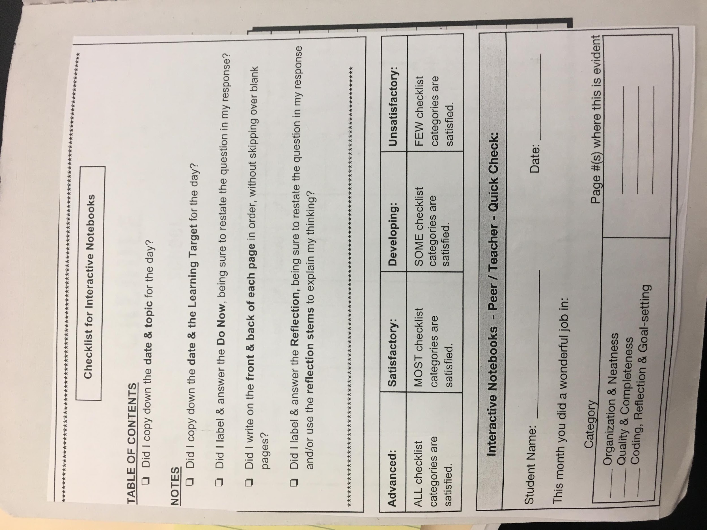
Checklist for Notebooks

Slide 9

NUMBER YOUR PAGES
It’s a good idea to always add the about the weather –(Why?)
1
Notes:
Now take a few moments only to number your pages. You will notice that the #1 is on the right hand side. This is a convention you will find in any published material.

Slide 10
The Last Page Can be….
Word Wall, Word Bank, Vocabulary, Bibliography, Internet Resources
Or the vocabulary can be embedded in the daily notes and lessons
Notes:
Continue to number your pages through page 10.

Slide 11
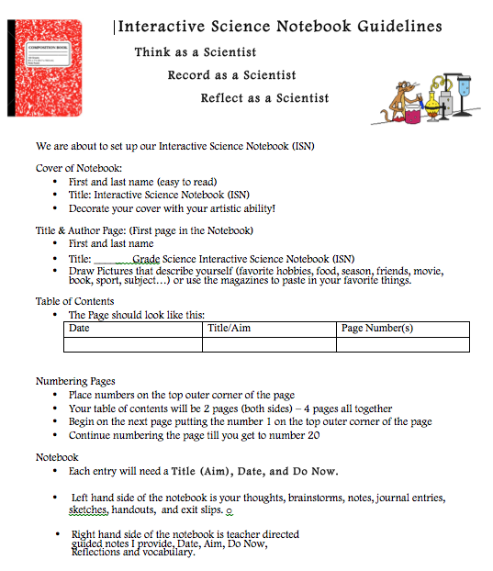
https://1drv.ms/w/s!AmdEQEoXGOGHpWQe5O35HLmNIuzI

Slide 12
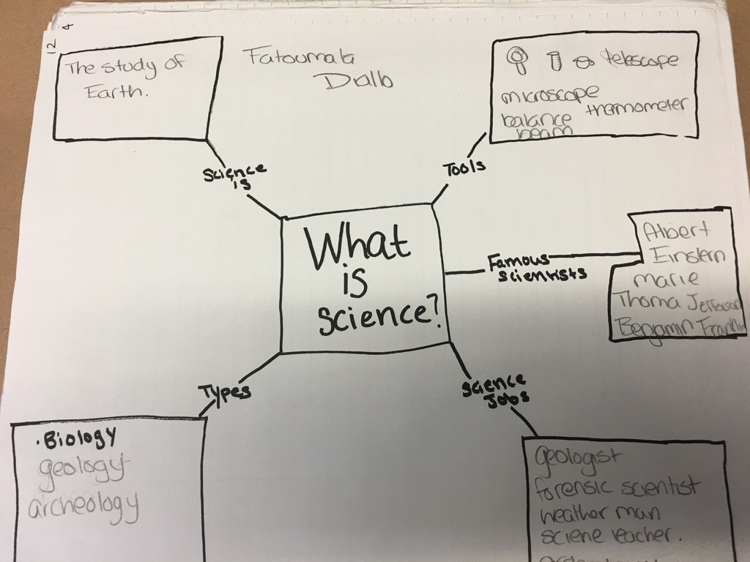
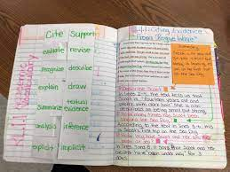
Samples from Student Notebooks

Slide 13
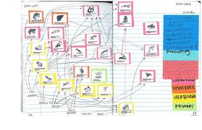
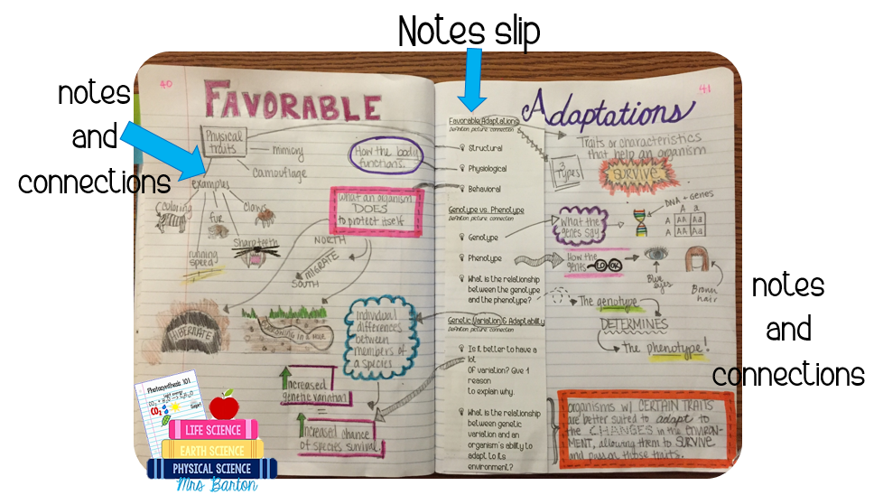
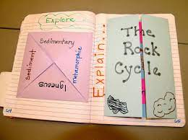
There is no one way to do note booking…
Cornell Notes, Interactive, right and left sides and other methods
Foldables

Slide 14
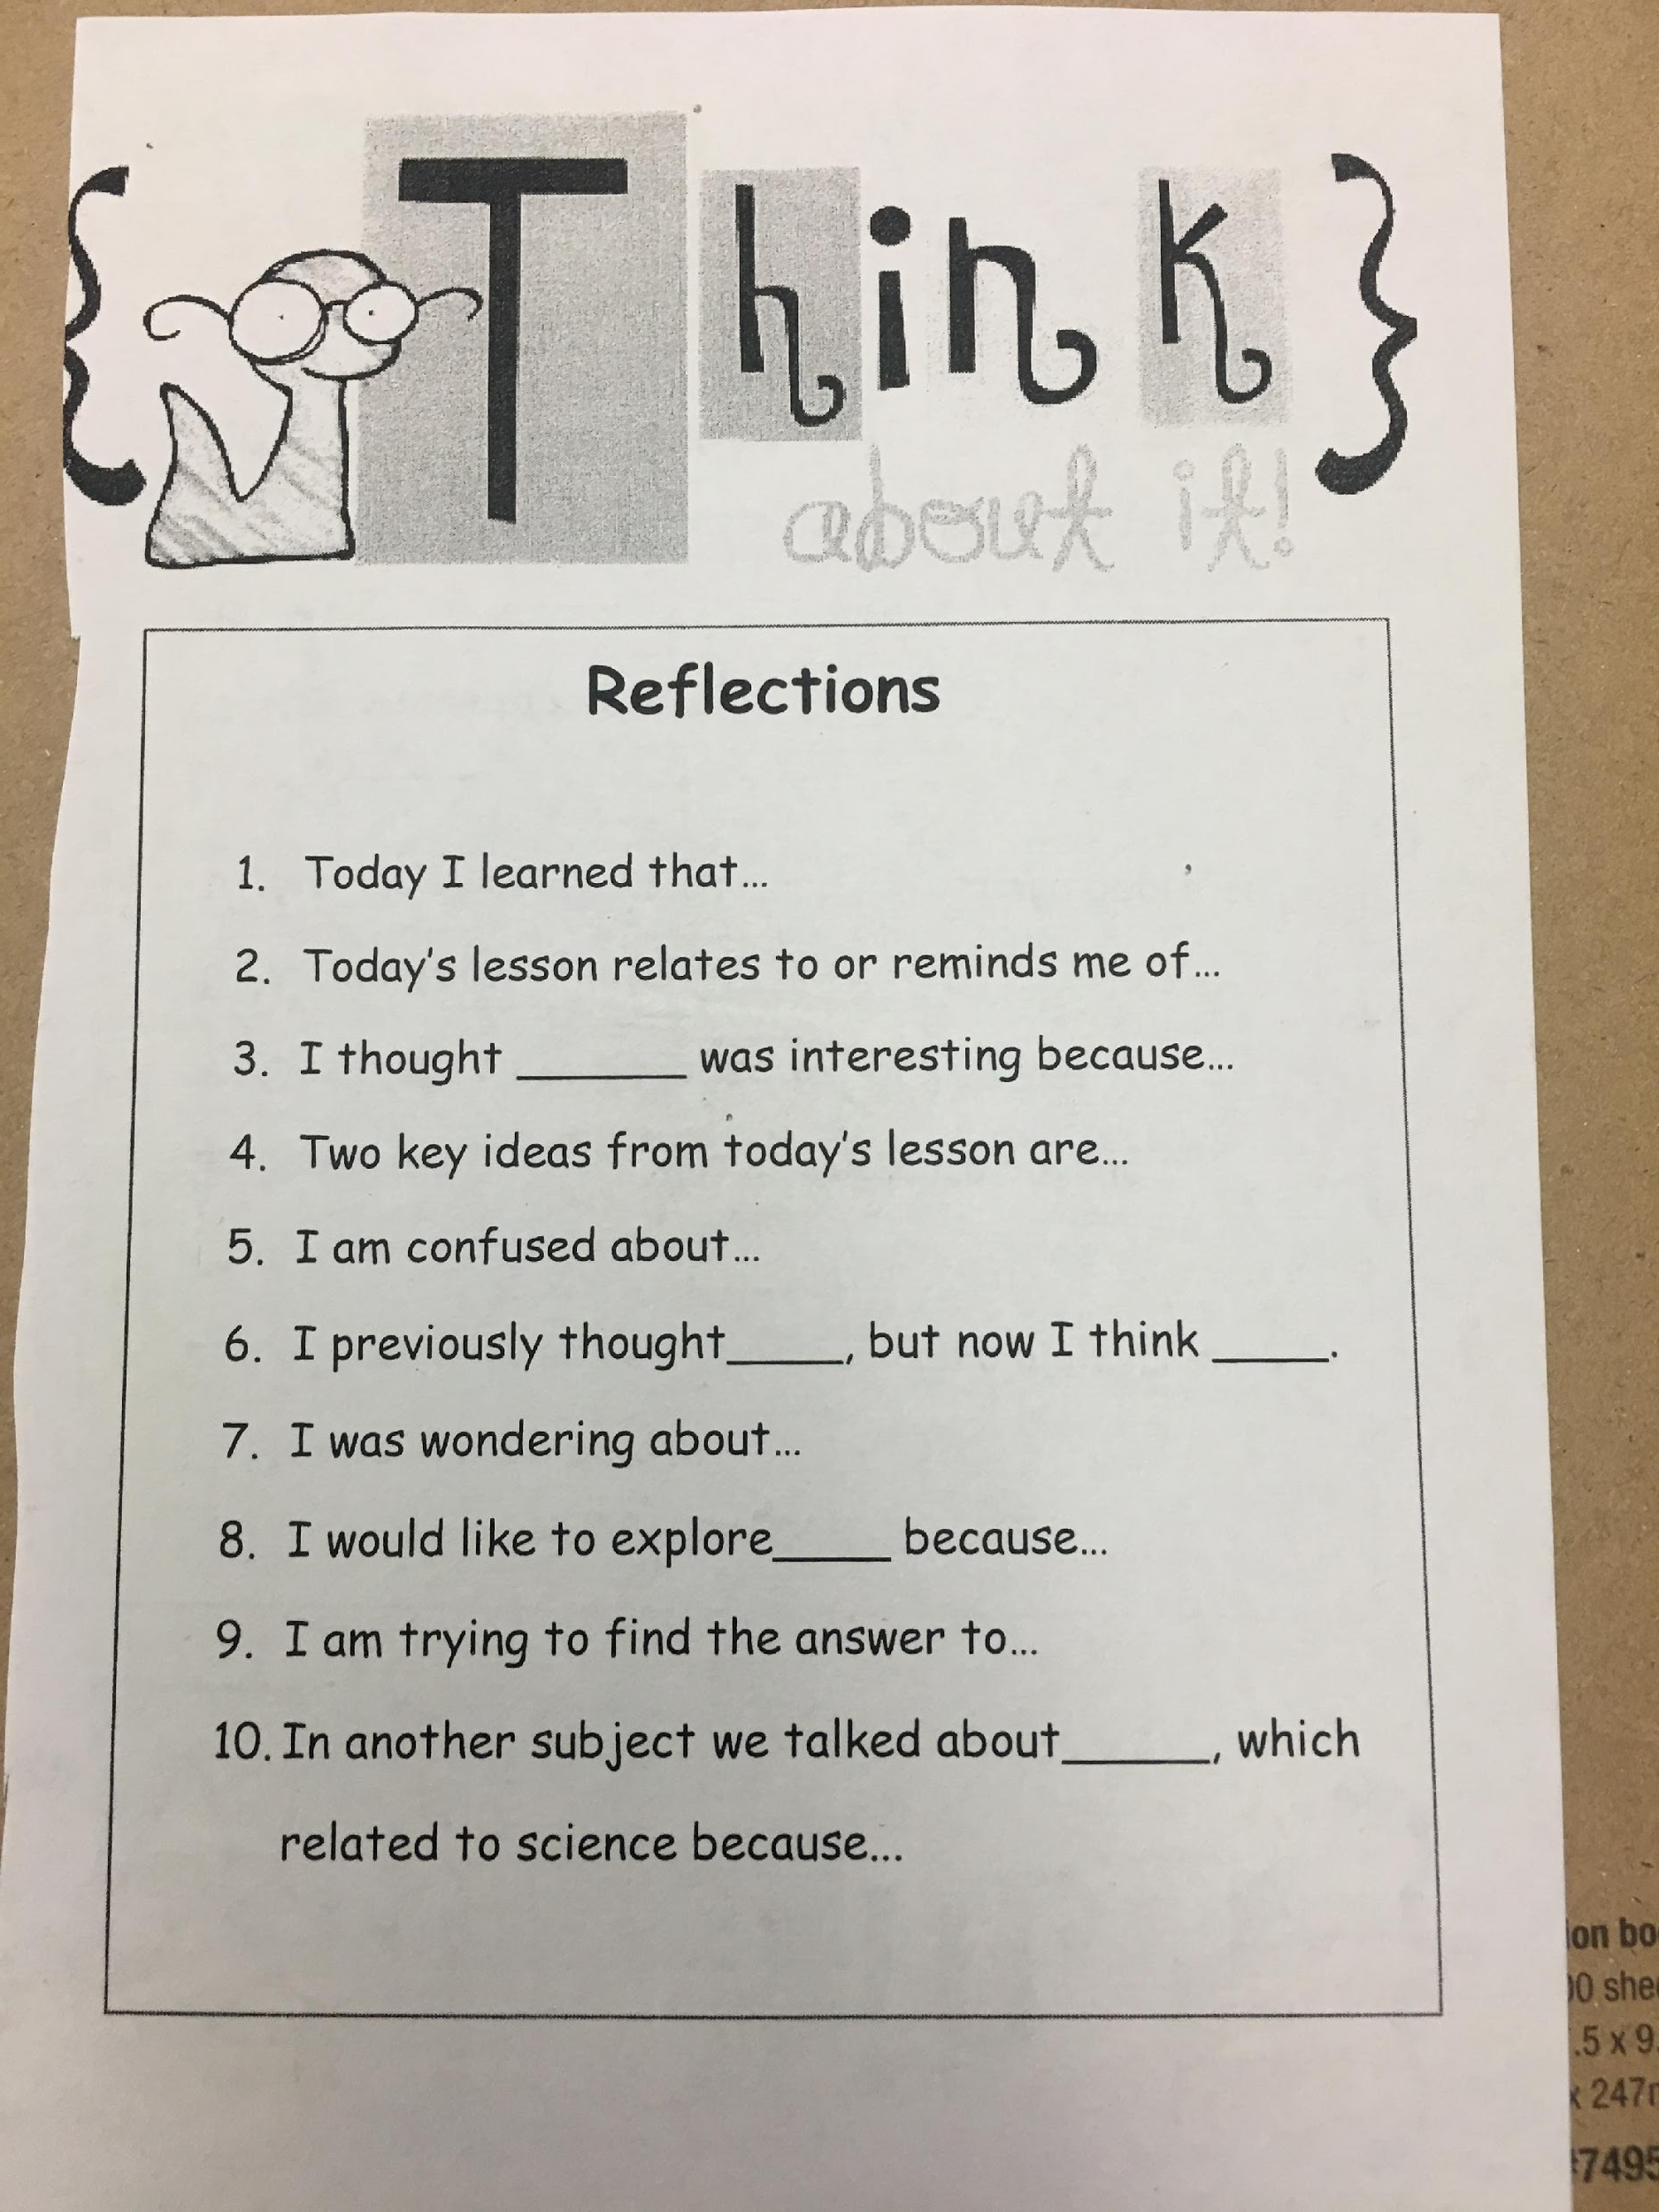
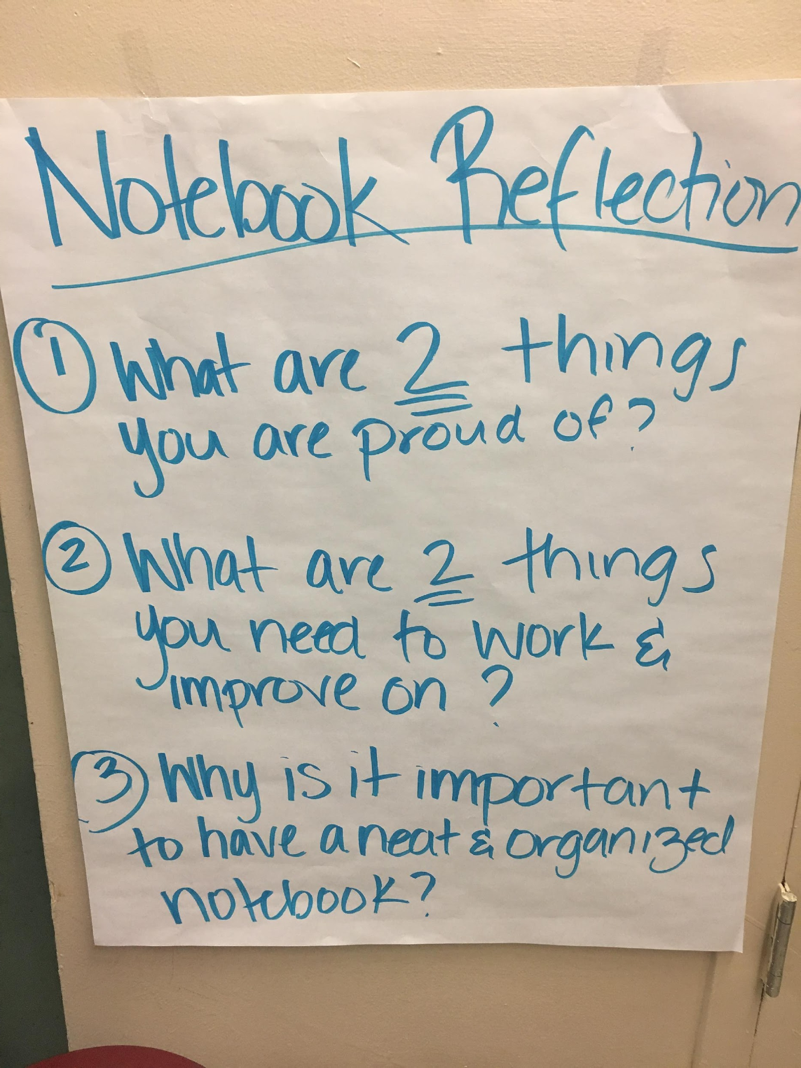
The end of the lesson should always be a “Reflection”- it could be an exit ticket in the notebook -
(not a paper post-it given to the teacher)

Slide 15

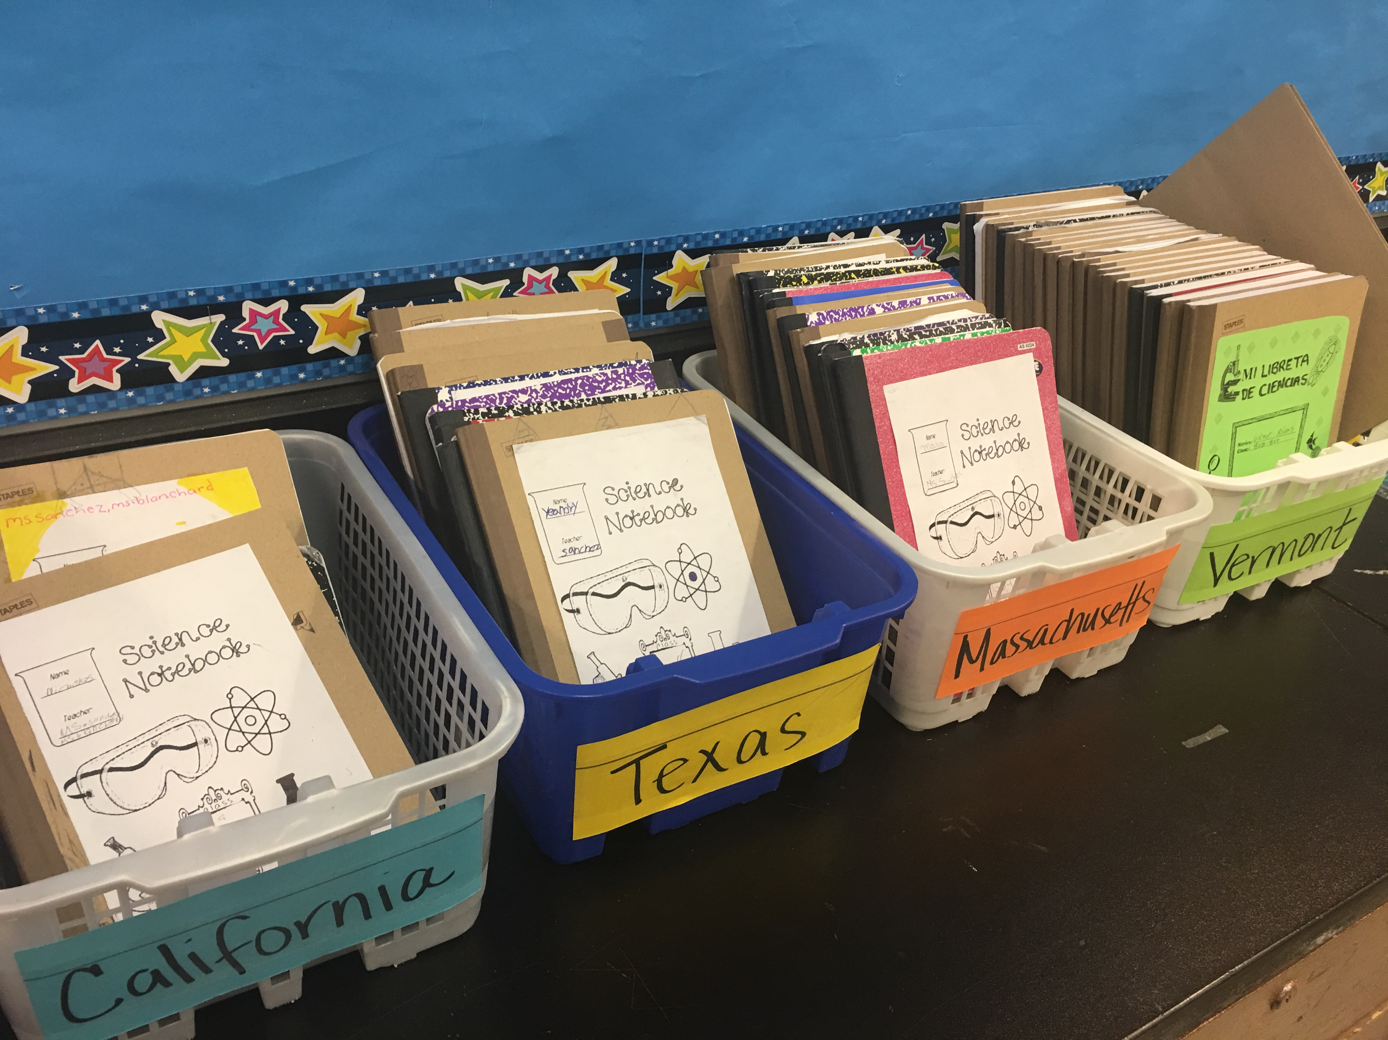
Notebooks can be easily stored and organized in bins or online

Slide 16
Some Resources
Teaching Science With Interactive Notebooks by Kerllie Marcarelli, Corwin Press
Dinah Zike’s Notebook Foldables by Dinah Zike, M.Ed., Dinah- Might Adventures, LP www.dinah.com
Science Notebooks- Writing About Inquiry by Brian Campbell and Lori Fulton, Heinemann Press www.Heinemann.com
Google- GoogleDocs in setting up an on line Notebook for your students
Our Website….www.STEMHappensNetwork.com
Will have a list of further resources, websites, links as well as excellent articles to read that all deal with different types of notebooks

Slide 17
Thank you!
You can find information on:
www.stemhappensnetwork.com
or contact us at:
Sal Fernandez
salfernandez.shn@gmail.com
Kelli List Wells
kellilistwells.klw@gmail.com

Slide 18
APPENDIX

Slide 19
Write down your thoughts about the following question.
Why integrate Science and Literacy in
Elementary, Middle and High School?

Slide 20
Why Science and Literacy?
Natural overlap of science process skills and literacy skills (observing, classifying, measuring, inferring, predicting, and communicating)
Hands-on science can build background knowledge needed for vocabulary development and reading comprehension
Science provides a real-world context for reading, writing, and discussing
Inquiry science helps develop students' ability to ask questions

Slide 21
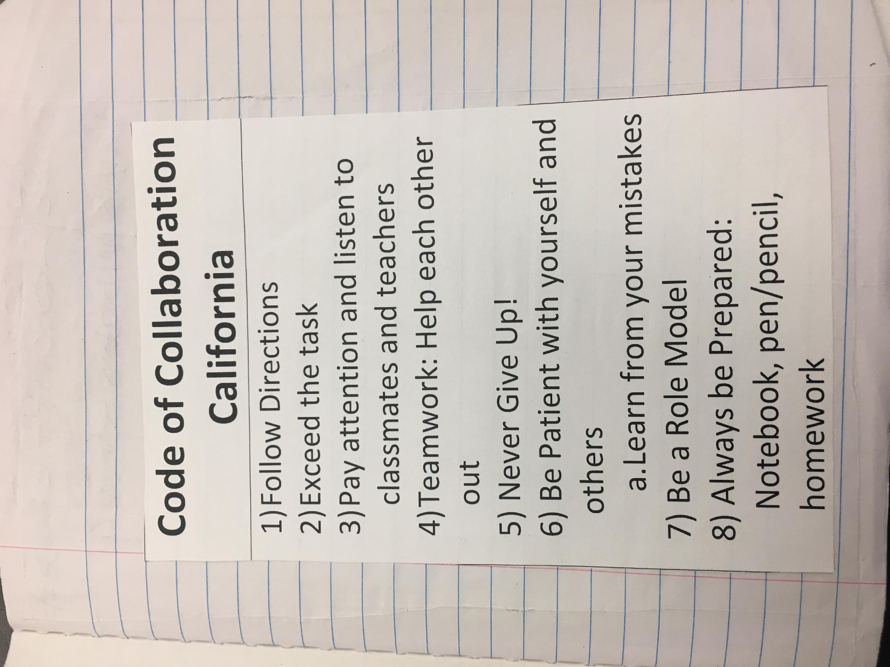
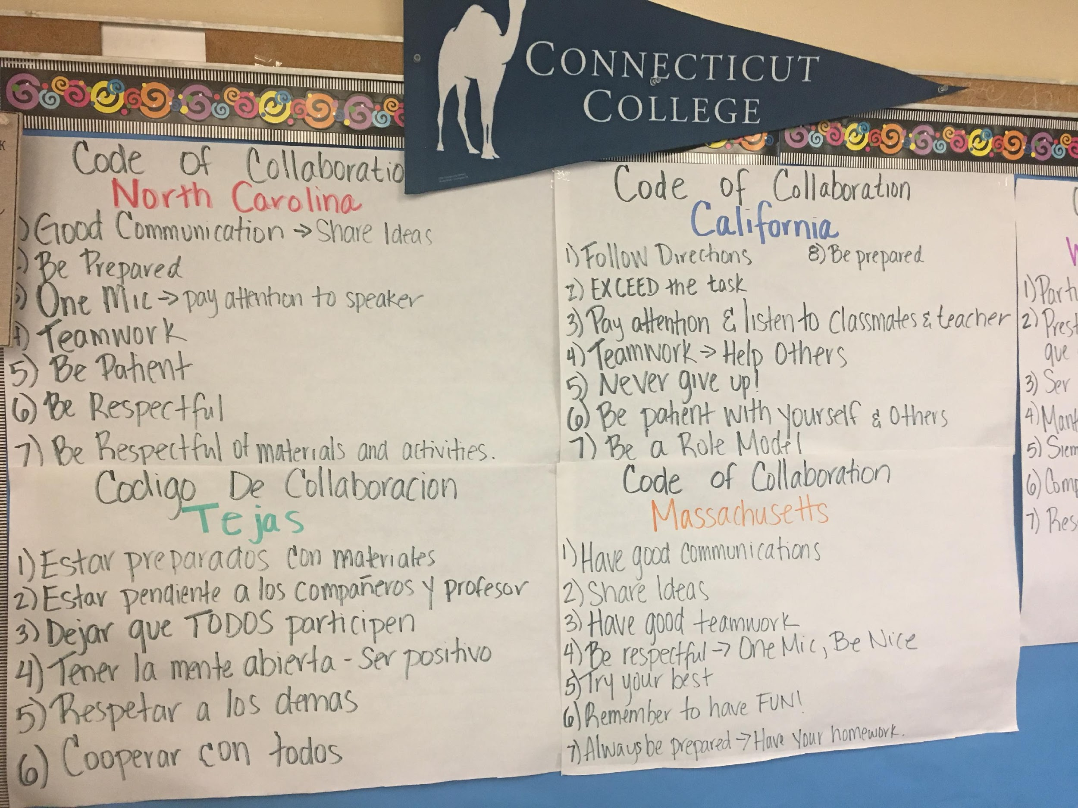
Sample Contracts Teachers Set Up in Collaboration with the Students

Slide 22
Looking at Scientist’s Notebooks
Write your first entry in the Table of Contents
  DATE ACTIVITY PAGE #
  Looking at Scientist's Notebooks 1

Slide 23
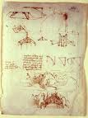
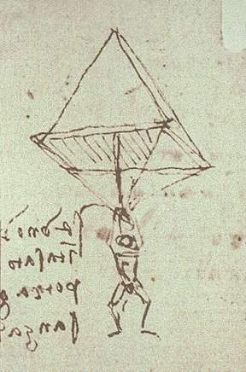

Scientist’s Notebooks
Da Vinci's sketch of a parachute from c. 1483 was in a notebook margin
The original drawing is kept in the
Biblioteca Ambrosiana in Milan

Slide 24
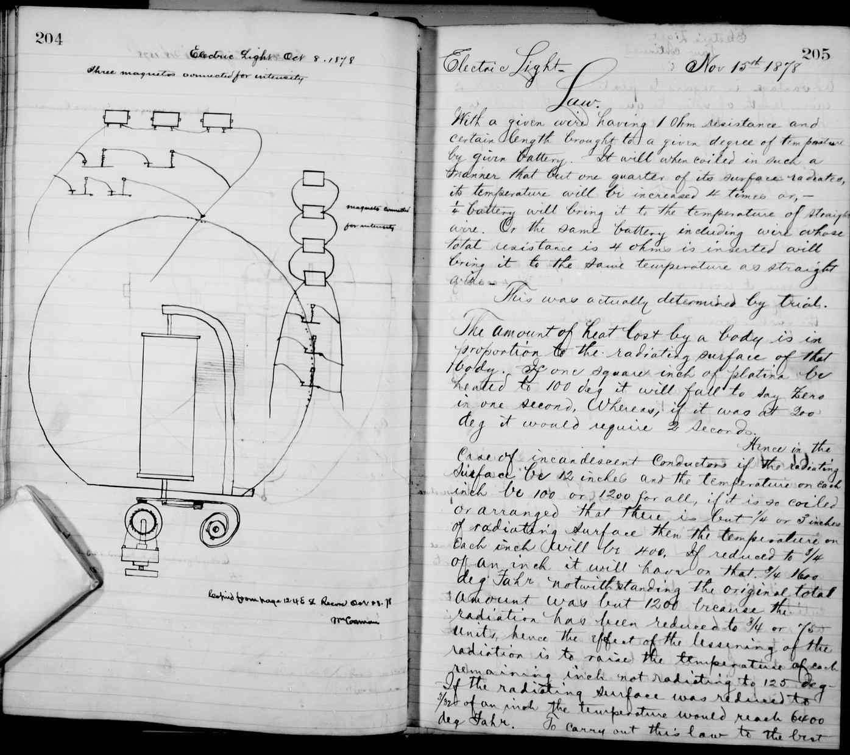
Thomas Edison’s Notebook
“I have not failed. I’ve just found 10,000 ways that won’t work” Thomas Alva Edison

Slide 25
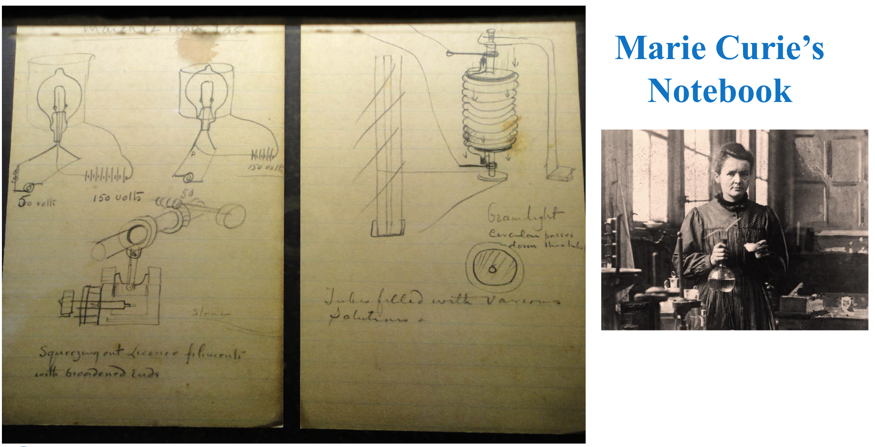
Marie Curie’s Notebook

Slide 26
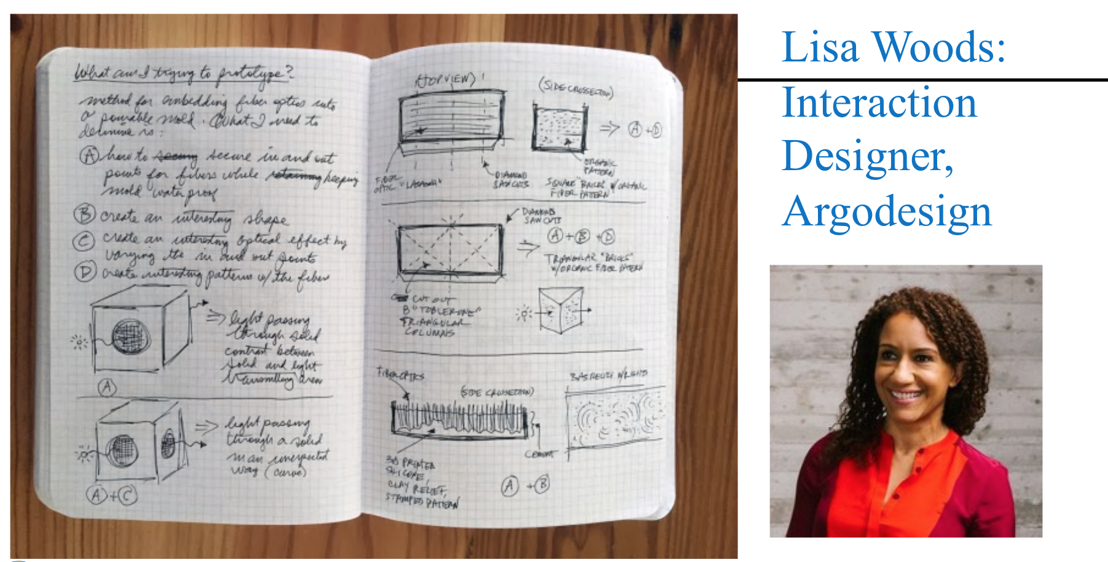

Lisa Woods’ Notebook: Interaction Designer, Argodesign

Slide 27
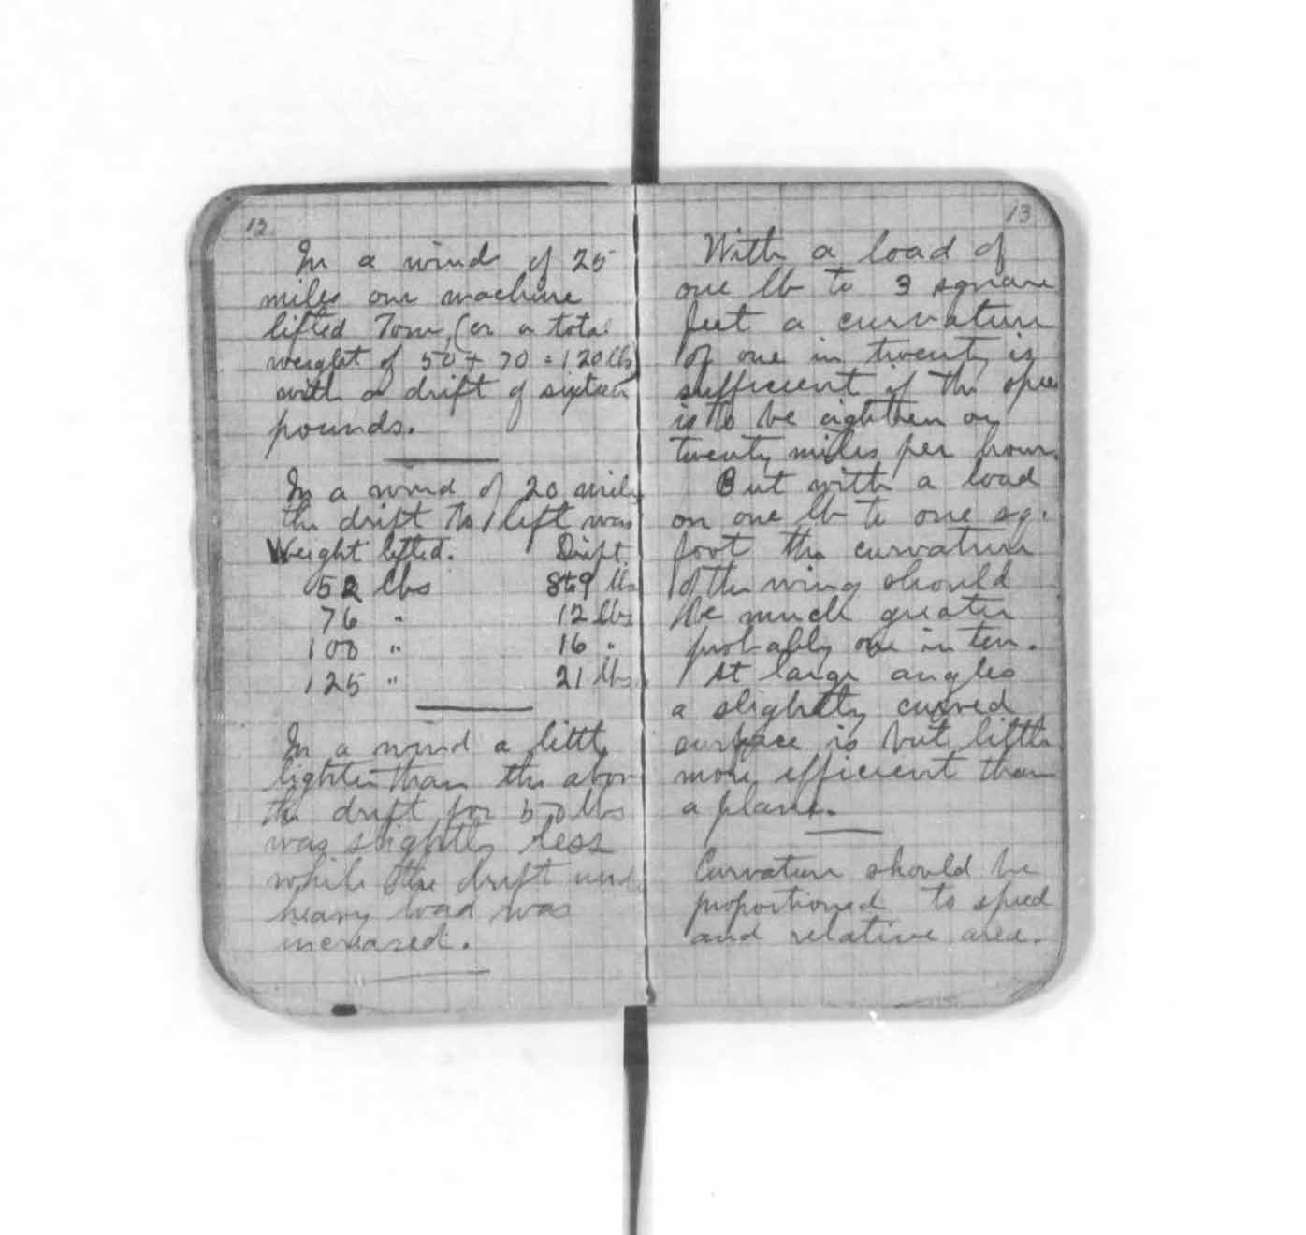
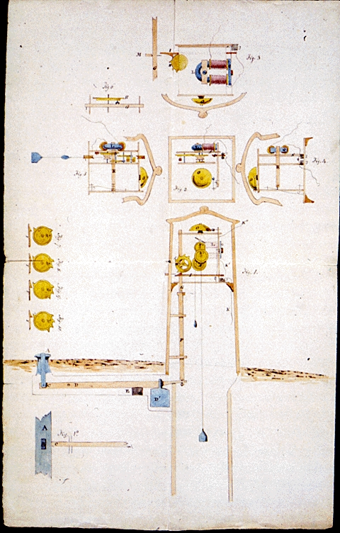
Samuel Morse’ Notebook
Wright Brother’s Notebook

Slide 28
Real Scientist’s Notebooks
The following slides show real notebooks from scientists who work at Battelle – Pacific Northwest National Laboratory in Richland, Washington.
Carefully observe as important parts to a scientist’s notebook are shared.

Slide 29
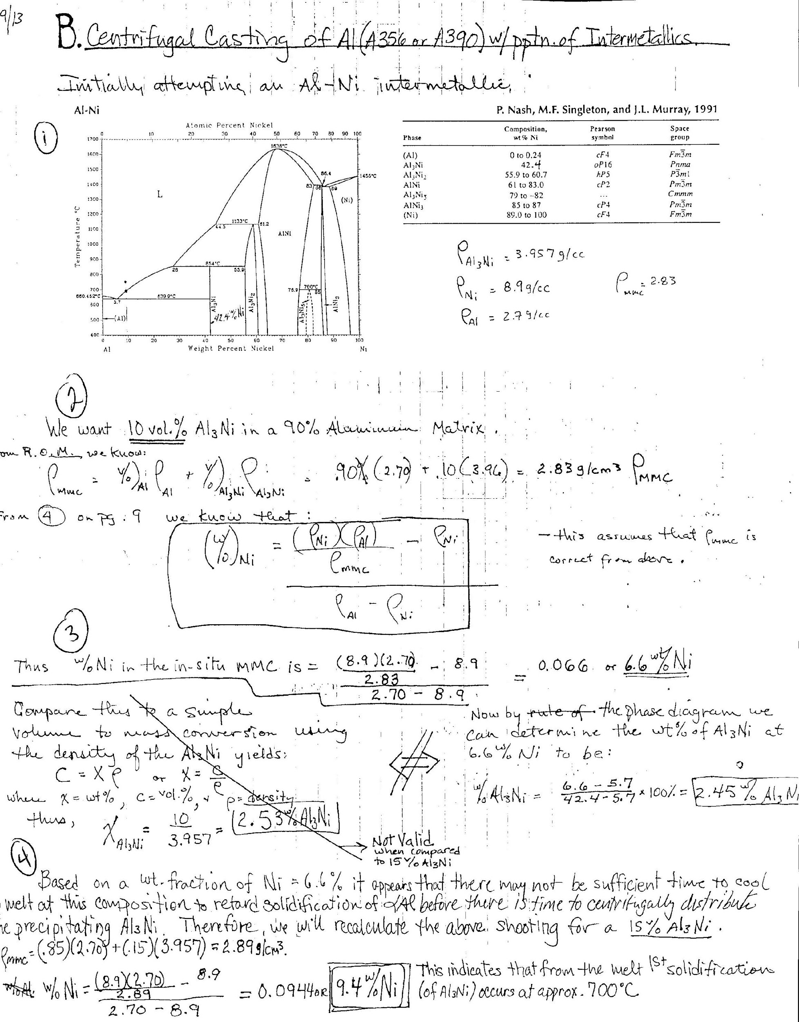
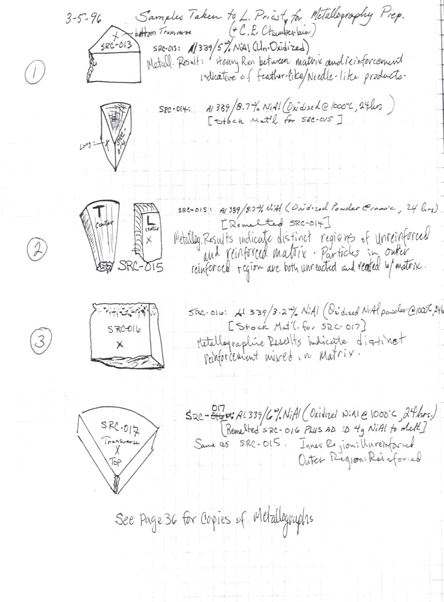

  Sample Sketch
Materials Scientist

Slide 30

Materials Scientist
Results (crossed out)

Slide 31
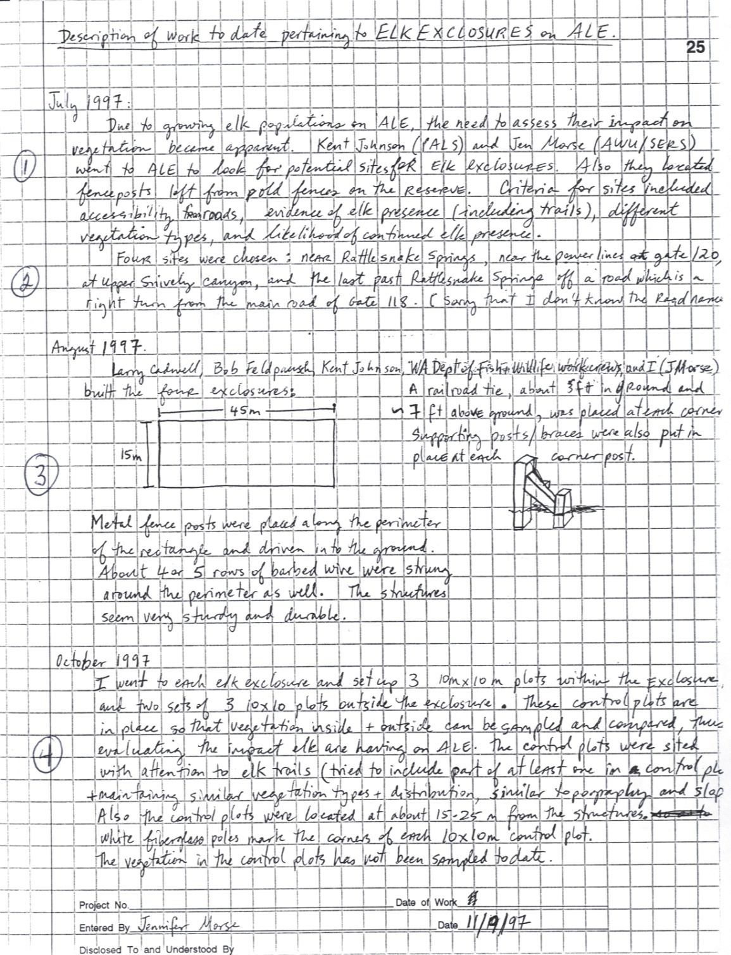
Describing the problem – the purpose of the study

Slide 32
Scientists Use Notebooks
As a guide and/or reference
As a place to record
    data
    observations
    illustrations
    reflections
    questions
    ideas while working
As a place to collect and record claims and evidence to support their inquiry
To make thinking visible
To document their organizational growth over time

Slide 33
There are Numerous Methodologies
to Setting Up A Notebook
Interactive Notebooks
Promote students thinking, important insight and understanding as well as a source of “formative assessments”
Helps to develop the students writing which connect the science to the literacy and all other content areas
Helps to promote organizational skills for your students
Helps students to record vital information including data for mathematical purposes
A number of interactive notebooks use a right side and a left side of the page very similar to Cornell Notes
Digital Interactive Notebooks
https://youtu.be/mGBaFNVDm_k
Setting up Interactive Digital Notebooks in Google Docs https://www.youtube.com/watch?v=Gqe6WrQG-Pw
Cornell Note Taking
http://lsc.cornell.edu/study-skills/cornell-note-taking-system/

