Slide 1

SCHOOL HAPPENS!
A Practitioner’s Guide for Increasing School Achievement in a Hybrid Learning Environment
Copyright © 2018 STEM Happens Network
STEM Happens
Network
SHN PROPRIETARY, NOT FOR DISTRIBUTION WITHOUT PERMISSION

Slide 2
AGENDA
What Makes a Great School
3 Pillars for School Achievement
  Effective Leadership
  Collaborative Teachers
  Rigorous Instruction
Reaching Our Goal
Summary
What’s Next

Slide 3


3
Congratulations!
Today is your day!
You’re off to Great Places!
You’re off and away!
You have brains in your head.
You have feet in your shoes.
You can steer yourself
Any direction you choose.
You’re on your own. And you know what you know.
And YOU are the guy who’ll decide where to go!

Slide 4

4
We have brains in our heads,
We know what we know,
And WE are the educators, so let’s go…..
Collectively, we as educators….
all want to build great schools.
have many of the tools & resources we need to succeed.
must determine how to best utilize our resources (persevere through remote learning) and determine the direction in which to steer our schools to greatness.

Slide 5
What Makes a Great School?
5
Teachers, administrators, students, parents, assessments, instructional materials, school environment…?
Many factors involved in building great schools; some over which we have control, others we don’t.
Educators face many harsh realities and challenges, but none should distract from the roles we are there to fulfill.
Acknowledging that we all come to this work at different levels of education, experience and background, accepting where we are, and problem-solve to move forward allows us to move from good schools to great schools.

Slide 6
Moving from Good to Great
6
Jim Collins, author of Good to Great and the Social Sectors, maintains that business thinking is not the answer. Rather we must consider the values of “greatness” – the elements that distinguish good organizations from great ones.
What are your thoughts of great schools?
(Share ideas in the chat room)

Slide 7
3 Pillars for School Achievement
Effective Leadership
Collaborative Teachers
Rigorous Instruction
SHN PROPRIETARY, NOT FOR DISTRIBUTION WITHOUT PERMISSION

Slide 8
8
EFFECTIVE LEADERS | COLLABORATIVE TEACHERS | RIGOROUS INSTRUCTION
Develop a strong school culture and supportive environment based on trust Develop a shared vision Offer continuous support and ongoing professional development opportunities for ALL teachers Ensure a viable curriculum for ALL students Build strong family and community ties | Share best practices with colleagues Engage in thoughtful, collaborative planning Engage in ongoing professional learning with colleagues Foster communication and positive dialogue with outside stakeholders Establish reflective stakeholders | Demands clear expectations and outcomes Demands knowledge of students Demands knowledge of content and pedagogy Embeds assessment opportunities with data-driven and goal oriented planning Creates opportunities for intellectual engagement and critical thinking by students, both collaboratively and independently
This Does Not Change With Remote Learning
SHN PROPRIETARY, NOT FOR DISTRIBUTION WITHOUT PERMISSION

Slide 9
In short, we need…
9
Effective Leaders
that support and develop
Collaborative Teachers
that plan and deliver
Rigorous Instruction
that intellectually engages students
We will achieve our GOAL…
To support school leaders in building and maintaining a successful school for their students
SHN PROPRIETARY, NOT FOR DISTRIBUTION WITHOUT PERMISSION

Slide 10
Let’s Discuss the Three Pillars
Effective Leadership
Collaborative Teachers
Rigorous Instruction
What resonated about Effective Leadership?
Why is it important to have Collaborative Teachers?
What does Rigorous Instruction mean to you?
Has any of this changed with Remote Learning?

Slide 11
Effective Leadership
“To lead requires those who willingly follow. It requires those who believe in something bigger than a single issue. To inspire starts with the clarity of WHY”
-Simon Sinek
SHN PROPRIETARY, NOT FOR DISTRIBUTION WITHOUT PERMISSION

Slide 12
Remember the Administration?
12
All administrators are not created equal – varying levels of knowledge, experience, and expertise.
Administrators observe teaching practices, provide feedback, coordinate professional development, and, like it or not, evaluate teaching. If teachers do not respect their supervisors, they will likely not respect their feedback.
Need to build mutual respect and solid professional relationships between teachers and administrators.

Slide 13
When “School Happens”
13
Building great schools requires paying attention to all school staff members. More and more, schools are being required to do more with less.
If we want everyone to give more and do more, we must ask ourselves, “What else would help them to perform their best every day? How can we better bridge the work/life balance for school staff members that will encourage their best work, avoid burnout and job dissatisfaction, and meet their needs?”
School leaders must reach out to their staff and discover what else they truly need to be great.
Write in the chat box your thoughts

Slide 14


What Do We Believe and Why?
14
Establish the purpose of the school’s work
  Why are we doing this work?
Define success for your school
  What does success look and sound like to you?
Align school goals to beliefs
    Have we developed clear goals and action plans aligned to these goals?
Implement an action plan
  How will we do this work?
SHN PROPRIETARY, NOT FOR DISTRIBUTION WITHOUT PERMISSION

Slide 15
Where Do You Want To Go?
15
Effective Teachers + Supportive Leaders = Great Schools
Varying strengths & needs dictate that the roadmaps for getting to our respective great school will vary, but there is one constant across all:
  Prior experience does not equal effectiveness; schools must plan to develop anyone who comes through their doors.
How do we motivate, develop and retain effective teachers and supportive leaders?
  STEP 1: Establish Well-Defined, Shared Values
  STEP 2: Develop Tools Aligned to Values
  STEP 3: Design a System to Assess Upon Implementation of Values
  STEP 4: Design a System to Reflect Upon Implementation of Values
Always use the lens of school improvement and make revisions along the way.

Slide 16
STEP 1: Establish Well-Defined, Shared Values
16
OVERVIEW
GREAT EXAMPLE
Determine the elements that are most important to building a great school – this is the foundation.
Consider:
  What are we trying to accomplish?
  What aspects of great teaching and leadership will be the focus of our learning efforts?
  How will we assess our progress as learners?
Framework for Teaching Rubric:
  Provides foundation of the work;
  Creates a coherent vision about what constitutes great instruction
  Guides us in thinking about ways to improve our practice

Slide 17
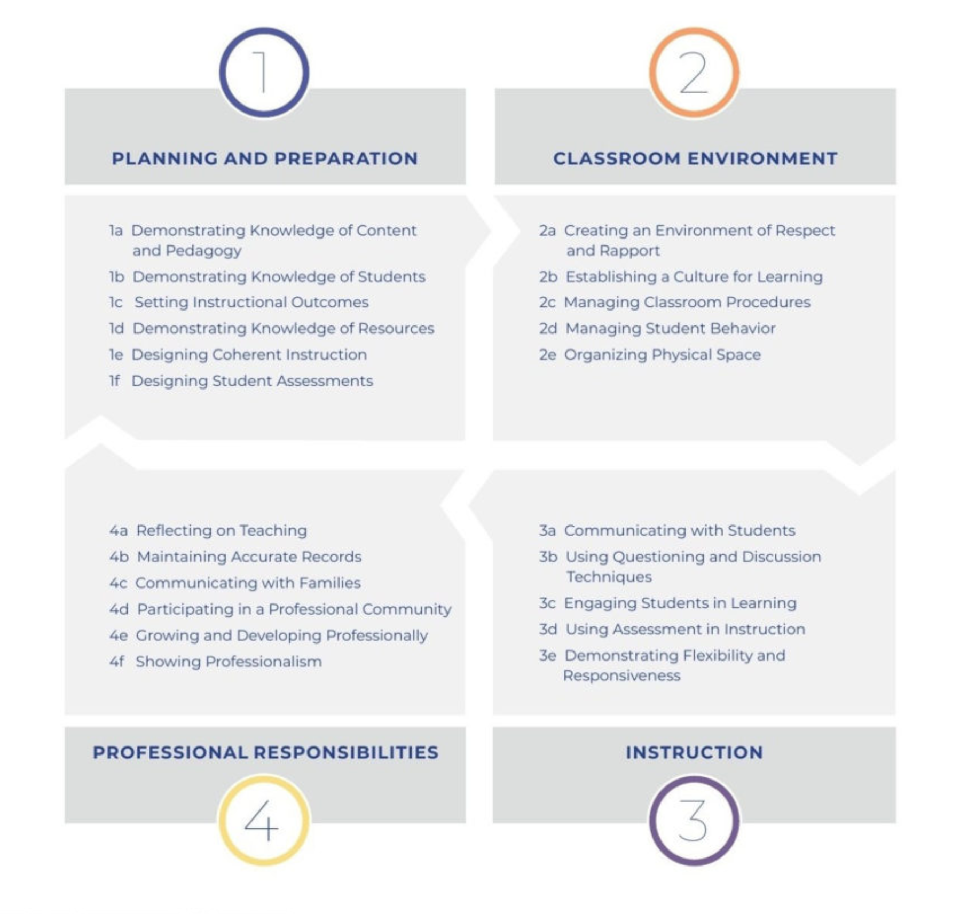
Framework for Teaching
17
Resource: Danielson Framework for Teaching
Notes:
DO RESEARCH ABOUT TEACHER EVALUATION RUBRICS (SANTA CRUZ, DANIELSON,ETC.)

Slide 18

STEP 2: Develop Tools Aligned to Values
18
Schools must create and align tools to their core values that work for the school building and for remote learning.
Tools, then, will maintain framework of assessment, reflection & support to ensure all staff members are engaged in the journey and working toward greatness.
Each component - the assessment, reflection, and support – is equally important. Without one, we miss out on a critical element of what makes a school great.

Slide 19
STEP 3: Design a System to Assess Implementation of Values
19
Assessment:
  The current system of formal observations is flawed and does not work well in a remote environment.
  Using a system of ongoing classroom observations, instead, better reveals a teacher’s strengths, pinpoints areas for improvement, and allows for more specific, ongoing support. In a remote learning environment reviewing class assignments, completion of meaningful work, student engagement and ownership.
  Schools can, but rarely do, employ two layers to classroom observations:
    1) Supervisor-to-Teacher – Do not need to be evaluative.
    2) Teacher-to-Teacher – Should not be evaluative.

Slide 20
Sample Informal Observation Process
20
Layer 1: Supervisor-to-Teacher
  Conduct frequent cycles of informal observations
  Meet with teachers to discuss findings
  Create a shared understanding of teacher needs
  Prioritize areas of development

Slide 21
Sample Interclass Visitation Process
21
Layer 2: Teacher-to-Teacher:
  Short cycles of interclass visitations establishes a streamlined approach for teachers to collaborate with colleagues.
Which allows teachers….
  to focus on best instructional practices & student learning.
  learn from other teachers.
  monitor their professional growth through observations and continuous feedback.

Slide 22
STEP 4: Design a System to Reflect Implementation of Values
22
Reflection:
  Self-reflection is absolutely necessary - All professionals should know how they’re performing at any given time.
  How can we expect educators to improve and become great if they are not asked to think about their own performance or become an active participant in their own professional growth?
  Teachers AND administrators must engage in self-assessment and reflection so that they can play key roles in deciding the direction and nature of their professional improvement.

Slide 23
Yearlong Plan Sample Worksheet:
Complete the following charts that will help you develop a framework for your school vision and the goals you wish to achieve for instruction.
23
VISION: | What is your long-term desired future state? Where do you want to be? What do you want to become?
MISSION: | What is your purpose? What do you do, for whom do you do it and how do you do it? What value do you provide?
INSTRUCTIONAL FOCUS: | What is your school’s priority area for classroom instruction?
RATIONALE: | How did you determine your instructional focus and why? What data supports it as a priority area for your school?
SHN PROPRIETARY, NOT FOR DISTRIBUTION WITHOUT PERMISSION

Slide 24
What goals will you set to support you in achieving your school’s mission and vision, and staying aligned to your instructional focus?
 | GOAL #1 School Culture | GOAL #2 Effective Leadership | GOAL #3 Professional Learning and Support | GOAL #4 Curriculum and Instruction Collaboration | GOAL #5 Family/ Community Connection
ACTION PLAN
TIMELINE/ CHECKPOINTS
FACILITATOR(S)
SHN PROPRIETARY, NOT FOR DISTRIBUTION WITHOUT PERMISSION

Slide 25
Weekly Check-In
Reflection | (General reflection on the week)
Priority Areas | (What did I work on this week? What am I trying to achieve?)
Progress | (Describe the progress made/lessons learned)
Areas of Concern/ Questions | (What challenges are ahead? What broader issues need to be considered if this action is to be successful? What questions do I have?)
Next Steps | (How will I continue the work? What specifically will I do in the next week and over the next month?)
SHN PROPRIETARY, NOT FOR DISTRIBUTION WITHOUT PERMISSION

Slide 26
Collaborative Teachers
“John Hattie (2015) has added further confirmation to our conclusions in his report What Works Best in Education: The Politics of Collaborative Expertise. His conclusion represents a powerful endorsement of our findings: “the greatest influence on student progression in learning is having highly expert, inspired and passionate teachers and school leaders working together to maximize the effect of their teaching on all students in their care” (p. 2).”
― Michael Fullan,
Coherence: The Right Drivers in Action for Schools, Districts, and Systems
SHN PROPRIETARY, NOT FOR DISTRIBUTION WITHOUT PERMISSION

Slide 27
Phases of a Professional Learning Plan:
27
  Phase I – Understanding school-wide expectations and outcomes.
  Phase II – Developing instructional practices; Focusing on key areas of our school-wide rubrics.
  Phase III – Offering opportunities for Teacher Leadership; Learning the theory of, and engaging in action research on, instructional practices.
Designed to run under three phases. All teachers participate in Phases I & II, with selected teachers participating in Phase III. The lengths of each phase may be modified for new teachers or those who require additional assistance along the various topics.

Slide 28
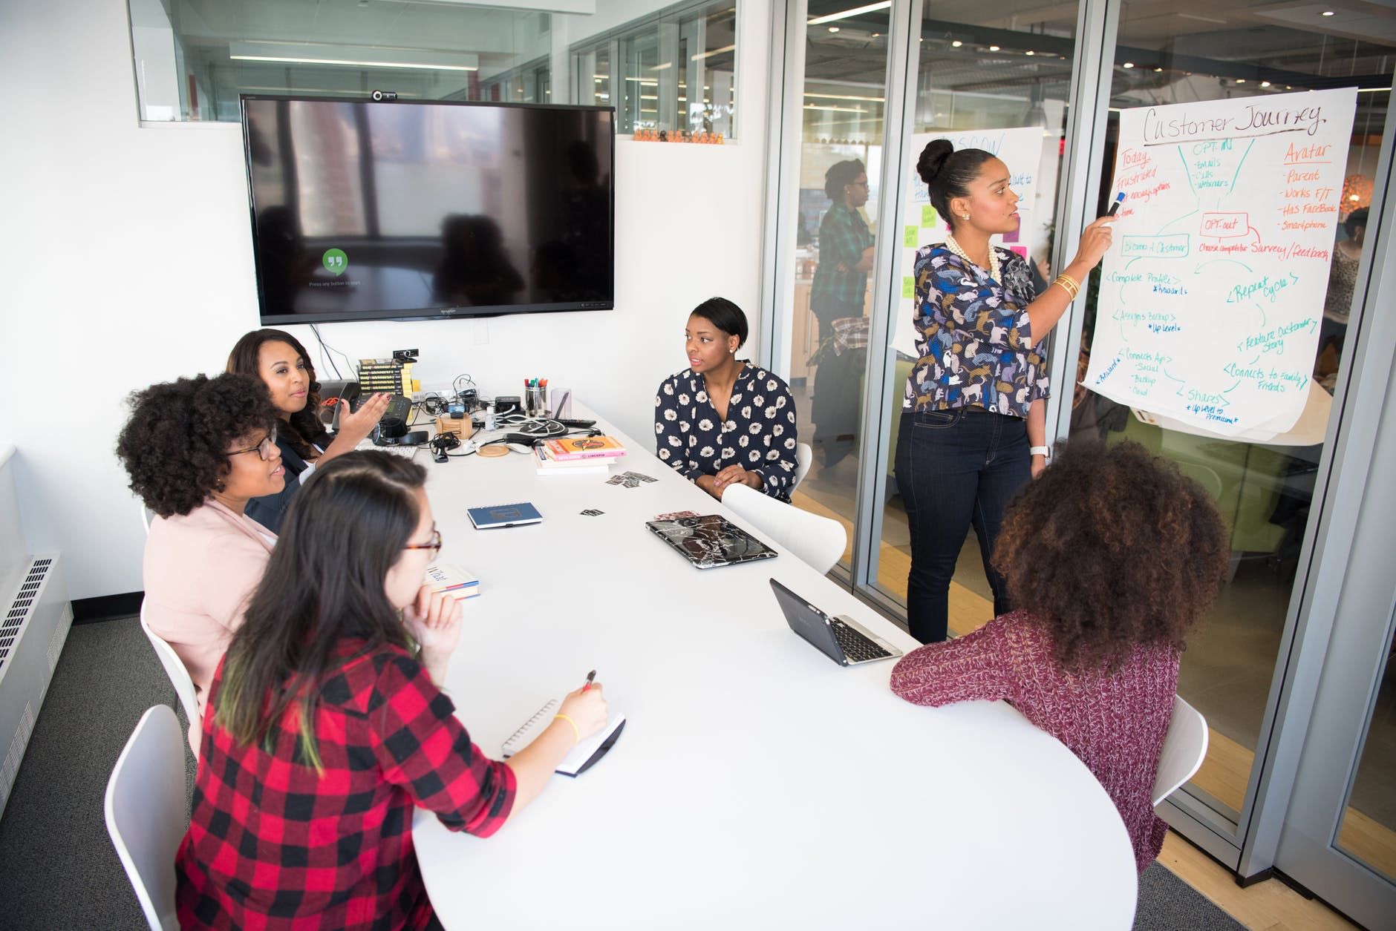
Setting the Stage for PLC’s
28
Purpose
  Why is collaboration important?
Time
  PLC’s programmed into teacher schedules
Training and Support
  People need to be taught how to work together effectively and efficiently
Accept Responsibility
  Recognize an opportunity to change the way a school operates
Interclass Visits (Even Remotely)
  Low-interference observation of teacher colleagues
Collaborative Planning
  Small teacher groups collaborate, deliver and reflect on group lesson plans
SHN PROPRIETARY, NOT FOR DISTRIBUTION WITHOUT PERMISSION

Slide 29
PLC Planning Document
29
Plan the Lesson | Participants spend the bulk of their time in this step of the process.
Deliver the Lesson | One teacher in the group will implement the lesson while the other participants will watch and take low inference observation notes.
Looking at Student Work | Together, participants assess student work produced as a result of the lesson.
Reflection and Lesson Debrief | Participants reflect on the lesson design and implementation and discuss the process and outcomes of this lesson.
Next Steps | Participants determine clear and concise next steps for future planning and delivery of instruction.
SHN PROPRIETARY, NOT FOR DISTRIBUTION WITHOUT PERMISSION

Slide 30
Rigorous Instruction
Effective practices are designed to achieve desired results. As educators expand their expectations for student learning to focus more on conceptual understandings and problem-solving skills, the instructional strategies used must correspondingly change.
-Charlotte Danielson
SHN PROPRIETARY, NOT FOR DISTRIBUTION WITHOUT PERMISSION

Slide 31

Students as Leaders
…….Own Their Learning
31
Viable Curriculum
Complex content and concepts aligned to grade level standards
Bringing
Curriculum to Life
Learning objectives, action plans & assessment
Data Analysis
Utilizing student data for future planning
SHN PROPRIETARY, NOT FOR DISTRIBUTION WITHOUT PERMISSION

Slide 32

Rigorous Instruction
32
Great Schools are not only built from strong, internal organizational structures.
Students can only perform to the assignments they are given; therefore, thinking about how effective our curriculum is, alongside our school-wide framework, is essential to building a Great School.
We must think about both curriculum and pedagogy together; the equation, then, changes.
Effective Teachers + Supportive Leaders + A Viable Curriculum = Great Schools

Slide 33

Thoughts on Rigorous Instruction
33

Slide 34
What is a Viable Curriculum?
34
Curriculum is not the end all, it is the delivery of instruction via in-person or remote.
Curriculum must be adapted to meet the needs of the learners and continues to be challenging.
A solid curriculum is both tight and loose, meaning there are non-negotiable items, but room for flexibility.
Consider:
  What do we want to achieve?
  How do we plan to achieve our goal?
  How will we know we have achieved our goal?

Slide 35

What is a Viable Curriculum?
35

Slide 36
What do We Want to Achieve?
36
Create a year-long plan - the foundation for the coursework.
Not specific enough to include daily lesson plans or even weekly calendars, but rather establishes:
  the standards that will be addressed over the course of the year;
  the number of units that will be addressed within the year;
  the length of each unit;
  the standards that will be addressed within each unit;
  the texts, topics, or concepts that will be addressed within each unit;
  the products or processes that will demonstrate the knowledge gained as a result of engaging with the identified text, topic, or concept, as well as mastery of the standards addressed; and
  the integrations across the content areas of each unit.

Slide 37

How Do We Plan to Achieve Our Goal?
37
Break down instruction into manageable chunks.
Consider:
  What are the essential questions with which students will grapple throughout the unit?
  What are the guiding questions that will allow students to explore and better grapple with the essential questions?
  How can the guiding questions shape our daily lesson plans, ensuring a clear focus and aligned activities?

Slide 38

Reaching Our Goal
Effective practices are designed to achieve desired results. As educators expand their expectations for student learning to focus more on conceptual understandings and problem-solving skills, the instructional strategies used must correspondingly change.
-Charlotte Danielson
SHN PROPRIETARY, NOT FOR DISTRIBUTION WITHOUT PERMISSION

Slide 39
How Will We Know We Have Achieved Our Goal?
39
Establish learning metrics and track student progress:
  This ensures we do not reach the end of the unit and learn then that our students have not mastered the standards addressed.
  Helps us determine:
    Were we clear about our expectations?
    Did we explicitly impart to students the knowledge and skills necessary for them to complete the task?
    Did we design interim checkpoints to ensure that students were understanding and able to apply their learning?
    Did students didn't learn or accomplish what we wanted them to learn or accomplish?

Slide 40
Month-By-Month Guide
Month | Focus Area (s) | Description | Products/ Outcomes | Follow Up/ Next Steps
July | Assessment | Assessment: Teachers engage in the second round of data discussions, revisiting their student learning goals and assessing progress in order to revise/set new goals. Teacher will provide leaders with sample student work and an analysis of assessment data. | Student Data Analysis- Goals and Action Plans Data Discussion Notes Meeting Agenda and Minutes Revised Professional Learning Plan | Classroom Instruction- Observations, Feedback and Next Steps Aligning Observation Feedback to PD Offerings
SHN PROPRIETARY, NOT FOR DISTRIBUTION WITHOUT PERMISSION

Slide 41
Revising the Framework Over Time
41
Needs will change over time.
Engage in assessing and reflecting on the framework itself to ensure that it continues to support work and lead us to even greater schools.
Consider:
  What are our needs?
  What is our capacity to move things forward?
  How can we move from theory to practice?
    What does this concept look like in practice?
    How do we know when we see it
    How is it defined at our school, across levels?
    How can it be improved upon over time?

Slide 42
Summary
42
Developing a framework of assessment, reflection, and support is an ongoing process.
It requires reflection, discussion, collaboration, and goal-directed thinking.
Working together, we can all improve our practice and ultimately move closer to our common goal: building great schools.

Slide 43

And will you succeed?
Yes! You will, indeed!
(98 and ¾ percent guaranteed.)
~ Dr. Seuss, Oh the Places You’ll Go!

Slide 44
44
Preview of Next Webinar:
The “Look Fors” in an Integrated STEM Classroom
Indicator 1: Use of STEM/Science Note booking
Indicator 2: Teacher as the Facilitator
Indicator 3: Accuracy of Content
Indicator 4: Creating Explanations and Arguing from Evidence
Indicator 5: Small Group Work and Discussion
Indicator 6: Whole Class Presentations
Indicator 7: Integrated Lesson Plan Connections

Slide 45

THANK YOU!
Dr. Salvador A. Fernandez
SFernandez@STEMHappensNetwork.com
Mr. Roy Harris
RoyHarris.SHN@gmail.com
Ms. Kelli List Wells
KelliListWells.SHN@gmail.com
@STEMHappens www.STEMHappensNetwork.com

