Slide 1
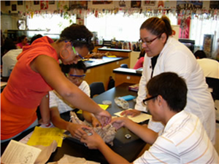

The Three Dimensions of
The Next Generation Science Standards
Presenter: Ms. Kelli List Wells and Dr. Salvador Fernandez

Slide 2
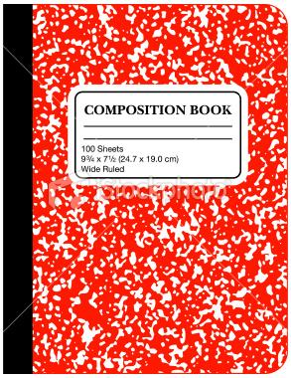

Agenda
The Three Dimensions of NGSS
Performance Expectations
Brian Reiser- Video –Using Phenomena in NGSS Designed Instruction
Card Sort Activity from AMNH 5 Tools
Conceptual Shifts in NGSS
Resources

Slide 3
Before We Begin…Let’s Discuss
What is 1 thing you know for sure about the NGSS?
01
What is 1 question you have about the NGSS?
02
How is NGSS different?
03

Slide 4
Conceptual Shifts in NGSS
K-12 Science Education Should Reflect the Interconnected Nature of Science as it is Practiced and Experienced in the Real World.
The Next Generation Science Standards are student performance expectations – NOT curriculum.
The science concepts in the NGSS build coherently from K-12.
The NGSS Focus on Deeper Understanding of Content as well as Application of Content.
Science and Engineering are Integrated in the NGSS from K–12.
The NGSS are designed to prepare students for college, career, and citizenship.
The NGSS and Common Core State Standards (Mathematics and English Language Arts) are Aligned.
Notes:
Slide 72

Slide 5
The Three Dimensions of Science Learning
A Quick Overview
Within the Next Generation Science Standards (NGSS), there are three distinct and equally important dimensions to learning science. These dimensions are combined to form each standard—or performance expectation—and each dimension works with the other two to help students build a cohesive understanding of science over time.

Slide 6

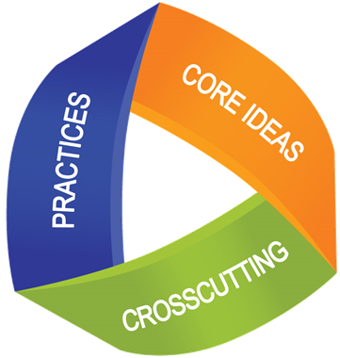


/
Three Dimensions
Science & Engineering Practices
Ask questions (for science) and define problems (for engineering)
Develop and use models
Plan and carry out investigations
Analyze and interpret data
Use mathematics and computational thinking
Construct explanations (for science) and design solutions (for engineering)
Engage in argument from evidence
Obtain, evaluate, and communicate information
Crosscutting Concepts
Core Ideas
Patterns
Cause and effect
Scale, proportion and quantity
Systems and system models
Energy and matter
Structure and function
Stability and change
Physical Sciences
Life Sciences
Earth and Space Sciences
Engineering, Technology and Applications of Science
Notes:
What patterns do you see in numeracy and literacy looking at the 3 dimensions?
Science is the core and the hook to make it happen

Slide 7
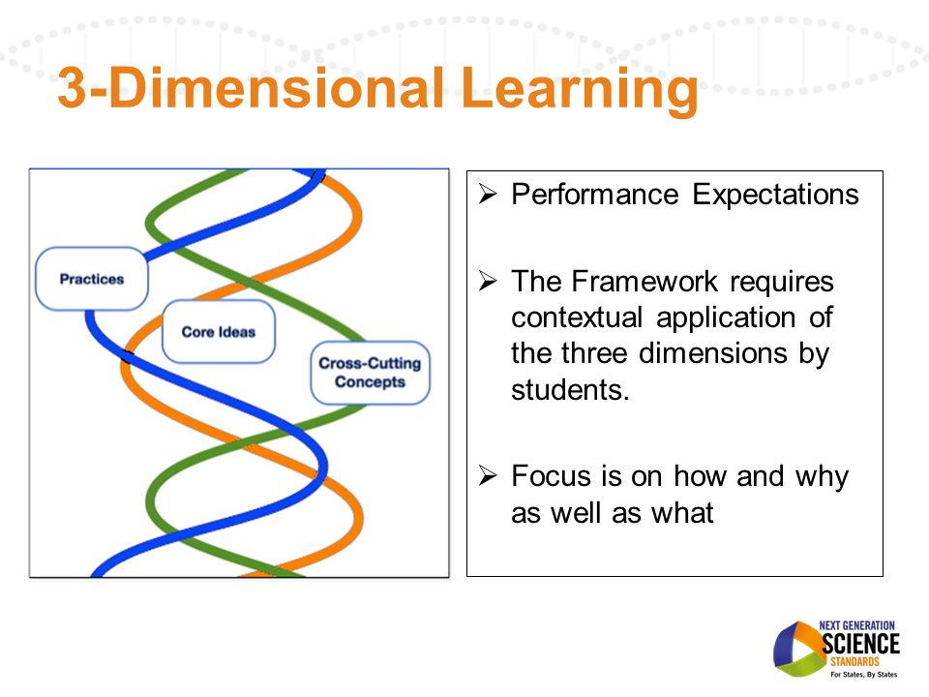
Three Dimension Learning
What does this diagram look like to you?
Notes:
What does this look like to you?
DNA Strands?☺

Slide 8

What Are Performance Expectations?
Performance Expectations state what students should be able to do in order to demonstrate that they have met the standard, thus providing clear and specific targets for curriculum, instruction, and classroom assessment.
Notes:
This is what students should be able to do….read on your on…..
Within the units we build we can set up formative assessments to see students are getting the literacy and numeracy
curriculum assessments here

Slide 9
Performance Expectations Build
Across Years
9-12
HS-PS1-1. Use the periodic table as a model to predict the relative properties of elements based on the patterns of electrons in the outermost energy level of atoms.
6-8
MS-PS1-2. Analyze and interpret data on the properties of substances before and after the substances interact to determine if a chemical reaction has occurred.
3-5
3-5
5-PS1-3. Make observations and measurements to identify materials based on their properties.
2-PS1-2. Analyze data obtained from testing different materials to determine which materials have the properties that are best suited for an intended purpose
K-2
Notes:
Important slide – elaborate what each means…connections….
Have them to have a discussion
Children needs to master performance expectations to be proficient
Turn and talk here
Monitor discussion
Come up with a really good question for here

Slide 10

Science and Engineering Practices
Science and Engineering Practices describes what scientists do to investigate the natural world and what engineers do to design and build systems.
The practices better explain and extend what is meant by “inquiry” in science and the range of cognitive, social, and physical practices that it requires. Students engage in practices to build, deepen, and apply their knowledge of core ideas and crosscutting concepts.

Slide 11
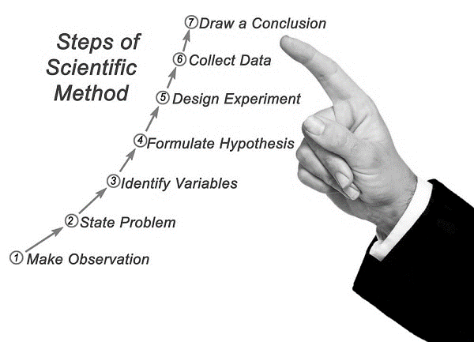

Slide 12
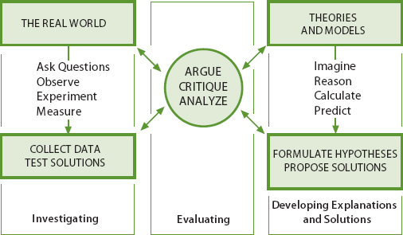
How the Practices Are Integrated into Both Inquiry and Design
The three spheres of activity for scientists and engineers.
Dominant Activity (investigation and inquiry)
Ideas (the models and explanations) to the evidence are analyzed, debated, and evaluated
Construction of explanation or design using reasoning, creative thinking, and models

Slide 13
Crosscutting Concepts
Crosscutting Concepts help students explore connections across the four domains of science, including Physical Science, Life Science, Earth and Space Science, and Engineering Design.
Think of them as “themes”. In a Framework for K–12 Science Education,” CCCs are defined as “concepts that bridge disciplinary core boundaries, having explanatory value throughout much of science and engineering. These concepts help provide students with an organizational framework for connecting knowledge from the various disciplines into a coherent and scientifically based view of the world.”
Notes:
Need to define crosscutting concepts here- what are they….

Slide 14
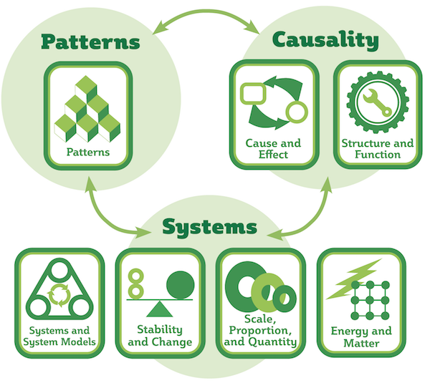

Slide 15



Understanding Crosscutting Concepts
1. Patterns
Patterns appear again and again in nature and science—such as the symmetry of flowers, the lunar cycle, the seasons, and the structure of DNA. Being able to recognize patterns is important for many scientific tasks, like classification or analyzing and interpreting data. Students need to be able to not only recognize patterns, but also ask questions about why and how patterns occur.
2. Cause and effect: Mechanism and explanation
Cause and effect can be seen as the next step after identifying patterns. This CCC involves discovering the underlying cause of phenomena, understanding connections and causation, and finding out why one event might lead to another. This concept will also help students when planning and carrying out investigations, or designing and testing solutions.
3. Scale, proportion, and quantity
A big part of investigating phenomena involves comparing them using relative scales (e.g., bigger and smaller, faster and slower) and describing them using units of, for example, weight, time, temperature, and volume. Many of the phenomena students study are at a scale either too small or too large to observe, and models can be used to make sense of them—such as comparing the planets in our Solar System to fruits of different sizes.

Slide 16



4. Systems and system models
To make the world easier to investigate, scientists often study smaller units of investigations, or “systems.” A system contains objects that are related and form a whole. It can be as large as a whole galaxy and as small as the human circulatory system. Or even smaller—a single molecule. System models are useful tools for studying how a system behaves in itself and how it interacts with other systems.
5. Energy and matter: Flows, cycles, and conservation
Building on the previous concept, this one emphasizes that energy and matter flows in and out of any system—for example, the sunlight (energy) and water (matter) that a plant needs to grow, or the flow of water in the Earth’s atmosphere. Being able to observe and model these flows and cycles is important in many areas of science and engineering.
6. Structure and function
This concept refers to the shapes, relationships, and properties of materials in natural and human-made systems. In engineering, for example, understanding the structure and function of different materials can help the engineer create a more effective and successful design.
7. Stability and change
The final CCC has to do with understanding how change occurs in any system and how we can use technology to control change. It also focuses on understanding concepts like dynamic equilibrium, where the perceived stability of a system depends on constant change, e.g. the flow of water through a dam that is always at the same water level, as well as cyclical change, e.g. the Moon’s constant orbit around the Earth and how it affects, for example, tides.

Slide 17

Disciplinary Core Idea
Disciplinary Core Ideas (DCIs) are the key ideas in science that have broad importance within or across multiple science or engineering disciplines.
These core ideas build on each other as students progress through grade levels and are grouped into the following four domains: Physical Science, Life Science, Earth and Space Science, and Engineering.

Slide 18
Disciplinary Core Ideas (DCI’s)
Life Science | Physical Science
LS1: From Molecules to Organisms: Structures and Processes LS2: Ecosystems: Interactions, Energy, and Dynamics LS3: Heredity: Inheritance and Variation of Traits LS4: Biological Evolution: Unity and Diversity | PS1: Matter and Its Interactions PS2: Motion and Stability: Forces and Interactions PS3: Energy PS4: Waves and Their Applications in Technologies for Information Transfer
Earth & Space Science | Engineering & Technology
ESS1: Earth’s Place in the Universe ESS2: Earth’s Systems ESS3: Earth and Human Activity | ETS1: Engineering Design ETS2: Links Among Engineering, Technology, Science, and Society
Notes:
Actual content does not matter what curriculum you are using this is the content
Building integrated stem units these are the ones we focus on

Slide 19
Life Science - Elementary
K
Interdependent Relationships in Ecosystems: Animals, Plants and Their Environment
1
Structures, Functions and Informational Processing
2
Independent Relationships in Ecosystems
3
4
5
Interdependent Relationships in Ecosystems: Environmental Impacts on Organisms
Inheritance and Variation of Traits: Life Cycles and Traits
Structure, Function and Information Processing
Matter and Energy in Organisms and Ecosystems

Slide 20
Life Science – Middle
Structure, Function and Information Processing
Growth, Development and Reproduction of Organisms
Matter and Energy in Organisms and Ecosystems
Interdependent Relationships in Ecosystems
Natural Selection and Adaptations
Engineering Design

Slide 21
Life Science – High School
Structure, Function and Information Processing
Inheritance and Variation of Traits
Matter and Energy in Organisms and Ecosystems
Interdependent Relationships in Ecosystems
Natural Selection and Adaptations
Engineering Design

Slide 22
Physical Science – Elementary
K
Structures and Properties of Matter
1
Waves: Light and Sound
2
Structures and Properties of Matter
3
4
5
Forces and Interactions
Energy
Structures and Properties of Matter
Forces and Interactions: Pushes and Pulls
Waves

Slide 23
Physical Science – Middle
Structures and Properties of Matter
Chemical Reactions
Forces and Interactions
Energy
Waves and Electromagnetic Radiation
Engineering Design

Slide 24
Physical Science – High School
Structures and Properties of Matter
Chemical Reactions
Forces and Interactions
Energy
Waves and Electromagnetic Radiation
Engineering Design

Slide 25
Earth & Space Science Elementary
K
Weather and Climate
1
Space Systems: Patterns and Cycles
2
Earth’s Surface Systems: Processes that Shape the Earth
3
4
5
Weather and Climate
Earth’s Surface Systems: Processes that Shape the Earth
Earth’s Surface Systems
Space Systems: Stars and the Solar System

Slide 26
Earth & Space Science – Middle
Space Systems
History of Earth
Earth’s Interior Systems
Earth’s Surface Systems
Weather and Climate
Human Impacts
Engineering Design

Slide 27
Earth & Space Science – High School
Space Systems
History of Earth
Earth’s Systems
Human Sustainability
Engineering Design
Weather and Climate

Slide 28
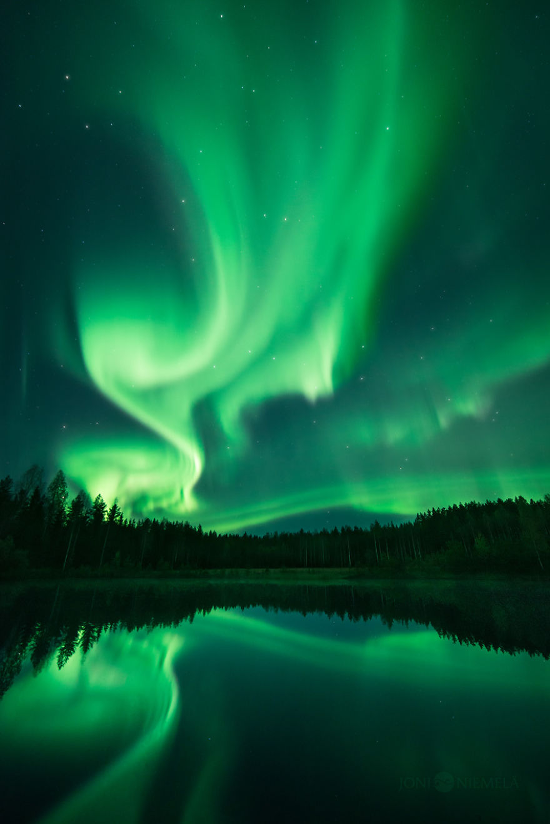
Use of PHENOMENA
in NGSS-designed instructional materials

Slide 29
Discussion
What comes to your mind when you hear the word “phenomena”?
01
What does phenomena have to do with the NGSS?
02
What does phenomena have to do with science education?
03

Slide 30
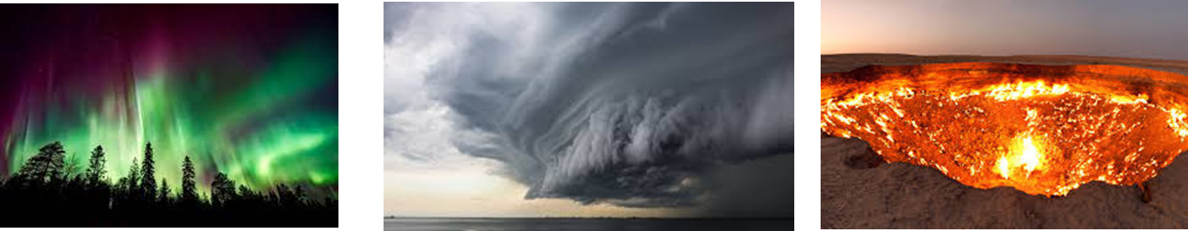
A phenomenon is an extraordinary occurrence or circumstance. In the 1950s, rock-n-roll was considered a new cultural phenomenon, while today we think of crop circles as a mysterious phenomenon. Like many words with Greek roots, phenomenon started out as a science term.
Phenomena are an essential part of implementing the NGSS.
But what is a phenomena, and how can they be used?
Phenomenon
Project
Solution to the Problem

Slide 31

Brian Reiser introduces phenomena and their connection to the NGSS and three-dimensional learning:

Slide 32
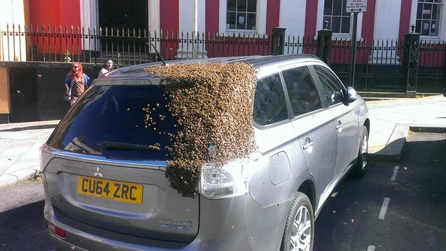
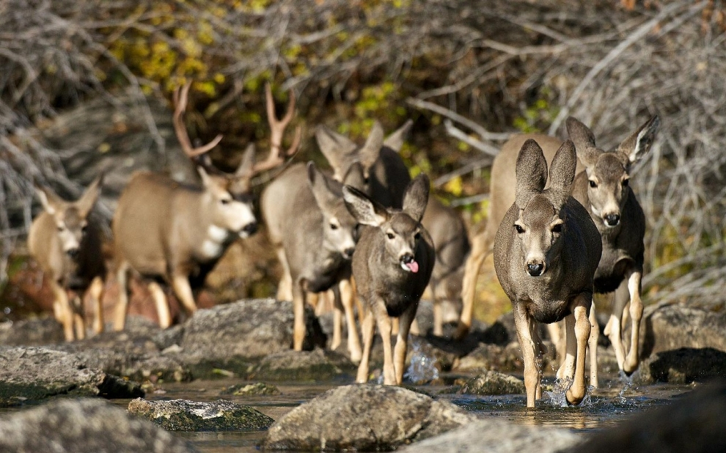
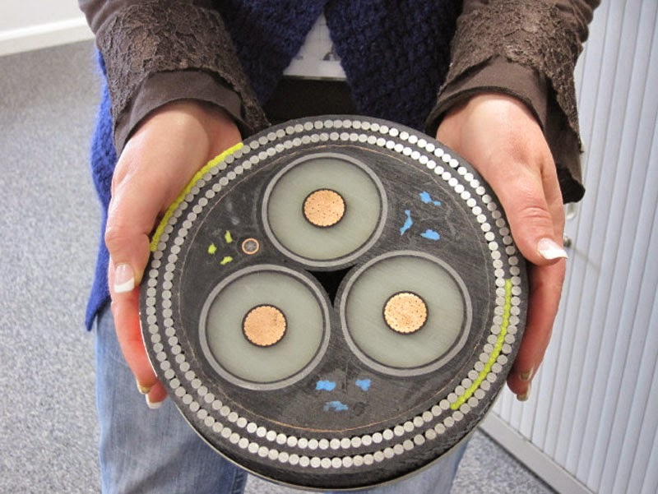
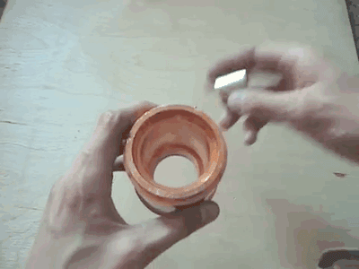
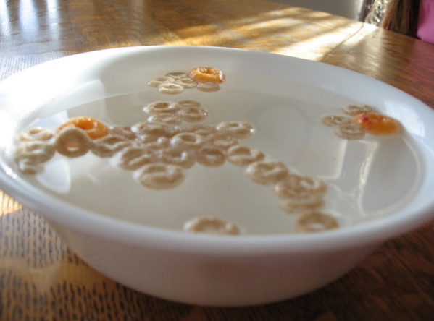
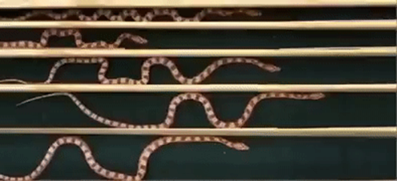
What are other types of Phenomena?

Slide 33
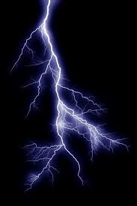
How can phenomena engage students in science?

Slide 34
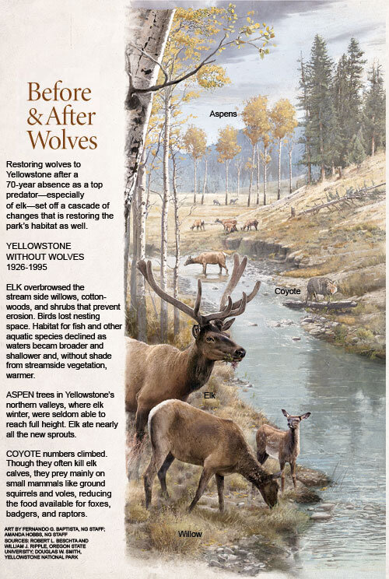
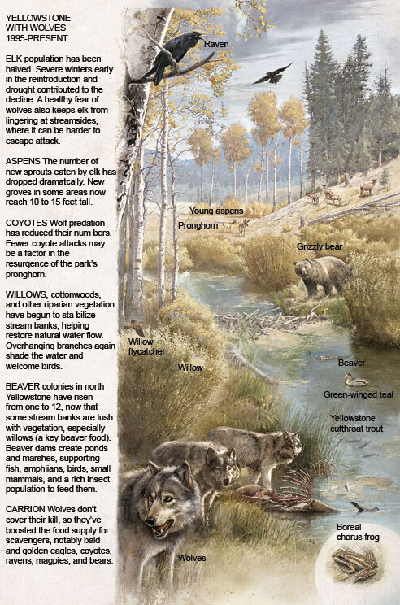
General Phenomena?
How organisms interact in an ecosystem?
Contextualized phenomena
Why did the reintroduction of wolves change the Yellowstone ecosystem so dramatically?

Slide 35

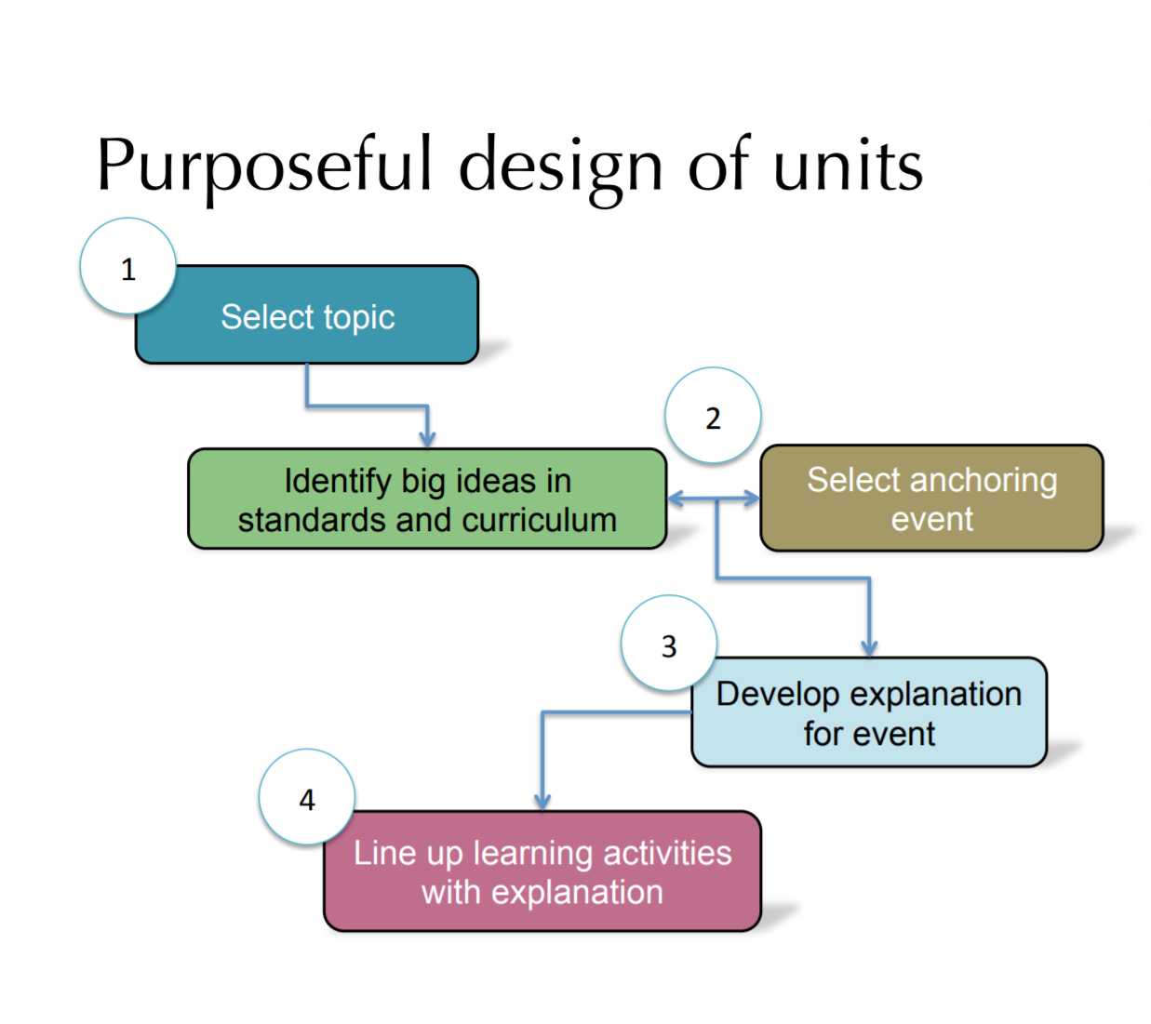
Checklist for Good Anchoring Events and Essential Question
It is a phenomenon, something that unfolds over time (it’s not a theme)
It is contextualized situation, takes place at a particular time, under unique circumstances
Explanation requires many core science ideas to be integrated with one another
Students can pull together core ideas in different ways to explain

Slide 36
Reflection
In what ways can phenomena make science accessible to ALL students?

Slide 37
Some Resources
American Museum of Natural History 5 Tools Website
https://www.amnh.org/learn-teach/curriculum-collections/five-tools-and-processes-for-ngss
American Museum of Natural History Card Sort Materials
https://1drv.ms/w/s!AmdEQEoXGOGHqma8y_CnObhnQFA3?e=VjAIhu
https://1drv.ms/b/s!AmdEQEoXGOGHqm9bqYx5WRERzgCD?e=LllZNx
Brian Reiser Video on Phenomena
https://youtu.be/Jyiv1Lc0dng
Our Website….www.STEMHappensNetwork.com
Will have a list of further resources and websites for you to utilize.

Slide 38
Thank you!
You can find information on:
www.stemhappensnetwork.com
Sal Fernandez
Salfernandez.shn@gmail.com
Kelli List Wells
kellilistwells.klw@gmail.com

Slide 39
Your Categories
DCI’s
Phenomenon
Design Challenge
You are going to play along at home but the resources will be available to you to engage teachers or students in this activity.

Slide 40
Card Sort Activity
AMNH – 5 Tools
Review the set of cards with your table group.
Decide if the question is about:
“Phenomena”
“Disciplinary Core Ideas” (DCI’s)
“Design Challenge”.
After you are done, write a list of criteria - a definition - for each category.

Slide 41
In your notebook or on a piece of paper, write down your answer to each card. For today’s activity the cards will be numbered- in a workshop or activity the teachers or students would get the physical cards to sort.
How will climate change affect the distribution of Himalayan rabbits with less and more color in their fur? | How do the properties and movements of water shape Earth’s surface and affect its systems?
What mix of surfaces should cover the schoolyard in order to keep the largest area coolest in the summertime, and why will that surface keep the yard coolest? | What species of tree can we plant that will maximize the biodiversity of the tree canopy in Denver and bring the most benefits to humans and other organisms?
1
2
3
4
DCI ? Phenomena ? Design Challenge ?

Slide 42
DCI ? Phenomena ? Design Challenge ?
Why does your kitchen warm up when you leave the oven door open after you’ve been cooking something in it? | How did the beautiful arches found in the “Four Corners” area of the U.S. form? (in the southwest, where AZ, CO, NM, and UT meet)
What is biodiversity, how do humans affect it, and how does it affect humans? | What happens when energy is transferred to a substance?
5
6
7
8

Slide 43
DCI ? Phenomena ? Design Challenge ?
How does the environment affect the variation and distribution of expressed traits in a population? | Can sand catch fire and burn?
Why does a breeze form along the coast after a warm day?
9
10
11

Slide 44
1) How will climate change affect the distribution of Himalayan rabbits with less and more color in their fur? Phenomenon
2) How do the properties and movements of water shape Earth’s surface and affect its systems? DCI
3) What mix of surfaces should cover the schoolyard, in order to keep the largest area coolest in the summertime, and why will that surface keep the yard coolest? Design Challenge
4) What species of tree can we plant that will maximize the biodiversity of the tree canopy in Denver and bring the most benefits to humans and other organisms? Design Challenge
5) Why does your kitchen warm up when you leave the oven door open after you’ve been cooking something in it? Phenomenon
6) How did the beautiful arches found in the Four Corners area of the United States form? Phenomenon
7) What is biodiversity, how do humans affect it, and how does it affect humans? DCI
8) What happens when energy is transferred to a substance? DCI
9) How does the environment affect the variation and distribution of expressed traits in a population? DCI
10) Can sand catch fire and burn? Phenomenon
11) Why does a breeze form along the coast after a warm day? Phenomenon
The Answers
The resource section on the website will have a document with the
complete explanation of the answers.

