Slide 1

The Anatomy of an Integrated STEM Unit Across the Content Areas
Part 1
Presenters: Mr. Roy Harris, Dr. Salvador A. Fernandez and Ms. Kelli List Wells

Slide 2

Agenda
Connecting Dots to Teacher Practice- Danielson
Common Understanding of Good Teaching- Danielson Video
A Look at How Standards and Assessments Lead into an Integrated STEM Unit of Study
Looking at Videos from Engage NY on 1E , 3C, and 3D
The Importance of Feedback
Digging Deeper into Assessments
The Importance of PBL’s
Beginning to Develop your Integrated STEM Unit of Study

Slide 3

Where are We Now?
Above and Below the Surface…
Current work in the district…
Your work at the school level…
Your work with remote learning
Future Integrated STEM work….
Notes:
Principal Packet

Slide 4

Connecting the Dots to Teacher Practice
Through the lens of Danielson:
1e: Designing Coherent Instruction
3c: Engaging Students in Learning
3d: Using Assessment in Instruction

Slide 5

Through the Lens of Danielson:
Danielson 3b:
Questioning and Discussion Techniques
Questioning is extremely important to engage students in learning.
We are going to incorporate 3b in our discussion with 3c and 3d. We should always be cognoscente to high and low order questioning as we are developing the integrated STEM units as well as the lessons, whether they are remote learning or one on one in the classroom.

Slide 6
Danielson
A Common Understanding of Good Teaching
https://www.youtube.com/watch?v=MHdtldDMHcA
In the next slide you are going to view a 4-minute video by Charlotte Danielson that discusses “A Common Understanding of Good Teaching”
As always, please have your notebooks ready to jot down anything that resonates with you as you are viewing the video.

Slide 7

Charlotte Danielson
A Common Understanding of Good Teaching
https://www.youtube.com/watch?v=MHdtldDMHcA

Slide 8
Domain 1: Planning and Preparation
1e. Designing Coherent Instruction
Learning activities
Instructional materials and resources
Instructional groups
Lesson and unit structure

Slide 9
Unsatisfactory Basic Proficient Distinguished
(Danielson)
(NY State)
Ineffective Developing Effective Highly Effective
1e: Designing Coherent Instruction
Learning activities are poorly aligned with the instructional outcomes, do not follow an organized progression, are not designed to engage students in active intellectual activity, and have unrealistic time allocations. Instructional groups are not suitable to the activities and offer no variety. | Some of the learning activities and materials are aligned with the instructional outcomes and represent moderate cognitive challenge, but with no differentiation for different students. Instructional groups partially support the activities, with some variety. The lesson or unit has a recognizable structure; but the progression of activities is uneven, with only some reasonable time allocations. | Most of the learning activities are aligned with the instructional outcomes and follow an organized progression suitable to groups of students. The learning activities have reasonable time allocations; they represent significant cognitive challenge, with some differentiation for different groups of students and varied use of instructional groups. | The sequence of learning activities follows a coherent sequence, is aligned to instructional goals, and is designed to engage students in high-level cognitive activity. These are appropriately differentiated for individual learners. Instructional groups are varied appropriately, with some opportunity.

Slide 10

Think
Spend a minute thinking how can 1e of Danielson be applied to your classroom pedagogy as well as your remote learning process? How does it look the same or different?
Notes:
Most of remote learning right now is not in the highly effective area. This is a huge concern.

Slide 11
Domain 3: Instruction
3c: Engaging Students in Learning
Activities and assignments
Grouping of students
Instructional materials and resources
Structure and pacing

Slide 12
Unsatisfactory Basic Proficient Distinguished
(Danielson)
(NY State)
Ineffective Developing Effective Highly Effective
3c: Engaging Students in Learning
The learning tasks/activities, materials, and resources are poorly aligned with the instructional outcomes, or require only rote responses, with only one approach possible. The groupings of students are unsuitable to the activities. The lesson has no clearly defined structure, or the pace of the lesson is too slow or rushed. | The learning tasks and activities are partially aligned with the instructional outcomes but require only minimal thinking by students and little opportunity for them to explain their thinking, allowing most students to be passive or merely compliant. The groupings of students are moderately suitable to the activities. The lesson has a recognizable structure; however, the pacing of the lesson may not provide students the time needed to be intellectually engaged or may be so slow that many students have a considerable amount of “downtime”. | The learning tasks and activities are fully aligned with the instructional outcomes and are designed to challenge student thinking, inviting students to make their thinking visible. This technique results in active intellectual engagement by most students with important and challenging content, and with teacher scaffolding to support that engagement. The groupings of students are suitable to the activities. The lesson has a clearly defined structure, and the pacing of the lesson is appropriate, providing most students the time needed to be intellectually engaged. | Virtually all students are intellectually engaged in challenging content through well-designed learning tasks and activities that require complex thinking by students. The teacher provides suitable scaffolding and challenges students to explain their thinking. There is evidence of some student initiation of inquiry and student contributions to the exploration of important content; students may serve as resources for one another. The lesson has a clearly defined structure, and the pacing of the lesson provides students the time needed not only to intellectually engage with and reflect upon their learning but also to consolidate their understanding.

Slide 13
Engage NY- Danielson 3c
Let’s take a moment to look at this quick video from Engage NY on Domain 3C- Engaging Students in Learning
Write down in your notebooks what resonates with you viewing the short video
https://www.engageny.org/resource/teacher-develops-engaging-activities-and-assignments-example-7#.XrxZ6O8EkAY.email

Slide 14
Domain 3: Instruction
3d : Using Assessment in Instruction
Assessment criteria
Monitoring of student learning
Feedback to students
Student self-assessment and monitoring of progress

Slide 15
Unsatisfactory Basic Proficient Distinguished
(Danielson)
(NY State)
Ineffective Developing Effective Highly Effective
3d:
Using Assessment in Instruction
Students do not appear to be aware of the assessment criteria, and there is little or no monitoring of student learning; feedback is absent or of poor quality. Students do not engage in self- or peer assessment. | Students appear to be only partially aware of the assessment criteria, and the teacher monitors student learning for the class as a whole. Questions and assessments are rarely used to diagnose evidence of learning. Feedback to students is general, and few students assess their own work. | Students appear to be aware of the assessment criteria, and the teacher monitors student learning for groups of students. Questions and assessments are regularly used to diagnose evidence of learning. Teacher feedback to groups of students is accurate and specific; some students engage in self-assessment. | Assessment is fully integrated into instruction, through extensive use of formative assessment. Students appear to be aware of, and there is some evidence that they have contributed to, the assessment criteria. Questions and assessments are used regularly to diagnose evidence of learning by individual students. A variety of forms of feedback, from both teacher and peers, is accurate and specific and advances learning. Students self-assess and monitor their own progress. The teacher successfully differentiates instruction to address

Slide 16
Engage NY- Danielson 3d
Let’s take a moment to look at this quick video from Engage NY on Domain 3d- Using Assessment in Instruction
Write down in your notebooks what resonates with you viewing the short video
https://www.engageny.org/resource/teacher-provides-feedback-students-example-10#.XrxINBpvA3w.email

Slide 17
Think
Spend a minute thinking how can 3c and 3d of Danielson be applied to your classroom pedagogy as well as your remote learning process? How does it look the same or different?

Slide 18
Danielson Domains and Feedback
When actionable feedback is provided to teachers, supervisors then, must provide the professional learning to support to improve pedagogy. Therefore, when teachers provide actionable feedback to students, they should also provide the resources and support for students to master and own their learning.
The next few slides we are going to look at how Feedback can be greatly recognized in the development of lessons utilizing the Danielson Domains of 1e, 3c and 3d which we have been looking at.

Slide 19
Feedback to Support Improved Practice
Benefits
Characteristics of Effective Feedback
Learning happens most effectively when concrete, actionable feedback is given on a regular basis.
Feedback helps teachers to understand and act on key levers to improve their practice and improve outcomes for students.
Feedback is more readily received when a culture of trust exists in the school community and respectful feedback helps strengthen that culture.
There are numerous ways to approach feedback, but effective feedback always includes the qualities listed here.
Specific and evidence-based:
    Gives facts, low-inference evidence
    Detailed narrative not necessary
    Analysis and interpretation justified by evidence and aligned to the rubric
Selective:
    Prioritizes 1-2 most important practices that will improve student learning
Actionable:
    Identifies clear actions that can be taken in the next 2 weeks that will help teacher improve
    Next steps should be developmental and specific
Timely and time-bound:
    Gives feedback within 48 hours of observation
    Follow-up in a set timeframe
Degree of importance
    Communicates level of concern

Slide 20
Feedback Differences
Feedback Differences
Giving feedback amongst ourselves for improvement is different than giving students feedback – our experience as adult learners is different
These differences include:
Self-concept. As people mature, their self-concept moves from one of being a dependent personality toward one of being a self-directed human being.
Experience. As people mature, they accumulate a growing reservoir of experience that becomes an increasing resource for learning.
Readiness to learn. As people mature, their readiness to learn becomes oriented increasingly to the developmental task of their social roles.
Orientation to learning. As people mature, their time perspective changes from one of postponed application of knowledge to immediacy of application, and accordingly their orientation toward learning shifts from one of subject-centeredness to one of problem centeredness.
Motivation to learn. As people mature, the motivation to learn is internal (Knowles, 1984, p.12).

Slide 21
Feedback Must…..
be based on an accurate assessment of what was observed in the classroom that can be supported with evidence (note Specific and Evidence-Based on slide 1),
prioritize the areas of practice that would have the greatest impact on student learning (note Selective on slide 20) and
be useful so that the teacher knows what to do next (note Actionable and Timely/Time-bound on slide 1).
Feedback needs to be based on an accurate assessment of what was observed in the classroom that can be supported with evidence (note Specific and Evidence-Based on slide), it also must prioritize the areas of practice that would have the greatest impact on student learning (note Selective on the slide) and it must be useful so that the teacher knows what to do next (note Actionable and Timely/Time-bound on slide).
Notes:
Discuss culture - - -

Slide 22

Think
Spend a minute looking at the “Feedback” from the previous 3 slides and jot down in your notebooks any major points that resonate with you.

Slide 23
A Feedback Tool Suggestion
Now let's look at a possible Feedback Form that you can use in remote on-line learning or in the actual classroom.

Slide 24
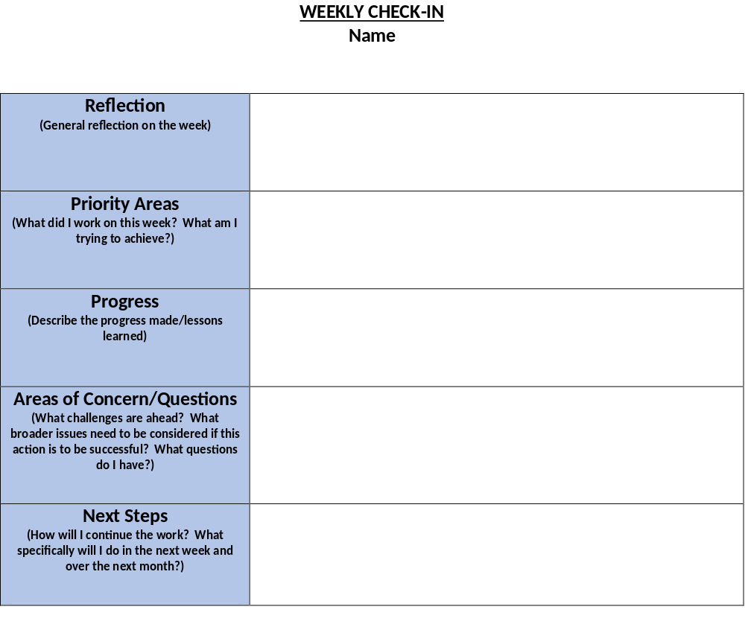
Weekly Check-in/Reflection
STEM Leadership TEAM, please use template below to reflect on the week, share progress and areas of concern, ask questions, and establish next steps.

Slide 25
Anatomy of an Integrated STEM Unit Plan Across
the Content Area
Develop an interdisciplinary team and provide time
Disciplinary literacy must be part of the Unit
Note booking should be done- formative assessment as well as archives of the student work including literacy and math (could be digital or hard copy)
Literacy, Math, Social Studies and Technology connections
Looking at NGSS and aligning standards in math, technology, literacy
Summative as well as formative assessments along the way (Actionable Feedback)
Using phenomena and storylines
Developing or using existing PBL’s (phenomena, project, or problem) as part of the Unit that is aligned with the Unit
Science can be used as the “hook” to develop these integrated Unit Plans (Can also be Social Studies)
Essential questions and guiding questions

Slide 26
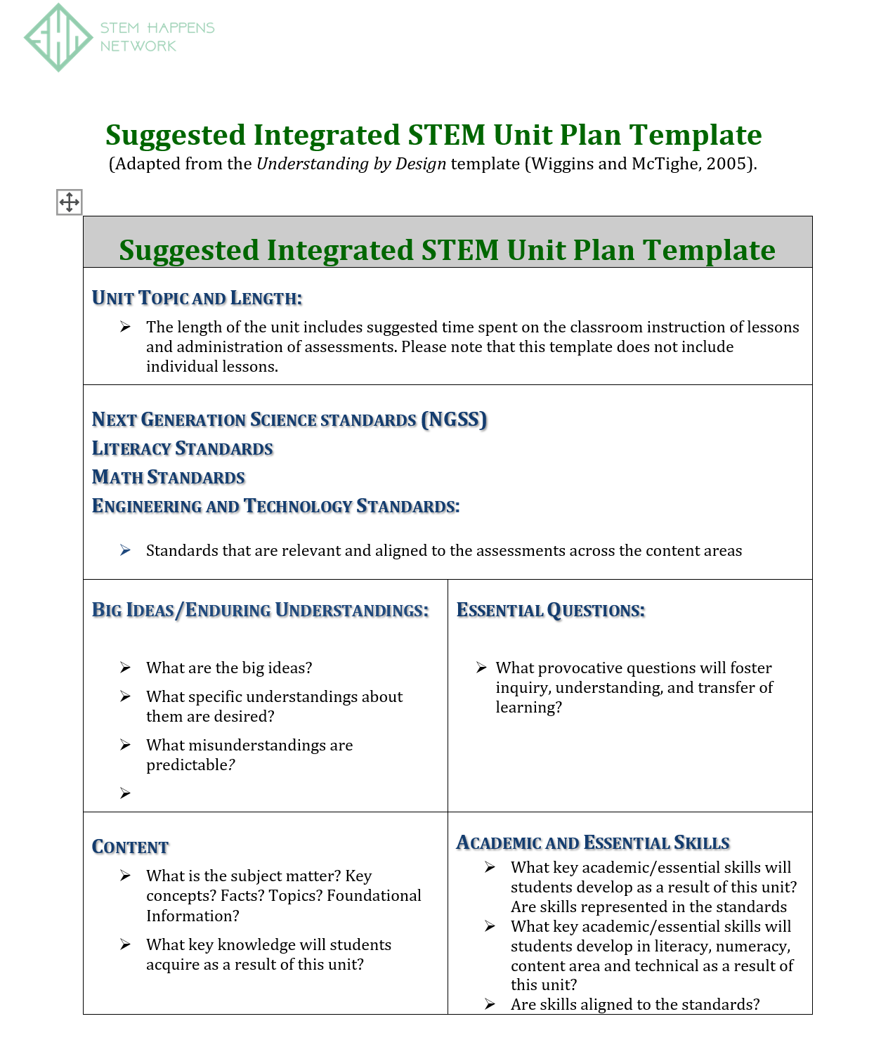

Slide 27
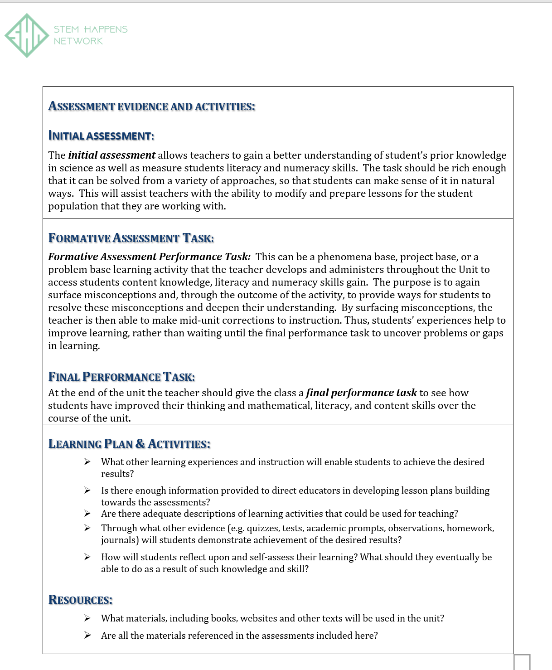

Slide 28
Your Assignment for Part 2 of Developing An Integrated a STEM Unit across the
Content Areas
We are going to share with you a Sample Integrated Unit of Study across the content areas that we worked on with another school district in the country. This Unit was “Earth’s Systems”.
This school district used the Discovery Education TechBook as their science curriculum
We want the teachers from the other content areas in your team to look at this unit as a sample and start to look at the connections that can be developed in your content area with the science curriculum
On the next slide look at the SHN modified Amplify suggested Scope and Sequence

Slide 29
SHN Middle School Modified Amplify Science Scope and Sequence
Grade 6:
ENERGY (Oct-Dec 2nd) 8 weeks
Harnessing Human Energy
Thermal Energy
ECOSYSTEMS (Dec-March 4th) 10 weeks
Populations and Resources
Matter and Energy in Ecosystems
CLIMATE (Mar-June 17th) 15 weeks
Weather Patterns
Ocean, Atmosphere and Climate
Earth’s Changing Climate
Grade 7:
M2 (Oct-Dec 2nd) 8 weeks
Microbiome
Metabolism
CHANGES IN MATTER (Dec-March 4th) 10 weeks
Phase Change
Chemical Reactions
GEOLOGY (Mar-June 17th) 15 weeks
Plate Motion
Engineering Internship: Plate Motion
Rock Transformation
???Engineering Internship Earth’s Changing Climate (Add to 6th grade?
Grade 8:
SPACE (Oct-Dec 2nd) 8 weeks
Geology on Mars
Earth, Moon, and Sun
PHYSICS (Dec-March 4th) 10 weeks
Force and Motion
Engineering Internship: Force and Motion
Magnetic Fields
Light Waves
EVOLUTION (Mar-June 17th) 15 weeks
Traits and Reproduction
Natural Selection
Evolutionary History

Slide 30
Thank you!
You can find information on:
www.stemhappensnetwork.com
or contact us at:
Roy Harris
royharris.shn@gmail.com
Dr. Salvador A. Fernandez
Salfernandez.shn@gmail.com
Kelli List Wells
kellilistwells.klw@gmail.com

