Slide 1
STEM Happens Network
Dr. Sal Fernandez
Ms. Kelli list wells

Slide 2

9:00 am – 9:15 am Welcome and Introductions
9:15 am- 9:45 am Overview of Work
9:45 am – 11:00 am Walking through the indicators
11:00 am – 11:10 am Break
11:10 am – 11:40 am Notebooking
11:40 am – Noon Reflect and Next Steps

Slide 3

Explain the Math?
Explain the Reading and Writing?

Slide 4

WHAT IS INTEGRATED STEM?
Science
Reading & Writing
Math
The connection of science, math, reading and writing, as well as other areas such as social studies, art, technology.
Let’s Take A Look…..

Slide 5
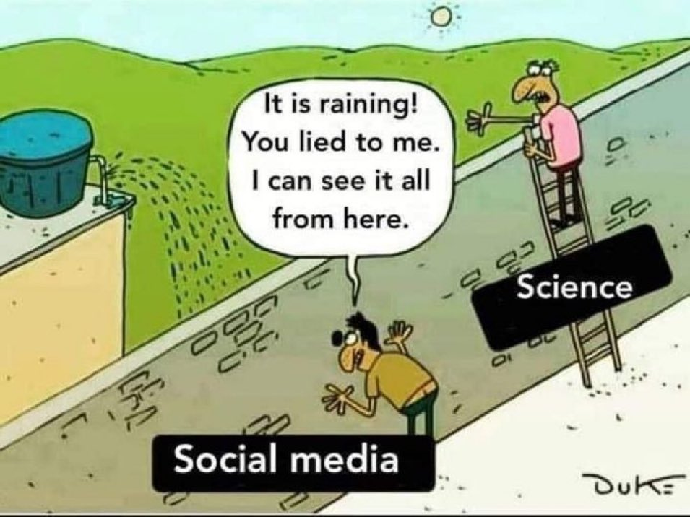

Slide 6
Creating an integratIVE stem Culture
The Problem:
The meaning of the word STEM is not clear yet, there is a call for STEM degrees. There is a disconnect between what business needs and what education is teaching.
  STEM is viewed as a four-letter acronym
  Disconnected from subject to subject taught in silos
  Students attend math with no understanding of how it relates to science and how science is relates to literacy
The Solution:
Connect the dots for students so math is connected to science, science is connected to literacy and students use their knowledge to solve local problems.
This is what Integrated STEM is about, it is about transforming educator’s practice, in order to create a deeper understanding of how subjects interconnect to develop critical thinkers and problem solvers to supply the STEM workforce.

Slide 7
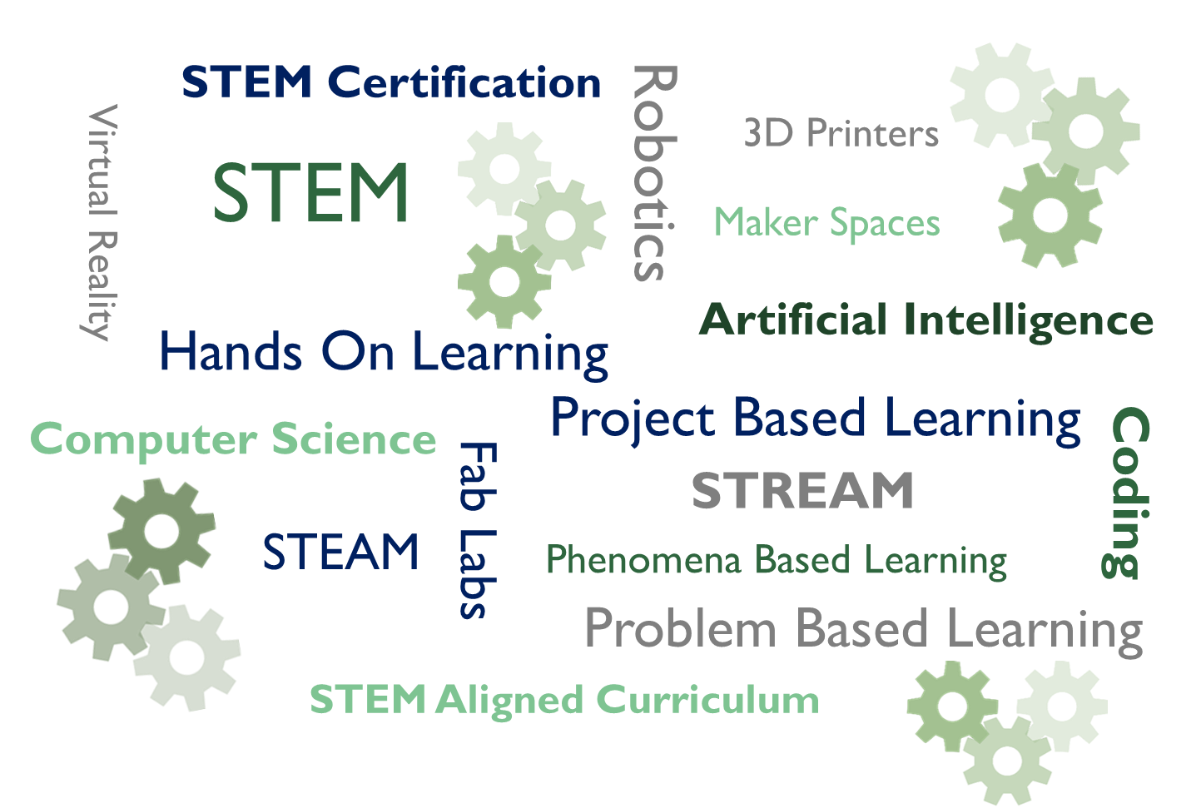
Vision
Mission
Goals
Creation of a Strategic Action Plan Focused on Integrated STEM
Using Existing Curriculum, Materials and Resources, STEMness Rubric,and Curriculum Instruction and Planning Tool
Notes:
Is How We Want Our Children to Learn
To Be:
Civically Ready
College Ready
Career Ready
Life Ready

Slide 8

Key Principles of Integrated STEM*
Principle 1: Integrated STEM education should advance the learning of each individual STEM discipline
Principle 2: Integrated STEM education should provide logical and authentic connections between and across the individual STEM disciplines
Principle 3: Integrated STEM education should serve as a bridge to STEM careers
To strengthen STEM for all students we must
change perceptions around STEM
*STEM4: The power of collaboration for change
A joint document authored by Advance CTE, Association of State Supervisors of Mathematics, Council of State Science Supervisors, and International Technology and Engineering Educators Association

Slide 9
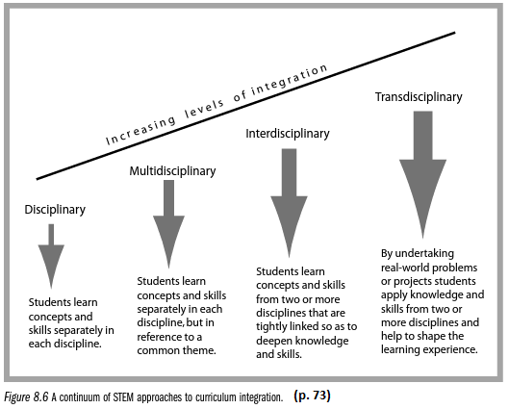
The Road to Integrated STEM…
Interdisciplinary-Multidisciplinary-Transdisciplinary
Source: STEM Learning Essentials by Jo Anne Vesquez, Cary Sneider, and Michael Comer

Slide 10

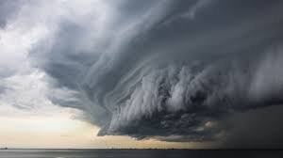
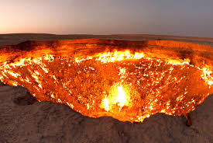

A phenomenon is an extraordinary occurrence or circumstance. In the 1950s, rock-n-roll was considered a new cultural phenomenon, while today we think of crop circles as a mysterious phenomenon or the Northern Lights, a Hurricane, or Volcano.
When you have an integrated STEM culture, students will work on real world problems.
Phenomena
Project
Solutions to the Problem

Slide 11
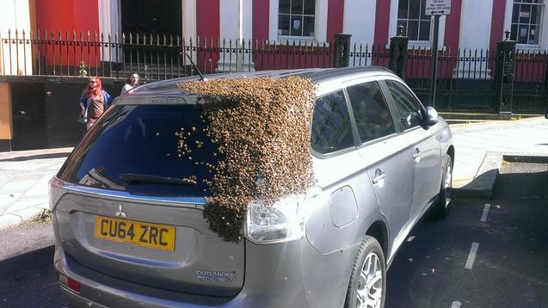
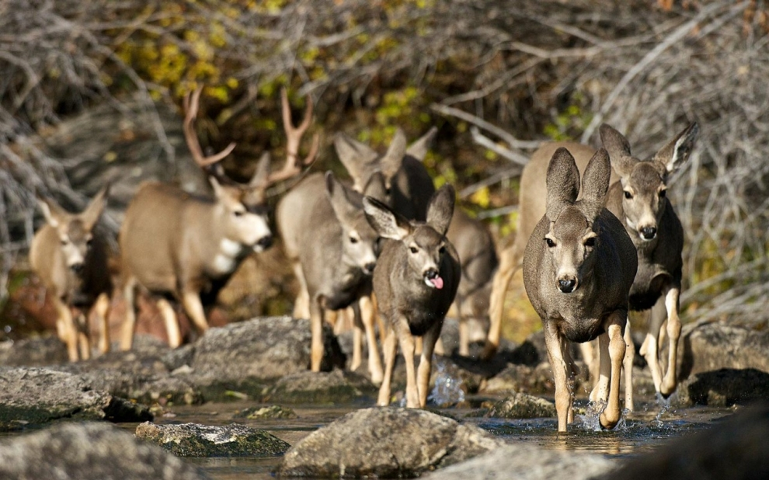
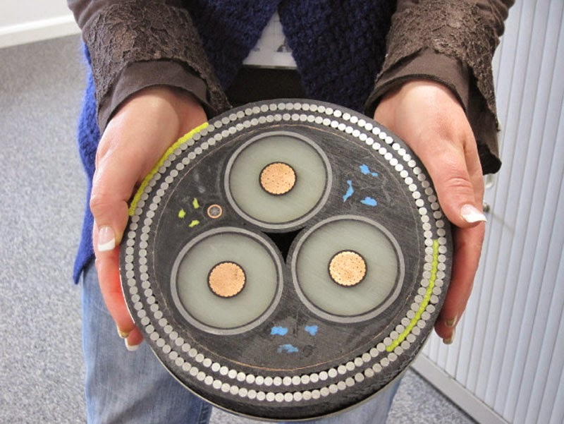
What are other types of Phenomena?
When you have an integrated STEM culture, students will work on real world problems.
Phenomena
Project
Solutions to the Problem

Slide 12
Overview of Support:
Professional development provided to build the capacity of the principals, teachers, schools, and parents to support all student’s in connecting the classroom to the real-world.
Review of Current State
Science Note Booking and Using Phenomena Based Investigations
Understanding the Next Generation Science Standards
Understanding the Importance of Disciplinary Literacy and Content Literacy
Developing Integrated STEM Units Across the Subject Areas
Each Session is 3 hour Saturday Academies (virtual for now)
Monthly Sessions
Special Sessions for Parents Only (coincides with PD but geared for parents)
Schools Come Together as a Group
Individual Office Hours to Work with Schools One on One

Slide 13
Where is your school performing in Integrated stem?

Slide 14
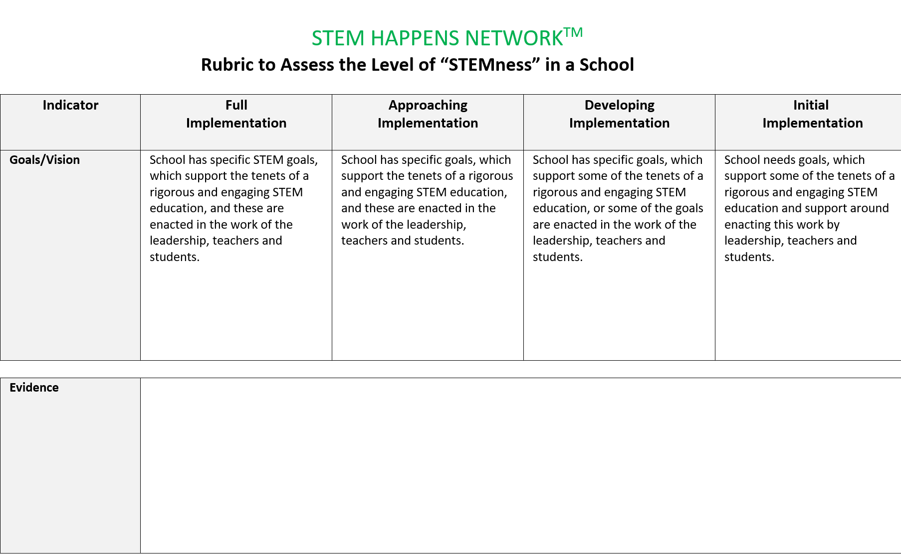
Indicator 1: Goals/Vision

Slide 15
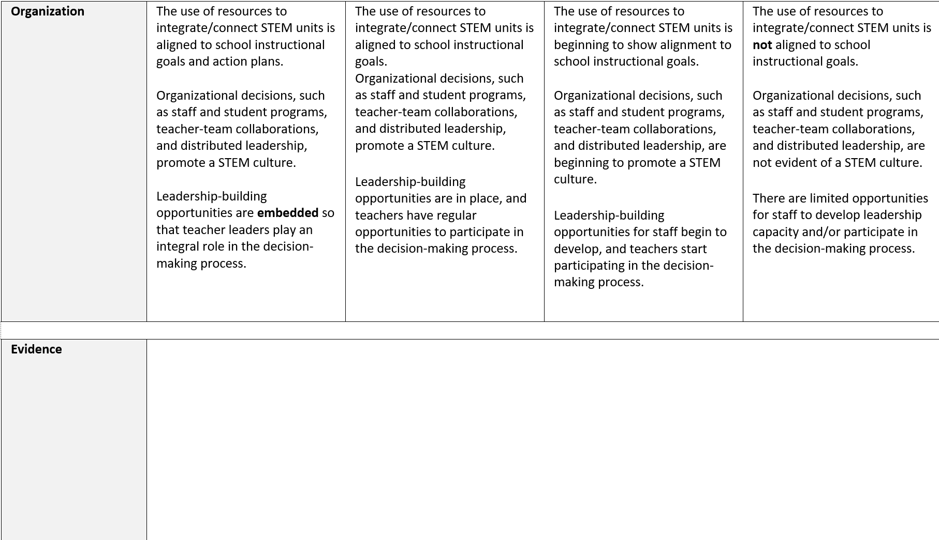
Indicator 2: Organization

Slide 16
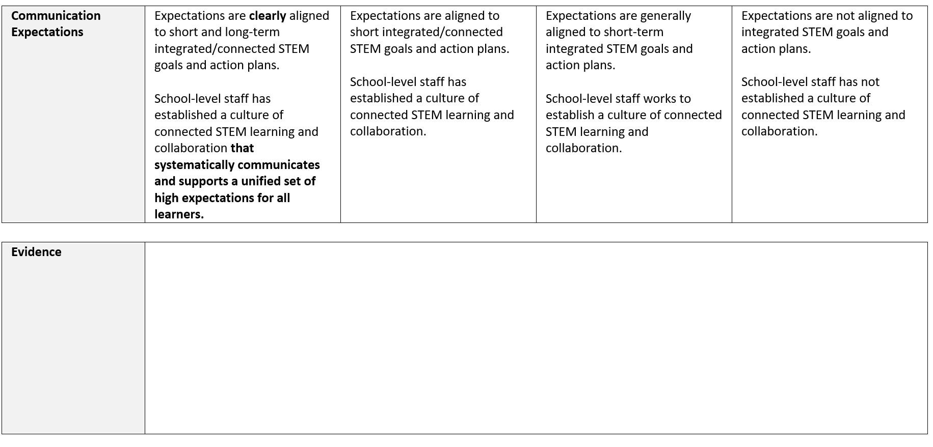
Indicator 3: Communication

Slide 17
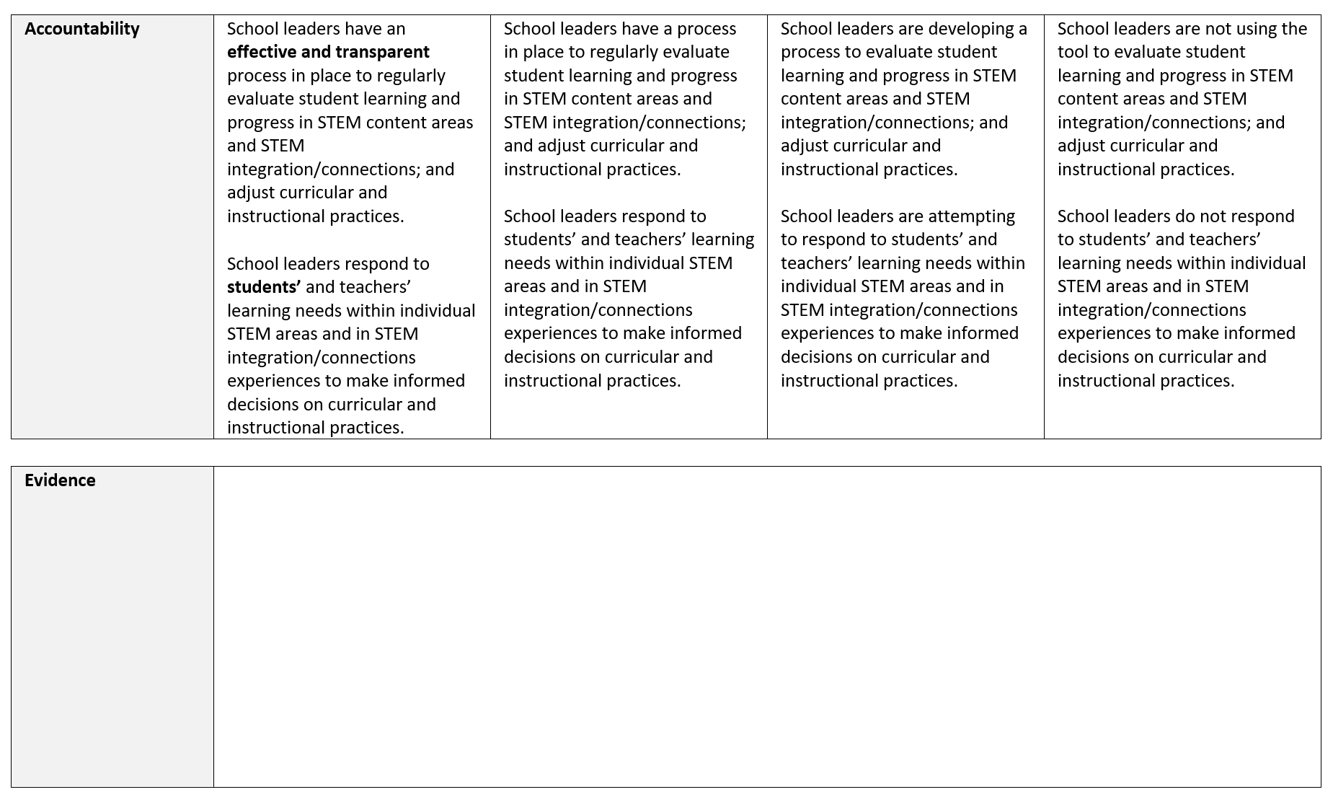
Indicator 4: Accountability

Slide 18
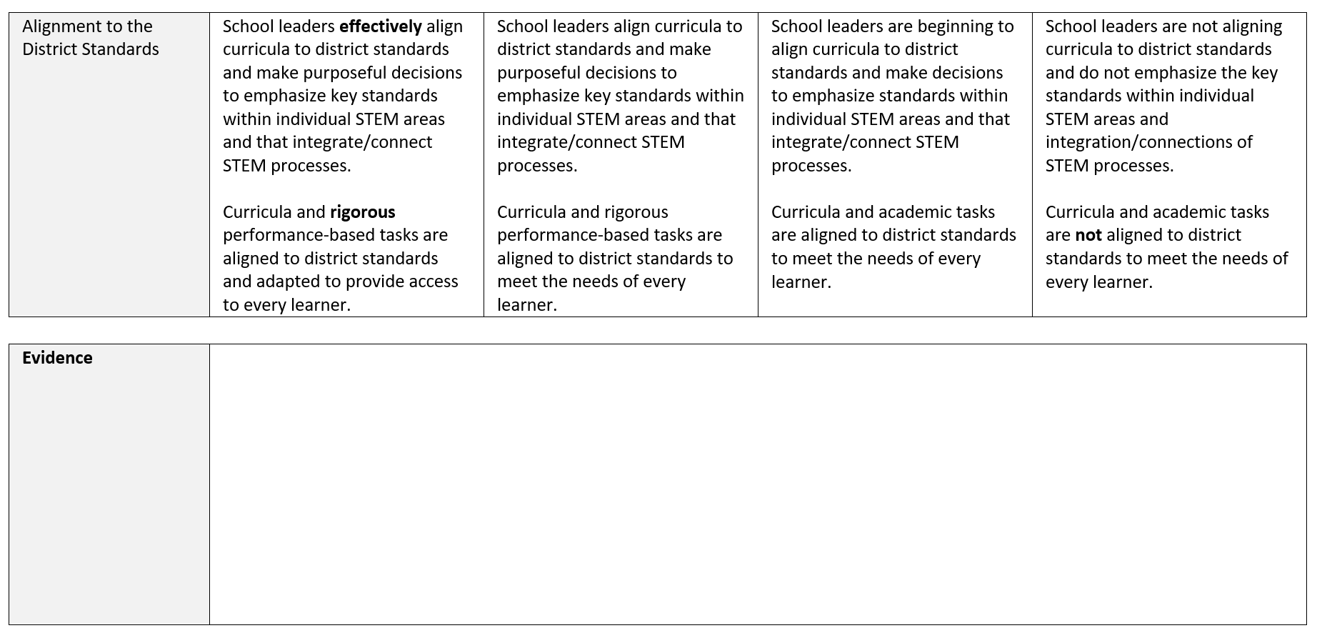
Indicator 5: Alignment to the district standards

Slide 19
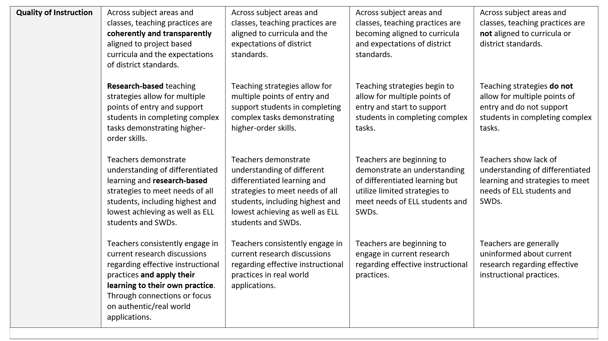

Indicator 6: Quality of instruction

Slide 20
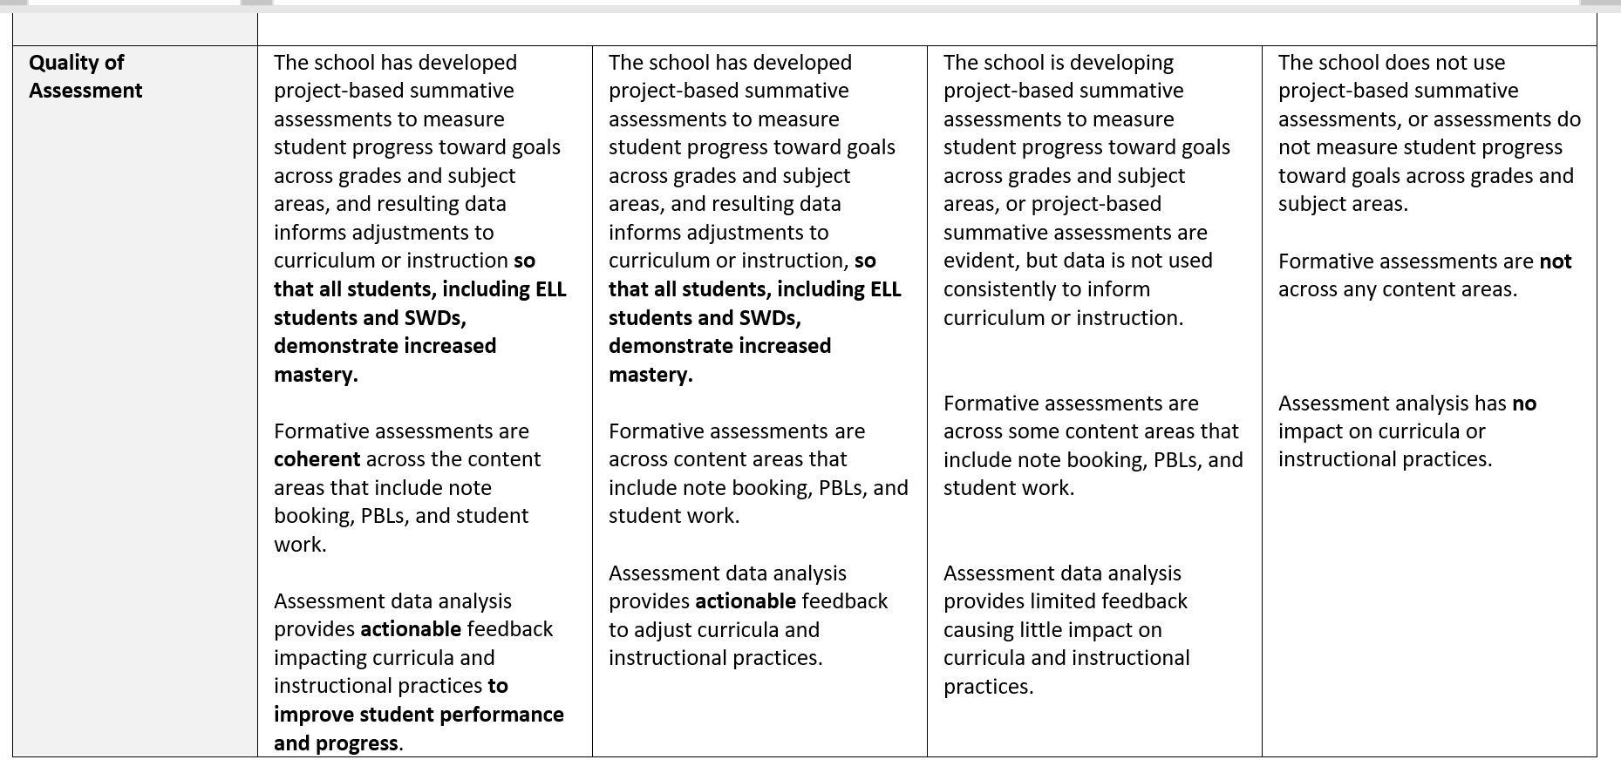
Indicator 7: Quality of assessment

Slide 21

Working Together Creates Our Children to Be critical thinkers, problem solvers, and leaders of Today and Tomorrow!

Slide 22
Resources
https://www.challengesuccess.org/resources/covid-19-resources-for-remote-learning/
https://www.understood.org/en/school-learning/coronavirus-latest-updates
http://www.africanamericanhomeschoolmoms.com/freebies-2/
https://www.nextgenscience.org/parents

Slide 23

Science Note Booking and Using
Phenomena Based Investigations
Presenters: Dr. Sal Fernandez and Ms. Kelli List Wells

Slide 24
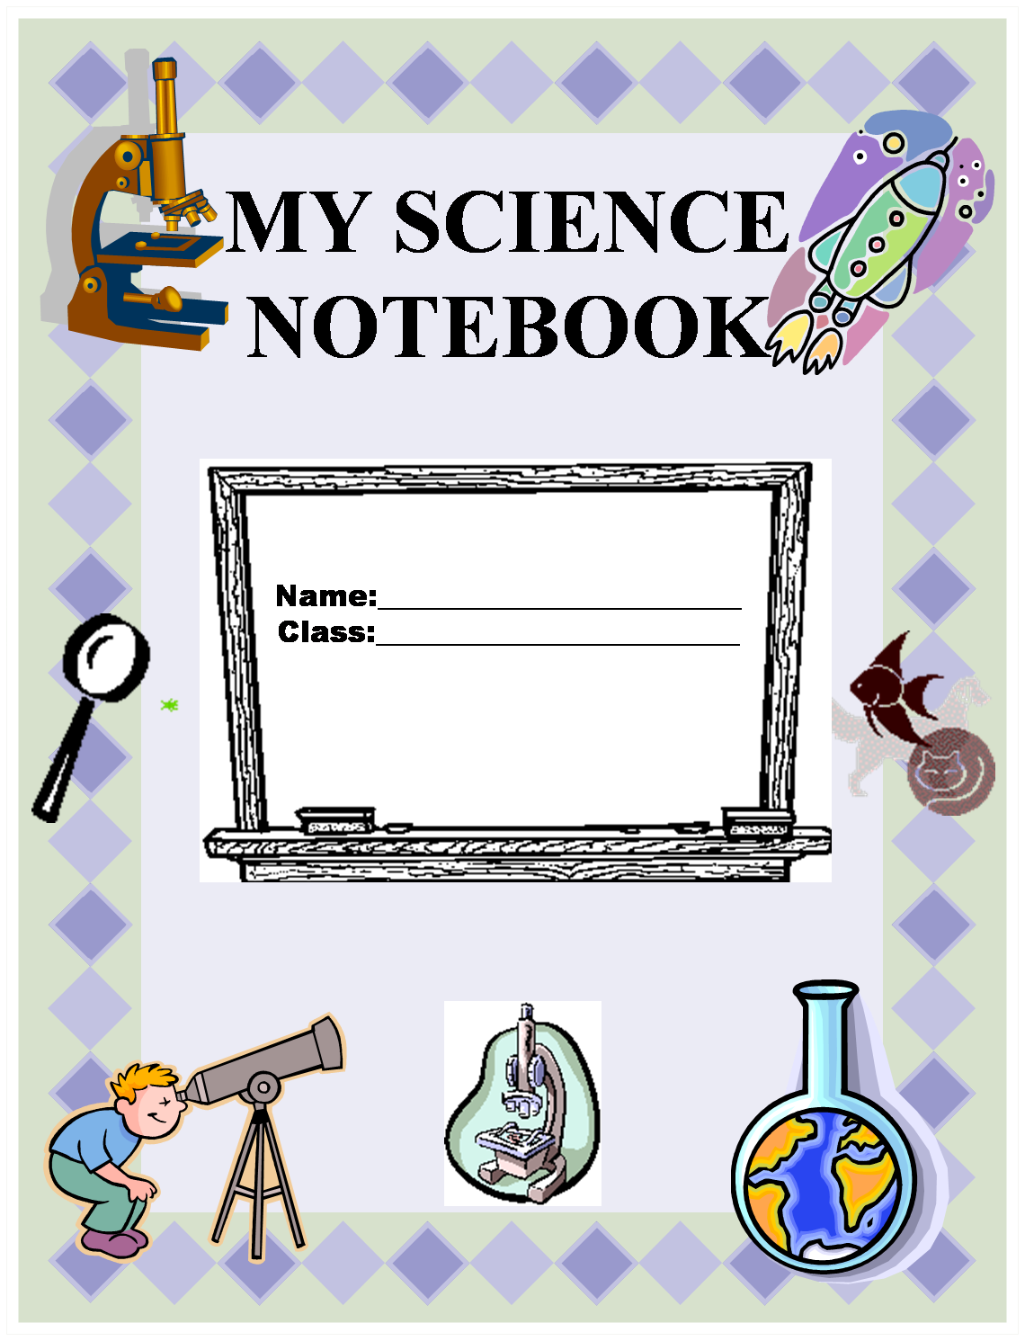
Setting Up a Science Notebook
Composition Books, Interactive and On-line Notebooks could all be utilized

Slide 25







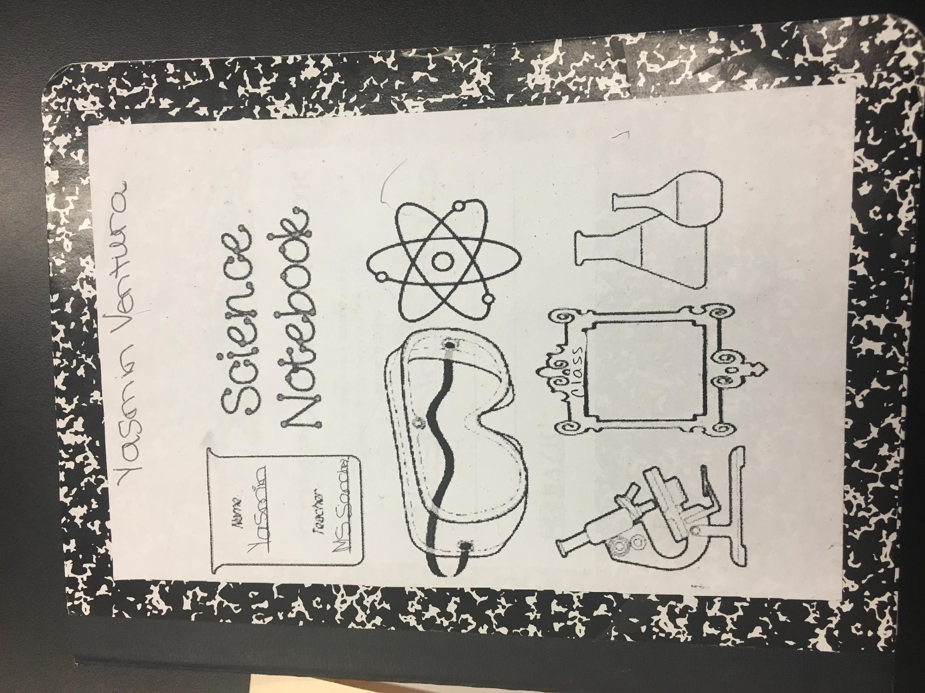
LET’S GET STARTED…
Add your name to the Cover
Don’t forget to let your notebook reflect your…
Add clip art for on-line notebooks or stickies for in school notebooks
ARTISTIC
PERSONALITY
Why do we want to make the notebook personal?
Notes:
The Cover will emerge for you as you take this notebook with you from place to place. Some people will doodle, some will cover the cover, some will leave it just the way it is, some will add stickers. Perhaps do the camouflage activity now.
Cover decorating activity. Camouflage Frog.
It is yours and you can express yourself through the cover, if you so desire.

Slide 26
TABLE OF CONTENTS
Use the first 1 to 2 pages for the Table of Contents
DATE ACTIVITY PAGE #
Notes:
The Table of Contents, IF YOU AS A TEACHER DECIDE TO USE ONE, can appear in a number of forms from teacher generated to student generated…
NOTE: The Table of Contents should be the first thing done before moving to the daily page.

Slide 27
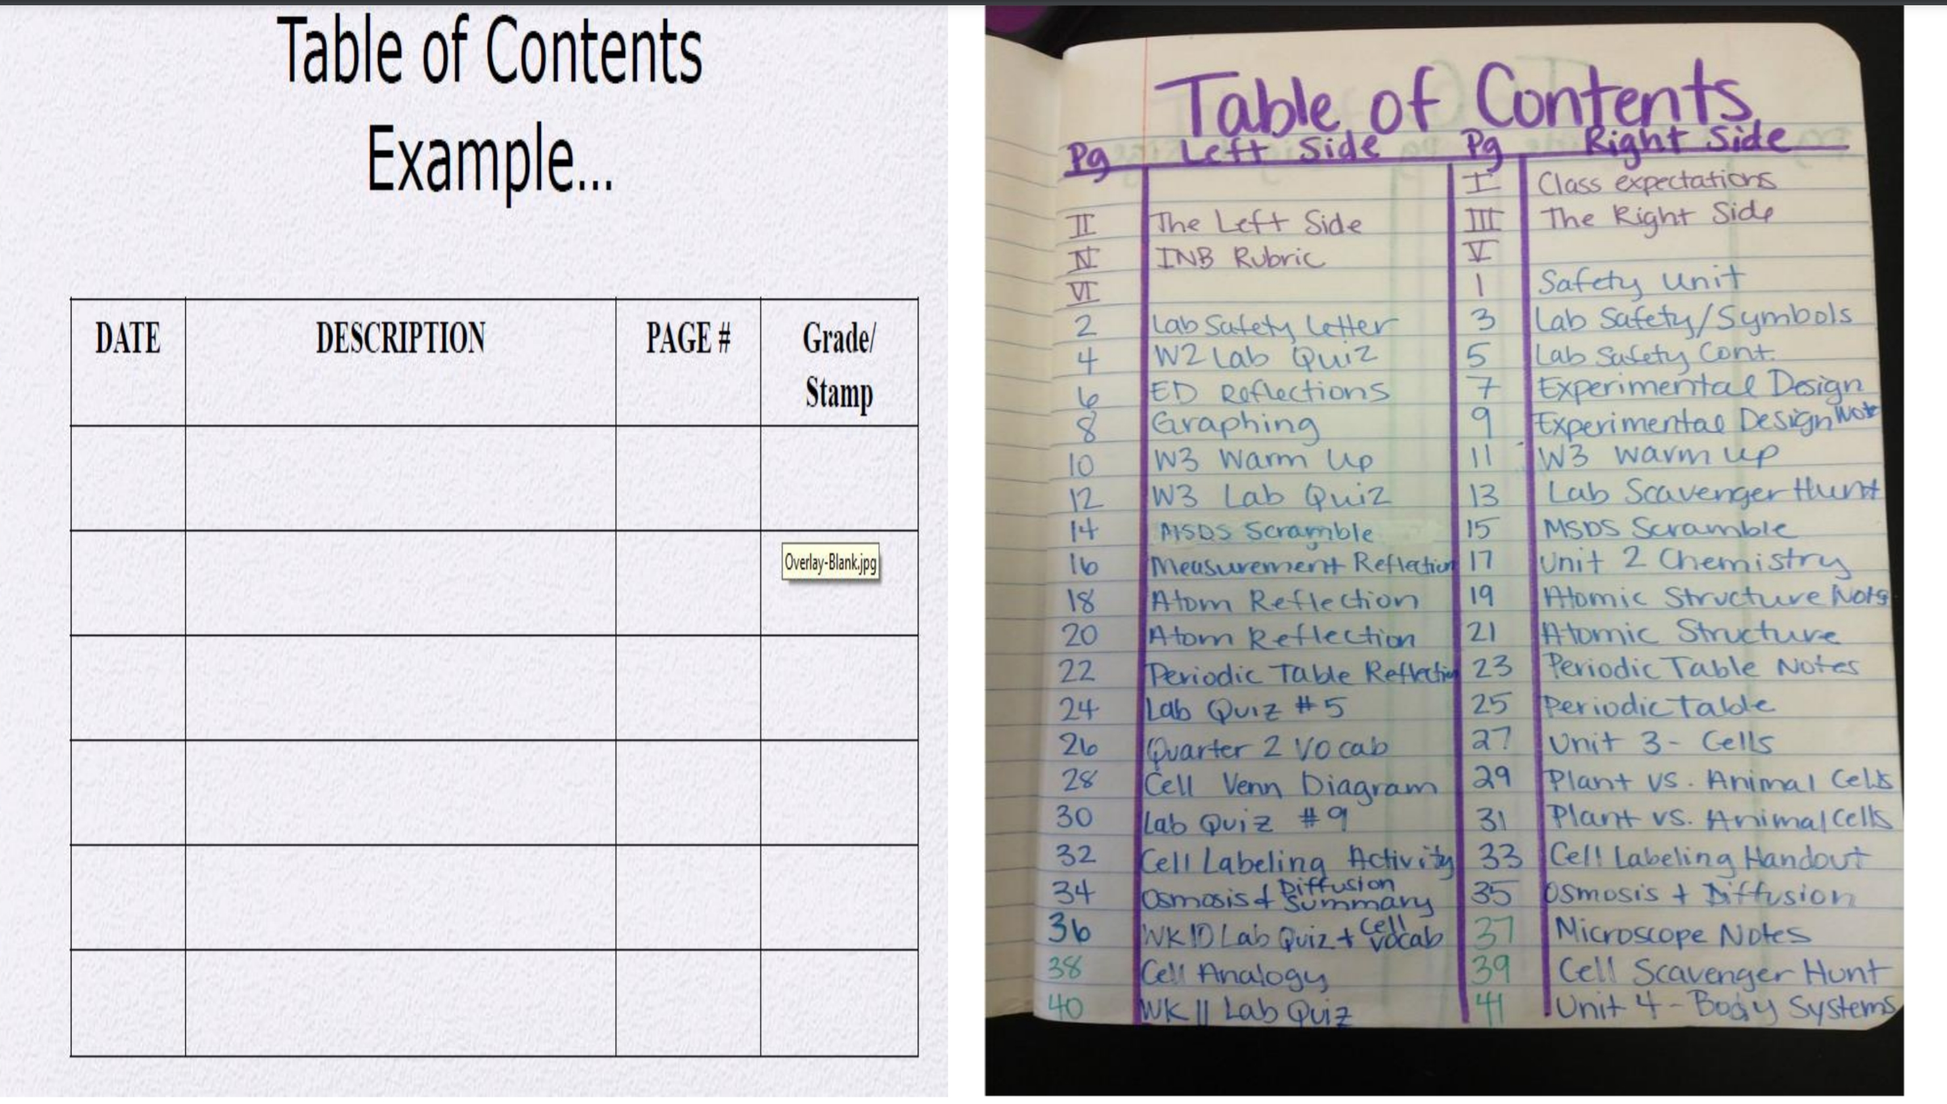
A Student’s Table of Contents Sample

Slide 28
Student Contract and/or
Safety Contract
Front Cover of the Book
How Do I Know I Did A Good Job?
I respected myself and others.
I was prepared to learn and think.
I listened to and followed directions.
I worked hard and did my very best.
I stayed focused on my work.
I cooperated and shared with my partners.
I took chances in thinking and shared my thoughts.
I listened to the answers of other students.
I filled out all parts of my notebook:
  Table of Contents
  Title
  Started with a topic sentence
  Vocabulary words entered in the index
I made careful and thorough observations.
I wrote, drew, and labeled my observations.
I reread and checked my writing for errors and made corrections.
I protected the animals in the lab.
I used science materials carefully and left my table clean and the way I found it.
I learned and had fun!

Slide 29
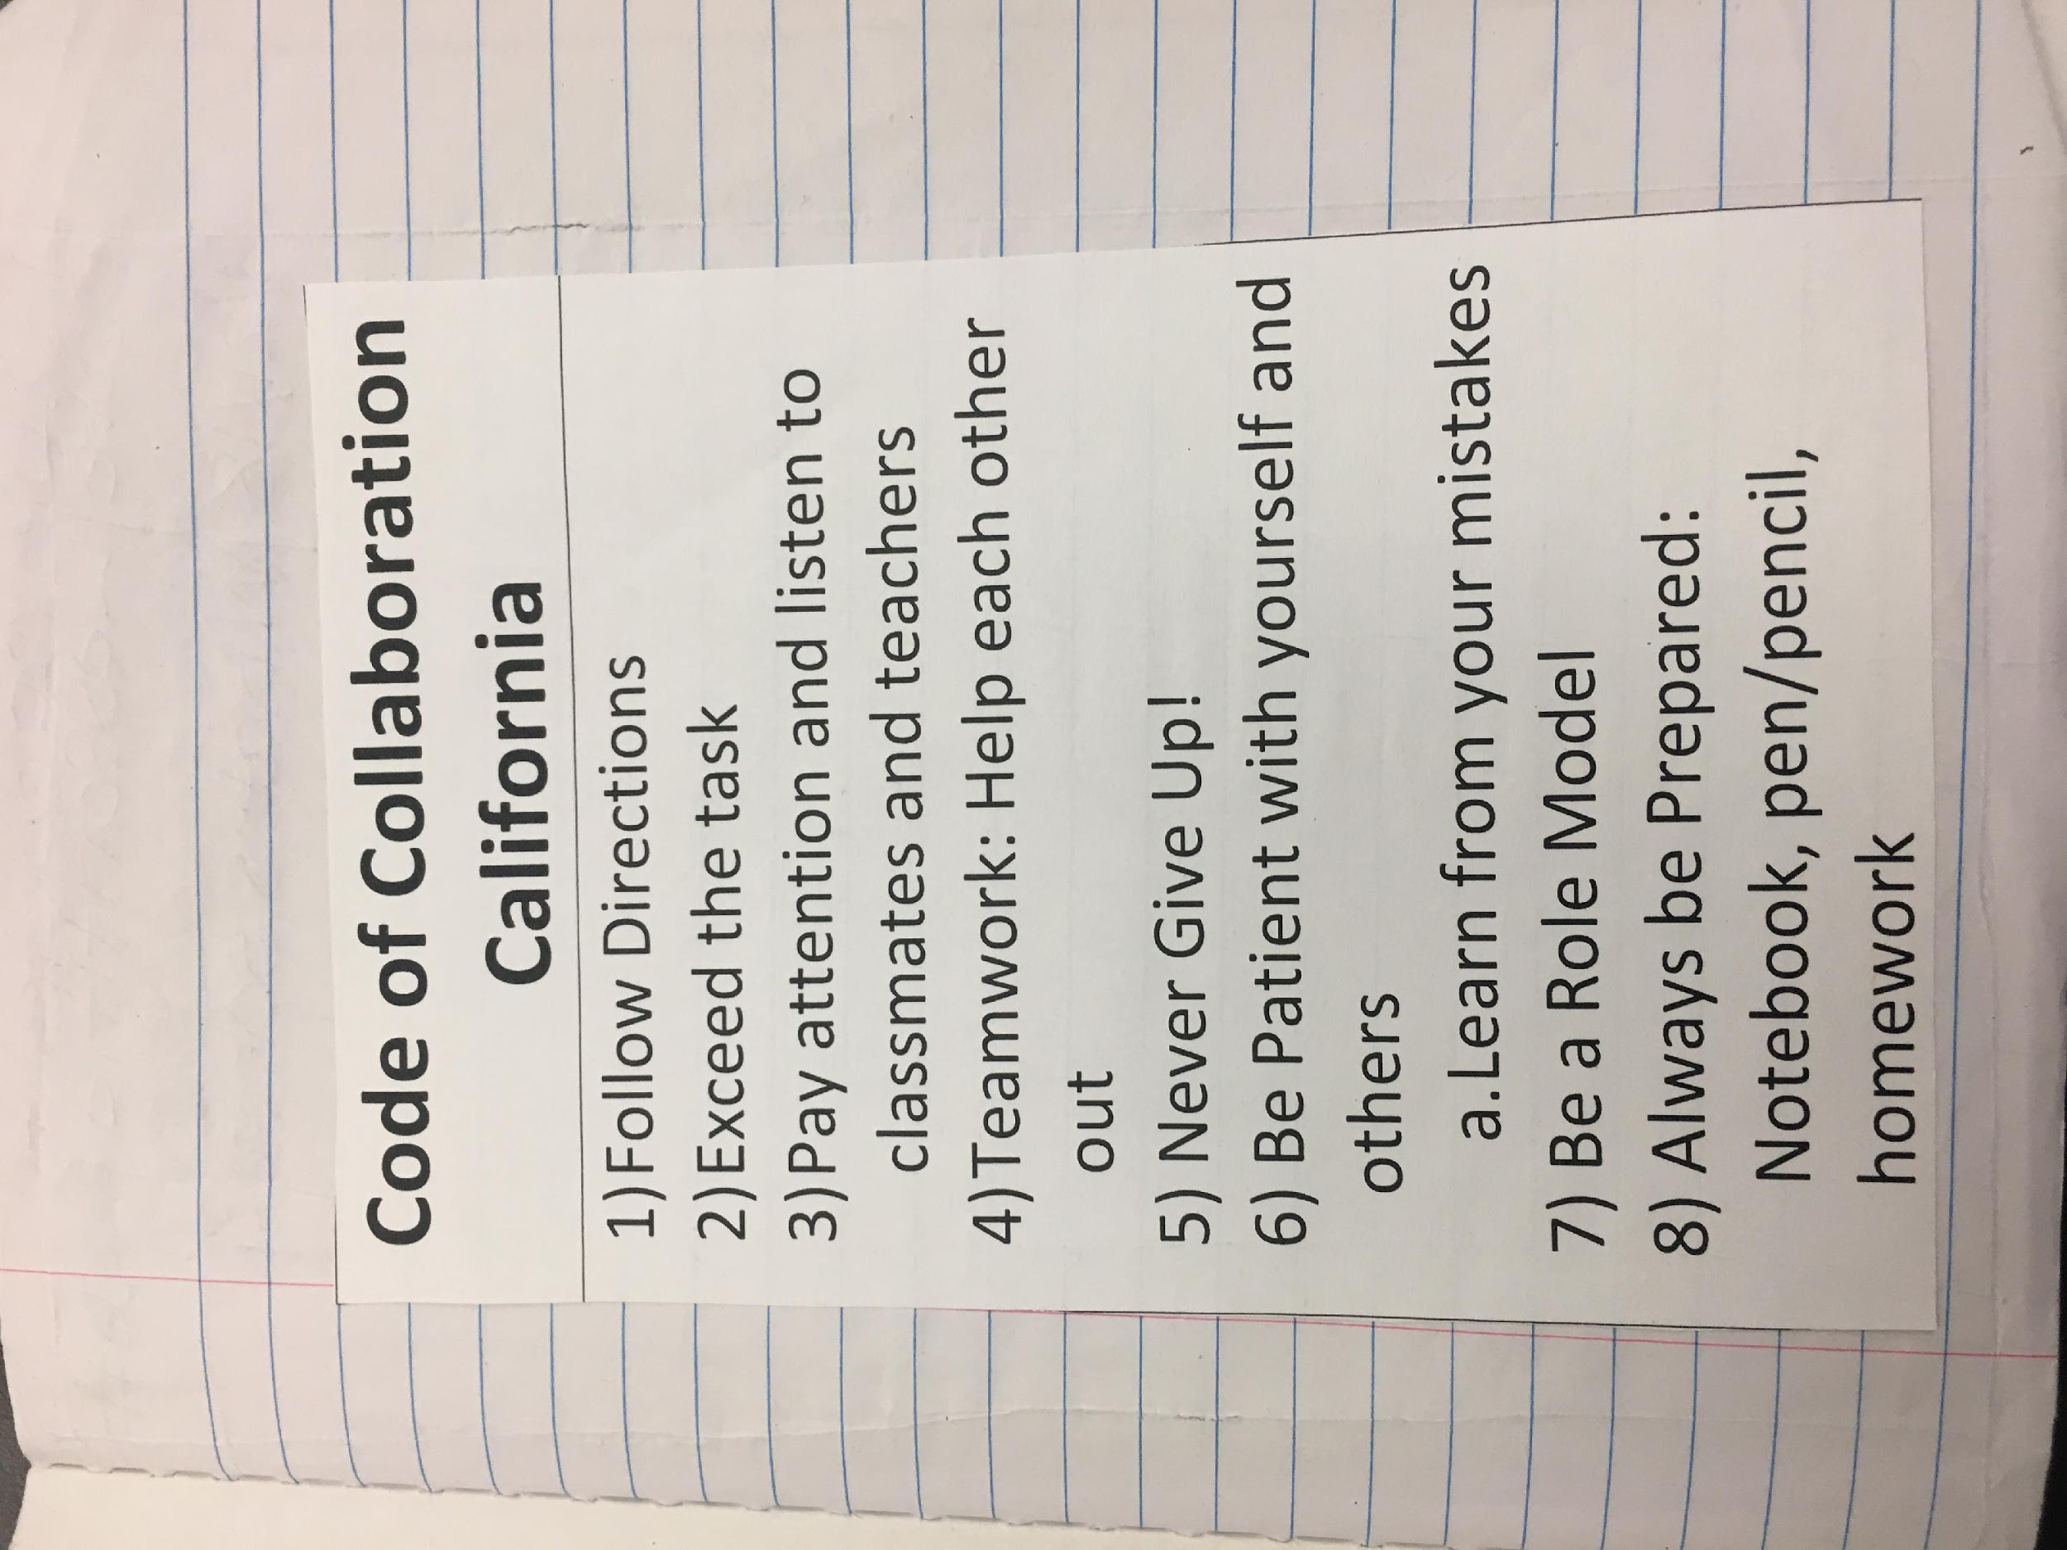
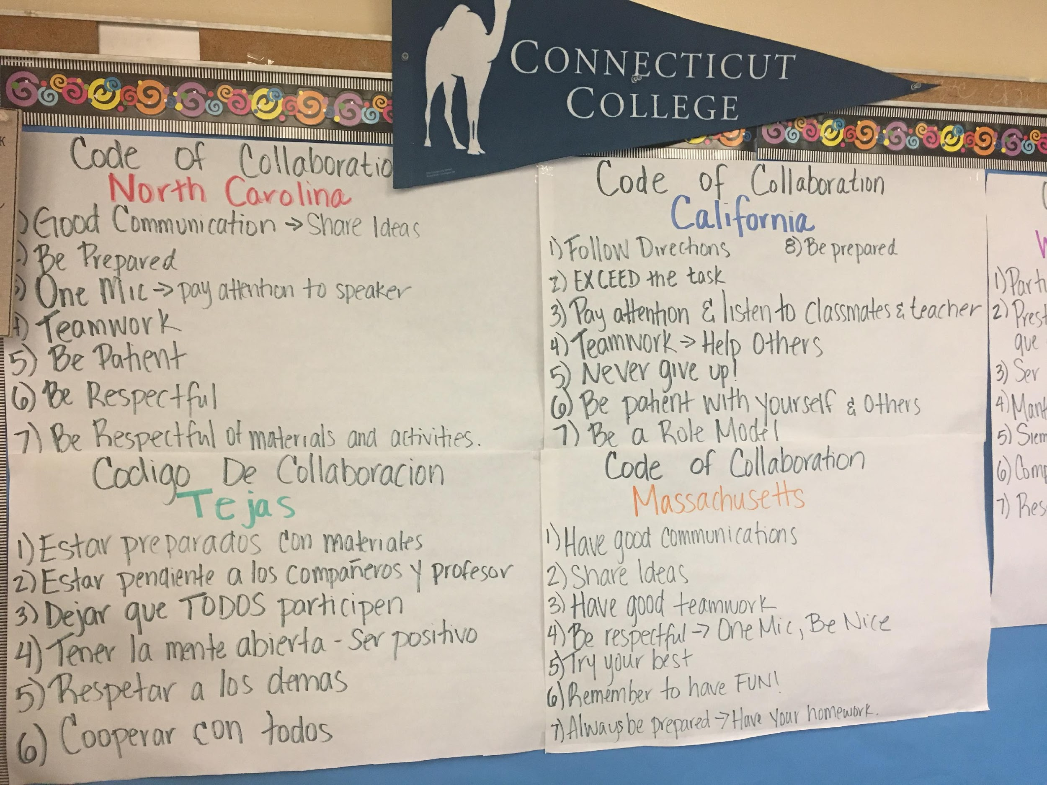
Sample Contracts Teachers Set Up in Collaboration with the Students

Slide 30
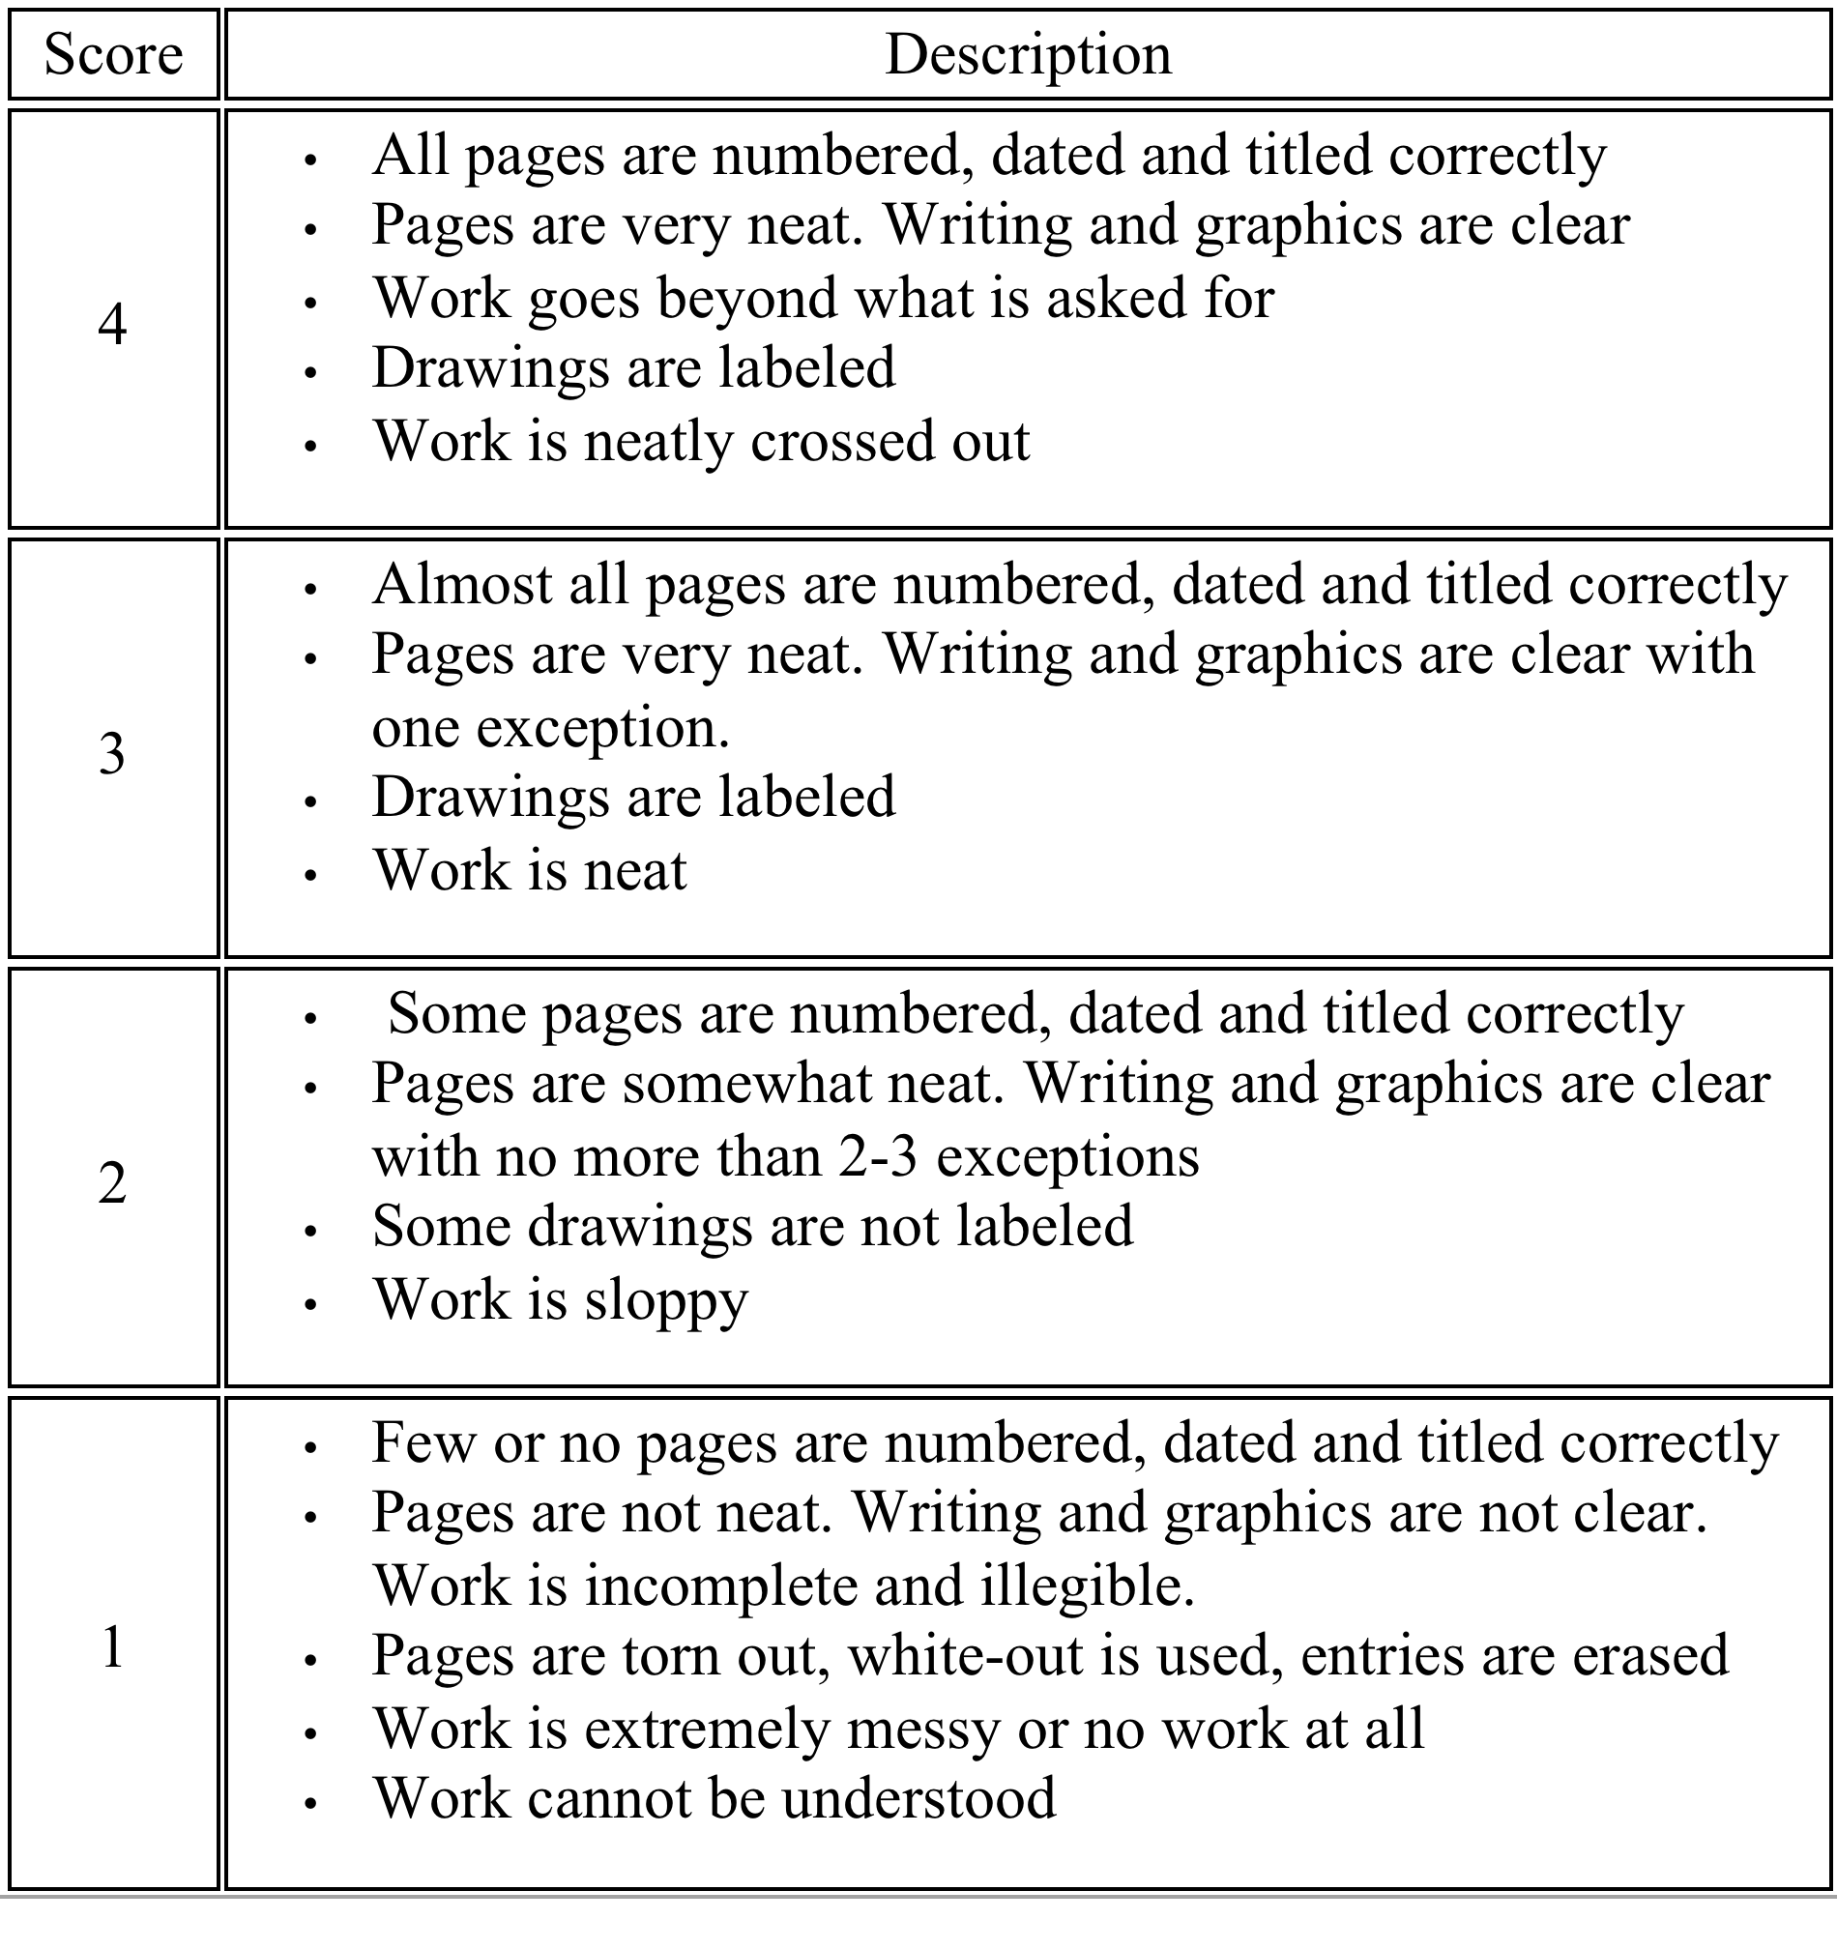
Science Notebook Rubric

Slide 31
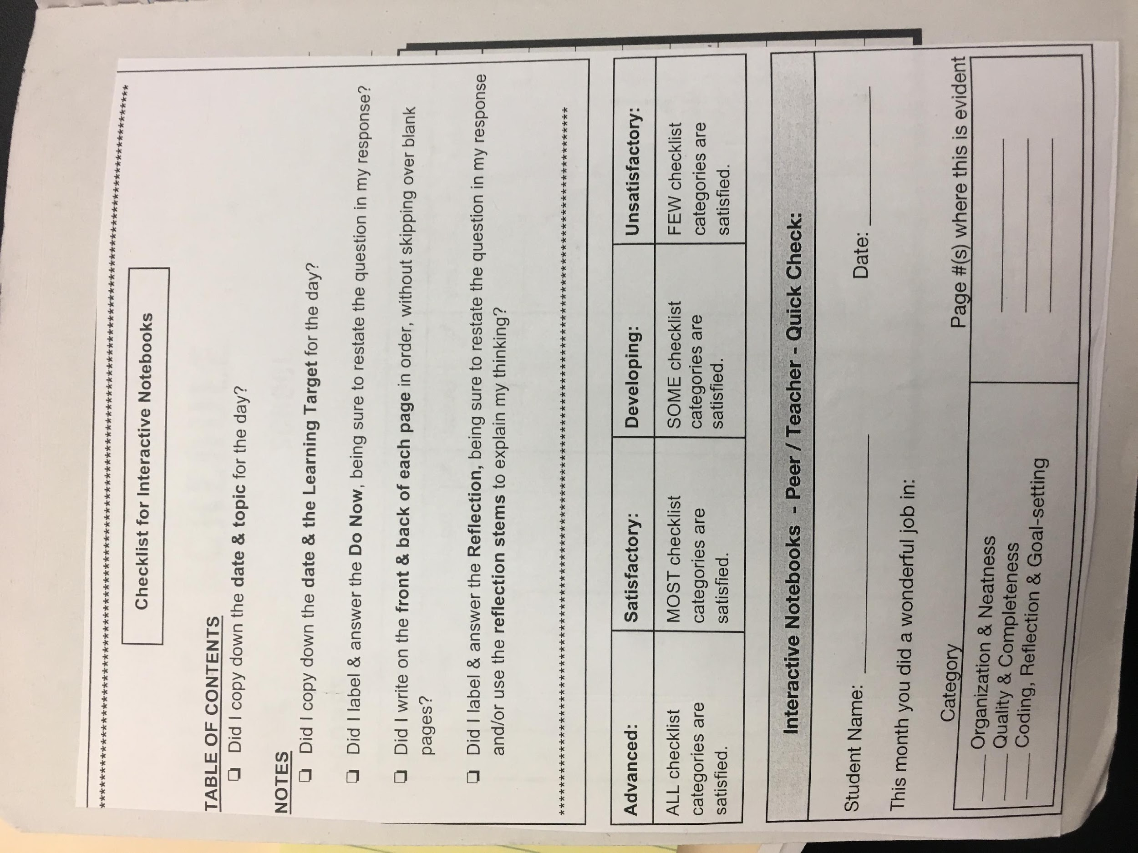
Checklist for Notebooks

Slide 32

NUMBER YOUR PAGES
It’s a good idea to always add the about the weather –(Why?)
1
Notes:
Now take a few moments only to number your pages. You will notice that the #1 is on the right hand side. This is a convention you will find in any published material.

Slide 33
The Last Page Can be….
Word Wall, Word Bank, Vocabulary, Bibliography, Internet Resources
Or the vocabulary can be embedded in the daily notes and lessons
Notes:
Continue to number your pages through page 10.

Slide 34
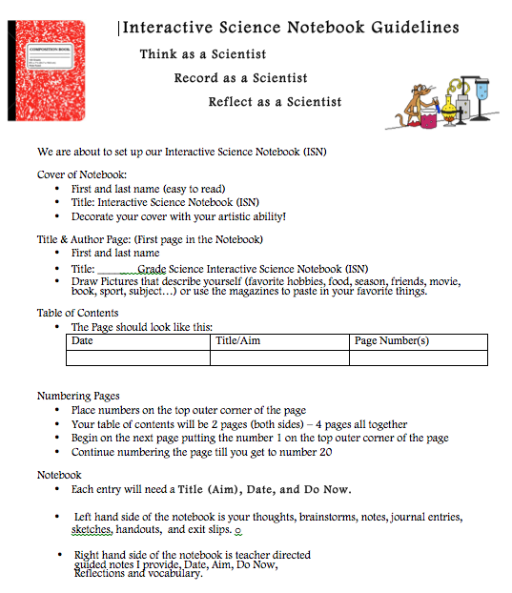
https://1drv.ms/w/s!AmdEQEoXGOGHpWQe5O35HLmNIuzI

Slide 35
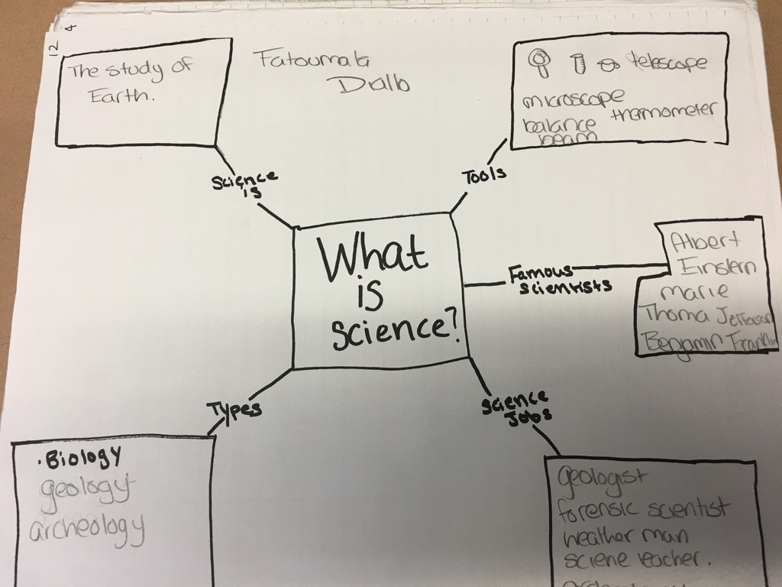
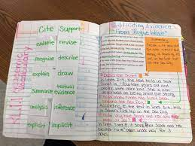
Samples from Student Notebooks

Slide 36
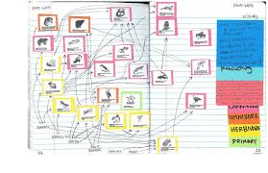
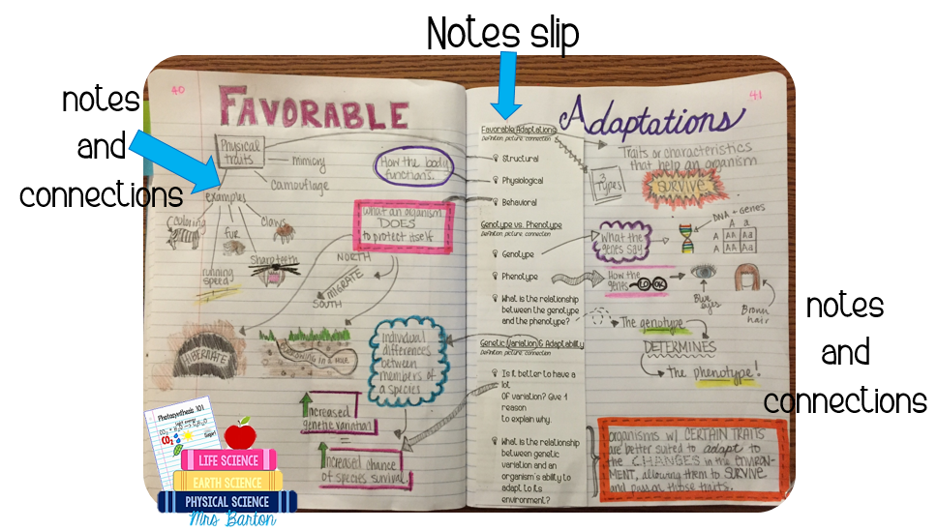
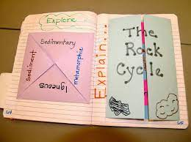
There is no one way to do note booking…
Cornell Notes, Interactive, right and left sides and other methods
Foldables

Slide 37
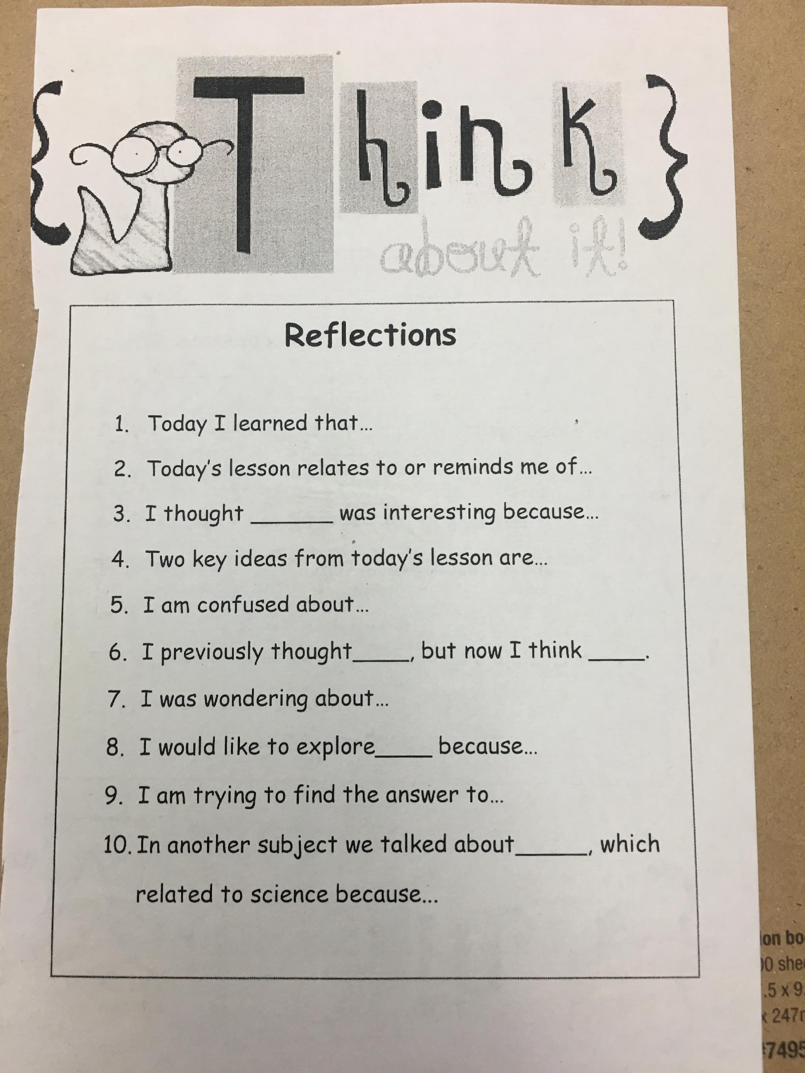
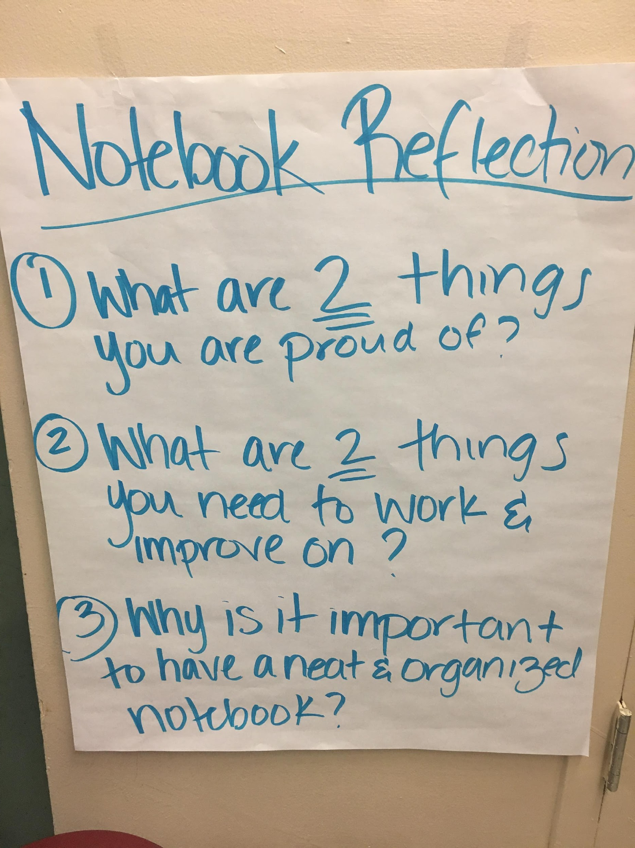
The end of the lesson should always be a “Reflection”- it could be an exit ticket in the notebook -
(not a paper post-it given to the teacher)

Slide 38

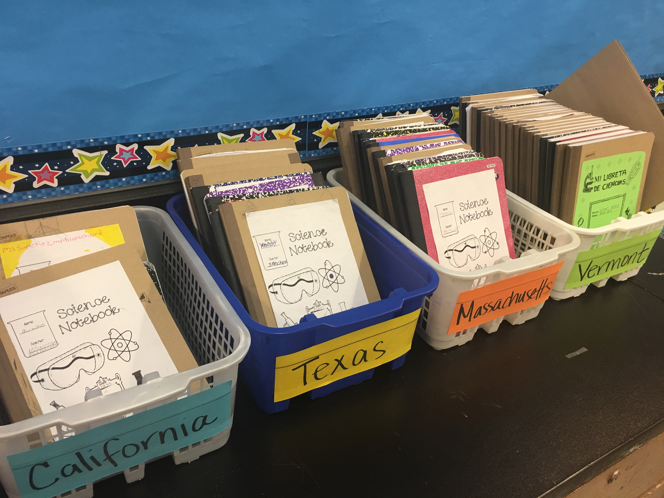
Notebooks can be easily stored and organized in bins or online

Slide 39
Some Resources
Teaching Science With Interactive Notebooks by Kerllie Marcarelli, Corwin Press
Dinah Zike’s Notebook Foldables by Dinah Zike, M.Ed., Dinah- Might Adventures, LP www.dinah.com
Science Notebooks- Writing About Inquiry by Brian Campbell and Lori Fulton, Heinemann Press www.Heinemann.com
Google- GoogleDocs in setting up an on line Notebook for your students
Our Website….www.STEMHappensNetwork.com
Will have a list of further resources, websites, links as well as excellent articles to read that all deal with different types of notebooks

Slide 40
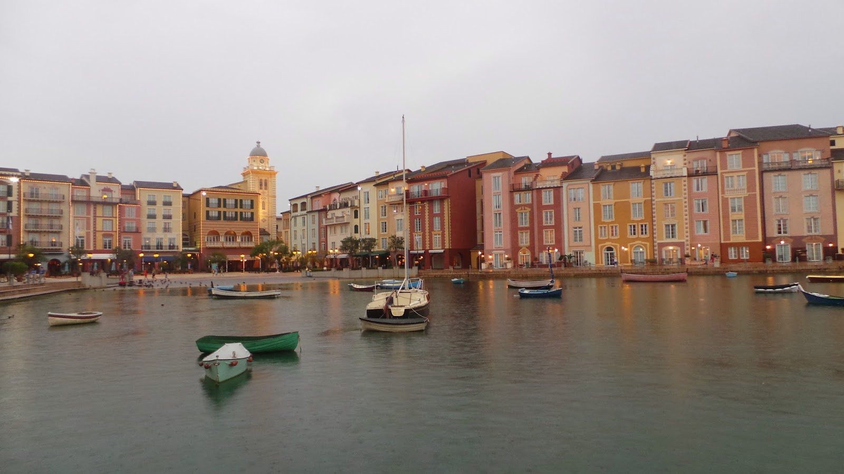
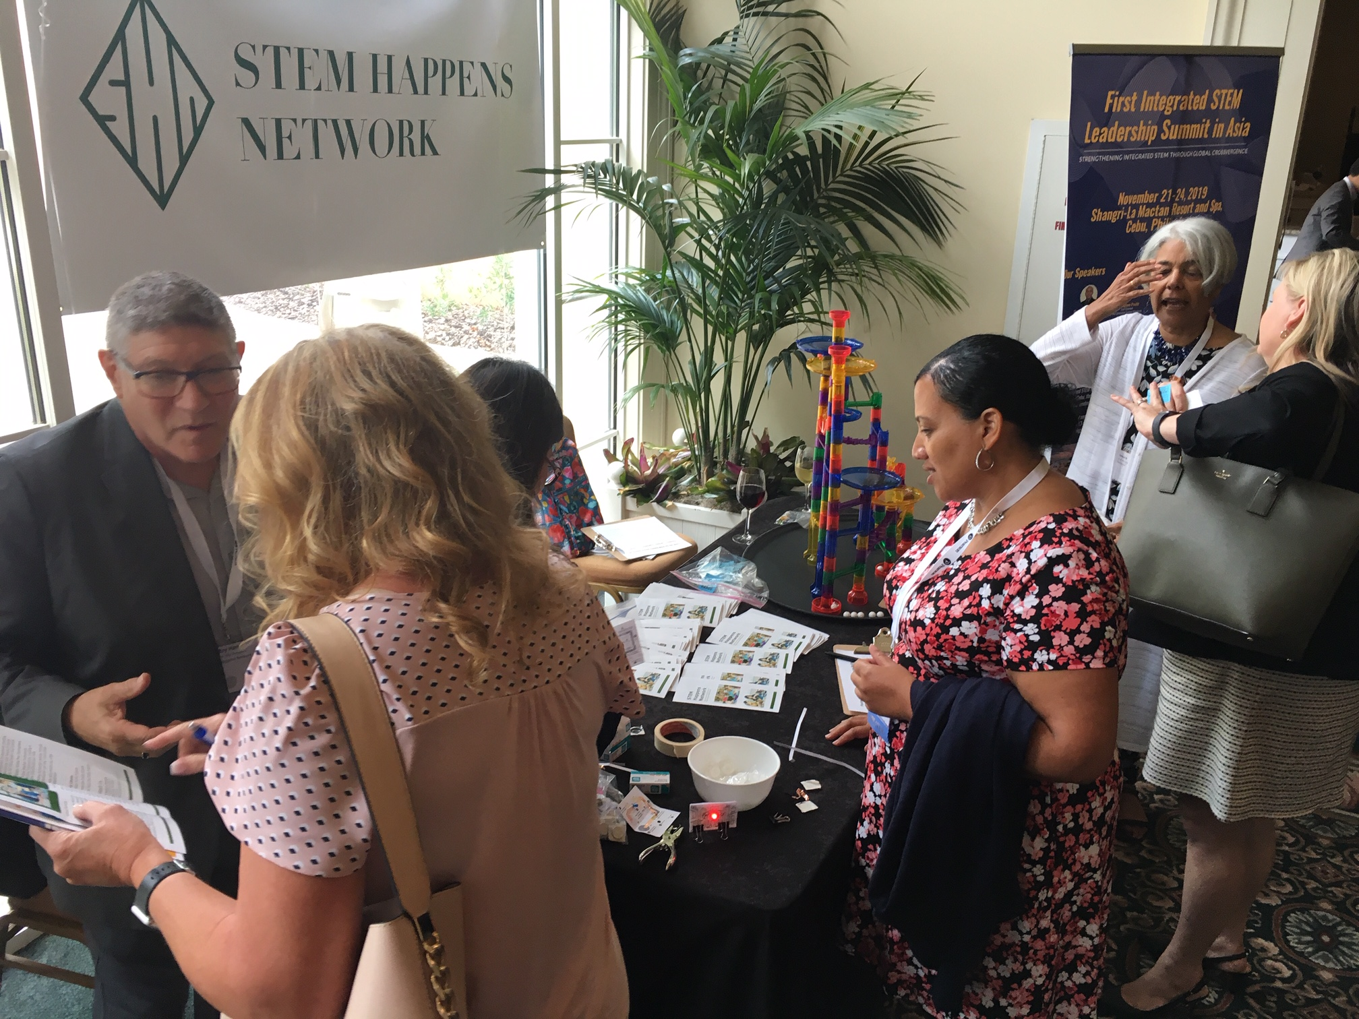
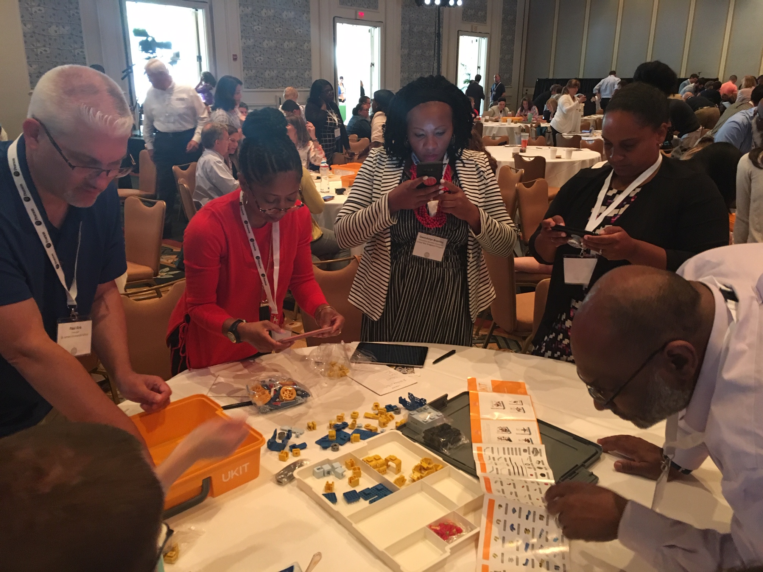
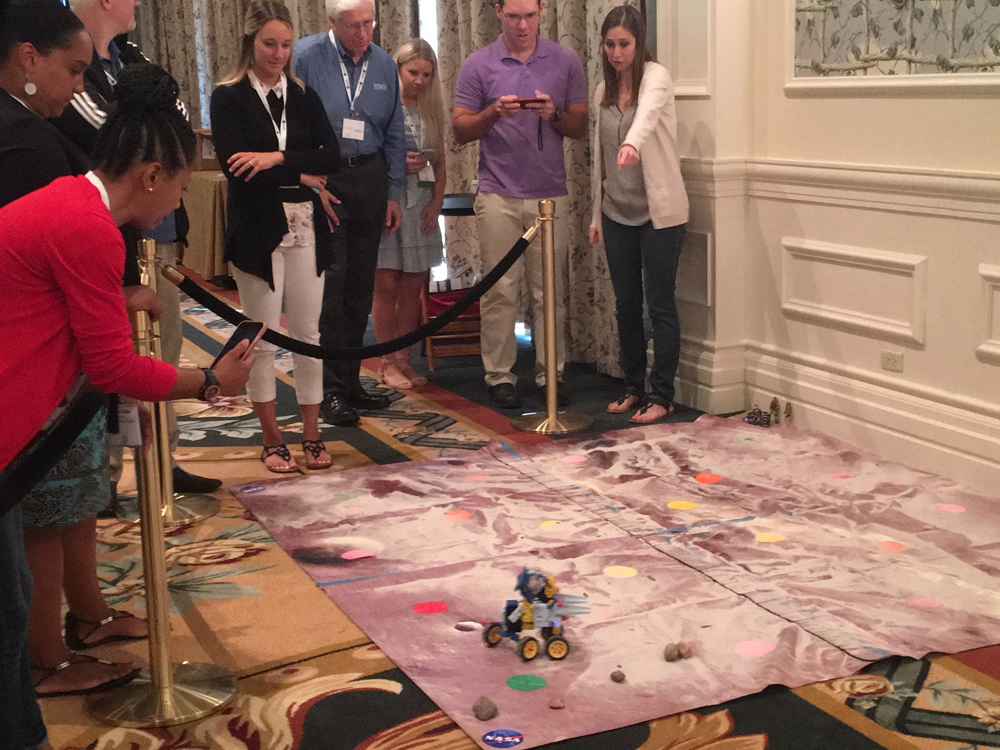
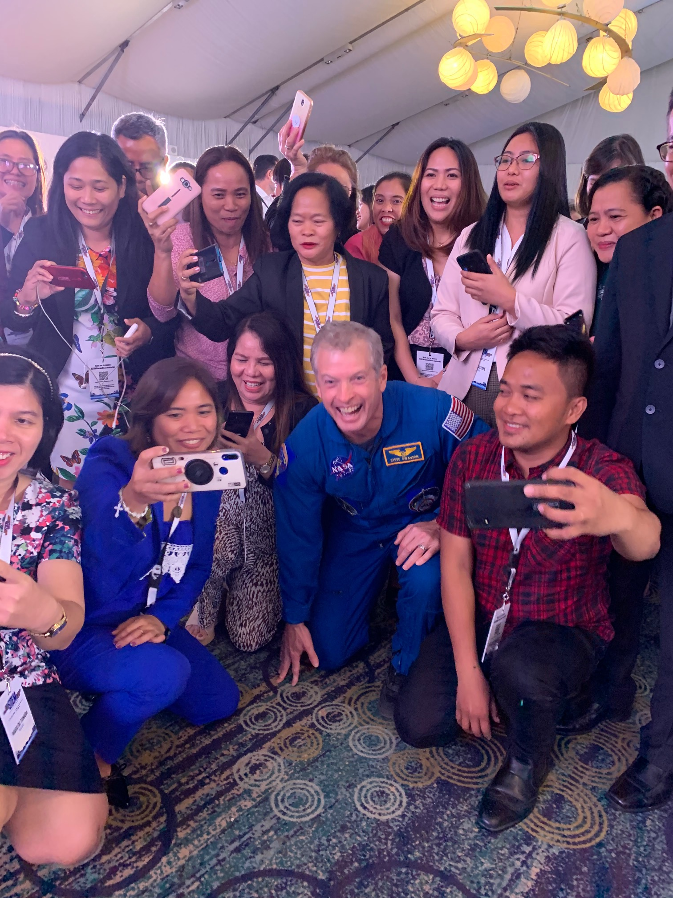
STEM Leadership Alliance Summit
July 11 to July 14
Orlando, Florida
Portofino Bay Hotel (part of Universal Studios)
300 to 400 key leaders across the United States working in improving education, using STEM as the key lever
Register at www.STEMLeadershipAlliance.org! Register early limited space!

Slide 41
THANK YOU!
Salfernandez.shn@gmail.com
KelliListWells.klw@gmail.com for More resources: www.Stemhappensnetwork.com www.stemleadershipalliance.com

