Slide 1
STEM Happens Network
Dr. Sal Fernandez
Ms. Kelli list wells

Slide 2
WHAT IS INTEGRATED STEM?
Science
Reading & Writing
Math
The connection of science, math, reading and writing, as well as other areas such as social studies, art, technology.
Let’s Take A Look…..

Slide 3
Creating an integrated stem Culture
The Problem:
The meaning of the word STEM is not clear yet, there is a call for STEM degrees. There is a disconnect between what business needs and what education is teaching.
  STEM is viewed as a four-letter acronym
  Disconnected from subject to subject taught in silos
  Students attend math with no understanding of how it relates to science and how science is relates to literacy
The Solution:
Connect the dots for students so math is connected to science, science is connected to literacy and students use their knowledge to solve local problems.
This is what Integrated STEM is about, it is about transforming educator’s practice, in order to create a deeper understanding of how subjects interconnect to develop critical thinkers and problem solvers to supply the STEM workforce.

Slide 4
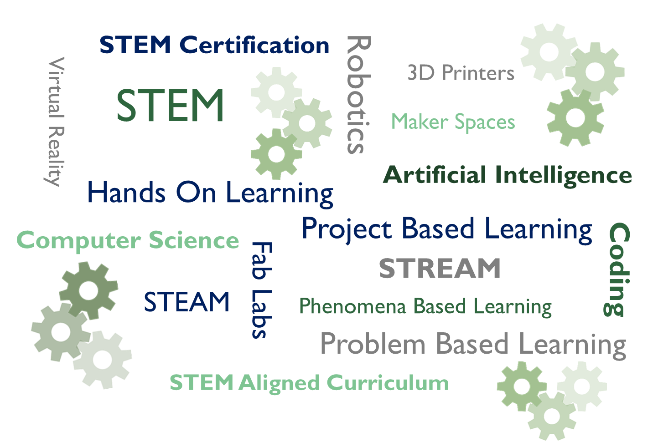
Vision
Mission
Goals
Creation of a Strategic Action Plan Focused on Integrated STEM
Using Existing Curriculum, Materials and Resources, STEMness Rubric,and Curriculum Instruction and Planning Tool
Notes:
Is How We Want Our Children to Learn
To Be:
Civically Ready
College Ready
Career Ready
Life Ready

Slide 5

Key Principles of Integrated STEM*
Principle 1: Integrated STEM education should advance the learning of each individual STEM discipline
Principle 2: Integrated STEM education should provide logical and authentic connections between and across the individual STEM disciplines
Principle 3: Integrated STEM education should serve as a bridge to STEM careers
To strengthen STEM for all students we must
change perceptions around STEM
*STEM4: The power of collaboration for change
A joint document authored by Advance CTE, Association of State Supervisors of Mathematics, Council of State Science Supervisors, and International Technology and Engineering Educators Association

Slide 6
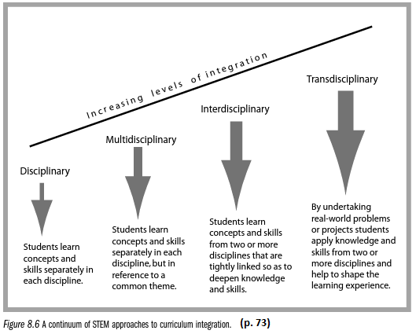
The Road to Integrated STEM…
Interdisciplinary-Multidisciplinary-Transdisciplinary
Source: STEM Learning Essentials by Jo Anne Vesquez, Cary Sneider, and Michael Comer

Slide 7

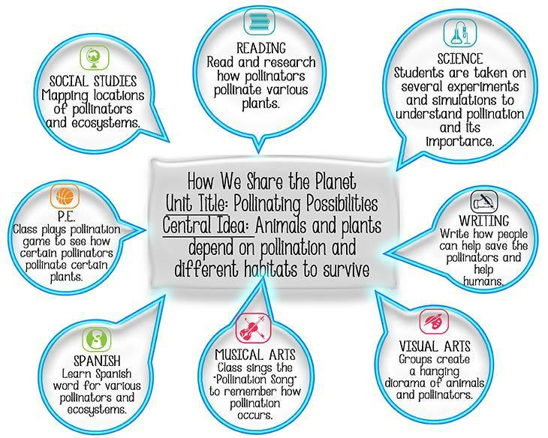
“I thought transdisciplinary meant using multiple subjects at once. Now, I think it’s using parts of topics to gain an overall view of a concept.” – Teacher

Slide 8
How does transdisciplinary connect to the NEW New York State Science Learning Standards?

Slide 9

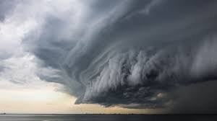
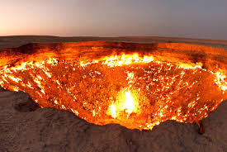

First, what is a phenomenon? A phenomenon is an extraordinary occurrence or circumstance. In the 1950s, rock-n-roll was considered a new cultural phenomenon, while today we think of crop circles as a mysterious phenomenon or the Northern Lights, a Hurricane, or Volcano.
Why do we care about a phenomenon?
When you have an integrated STEM culture, students will work on real world problems.
Phenomena
Project
Solutions to the Problem

Slide 10
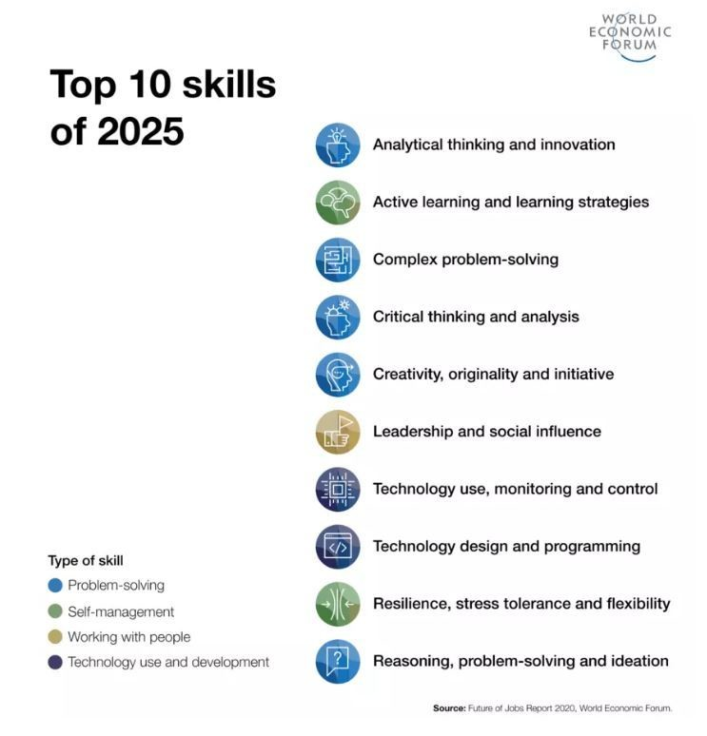

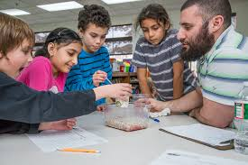
Why It’s Time for NEW Science Education Standards?
Science education needs to keep pace with the changing world around us
Our nation’s workforce needs people with STEM skills
In 2021, there were nearly 10 million workers in STEM occupations and this total is projected to grow by almost 11% by 2031, over two times faster than the total for all occupations.
We know more about how students learn science
STEM is not just about Careers it is about skills too

Slide 11
Overview of Support:
Professional development provided to build the capacity of the principals, teachers, schools, and parents to support all student’s in connecting the classroom to the real-world.
Review of Current State
Science Note Booking and Using Phenomena Based Investigations
Understanding the Next Generation Science Standards
Understanding the Importance of Disciplinary Literacy and Content Literacy
Developing Integrated STEM Units Across the Subject Areas
Each Session is 60 to 90 Minutes
Weekly Sessions
Special Sessions for Parents Only (coincides with PD but geared for parents)
Schools Come Together as a Group
Individual Office Hours to Work with Schools One on One

Slide 12

Recap: Supporting Students in iSTEM
Build Capacity of Educators and Expanded Capacity for Student Centered Learning in STEM
Current State Reflection & Assessment
Develop capacity of district & schools on how to develop an Integrated STEM culture within the Community:
District and schools assess current state using STEMness Rubric & Curriculum & Instruction Planning Tool
Identify vision for integrative STEM learning with district & schools
Develop action plans
Review the Leadership Guide’s 3 Pillars: Effective Leadership, Collaborative Teachers, and Rigorous Instruction
Identify i-STEM district team & schools identify interdisciplinary team (key to connecting content areas to add relevance for students)
Provide Professional Learning that leads to development of Integrated STEM units and understanding NGSS (connect the classroom to the real world)
Provide Parental Support and Learning opportunities aligned to cohort process
Participate in July 9-13 Summit, monthly webinars, & newsletter
Parent Engagement and Support
Understanding Student Population Assessment
Students
Leadership Support
Identify & Differentiate PD
Standards Aligned & Essential Skills Addressed
Develop STEM Integrated Units

Slide 13

Working Together Creates Our Children to Be critical thinkers, problem solvers, and leaders of Today and Tomorrow!

Slide 14
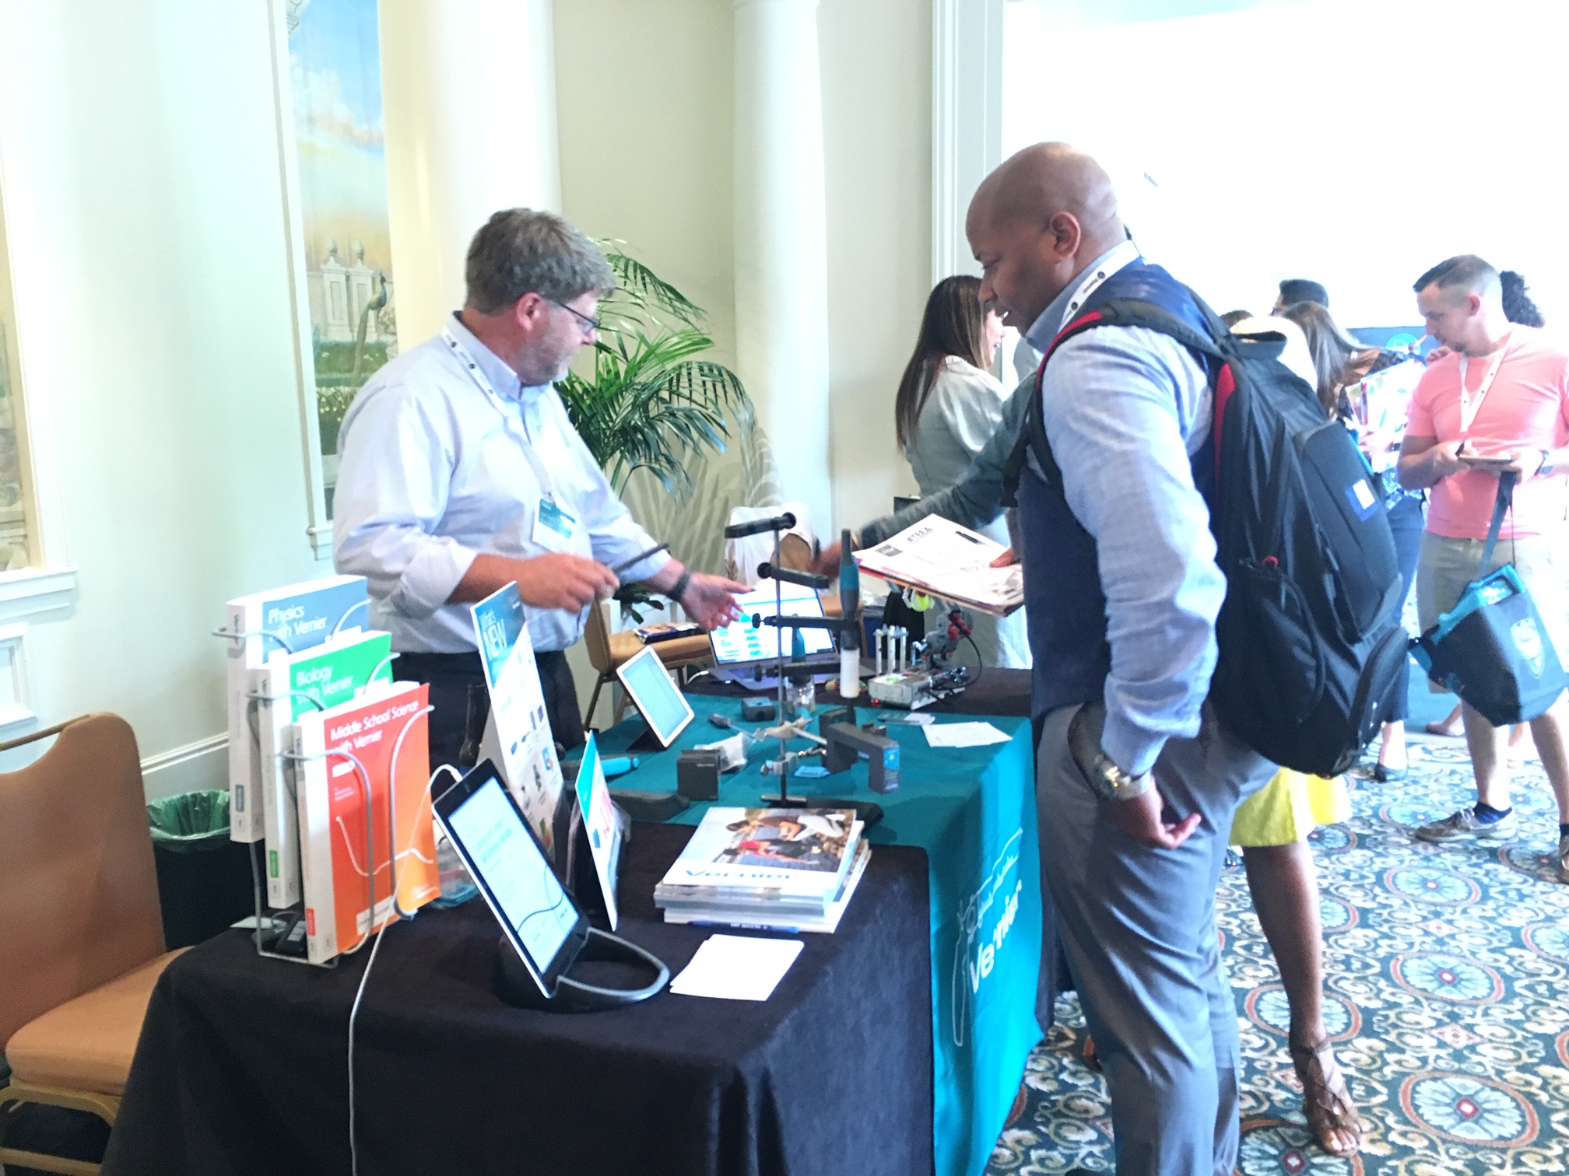
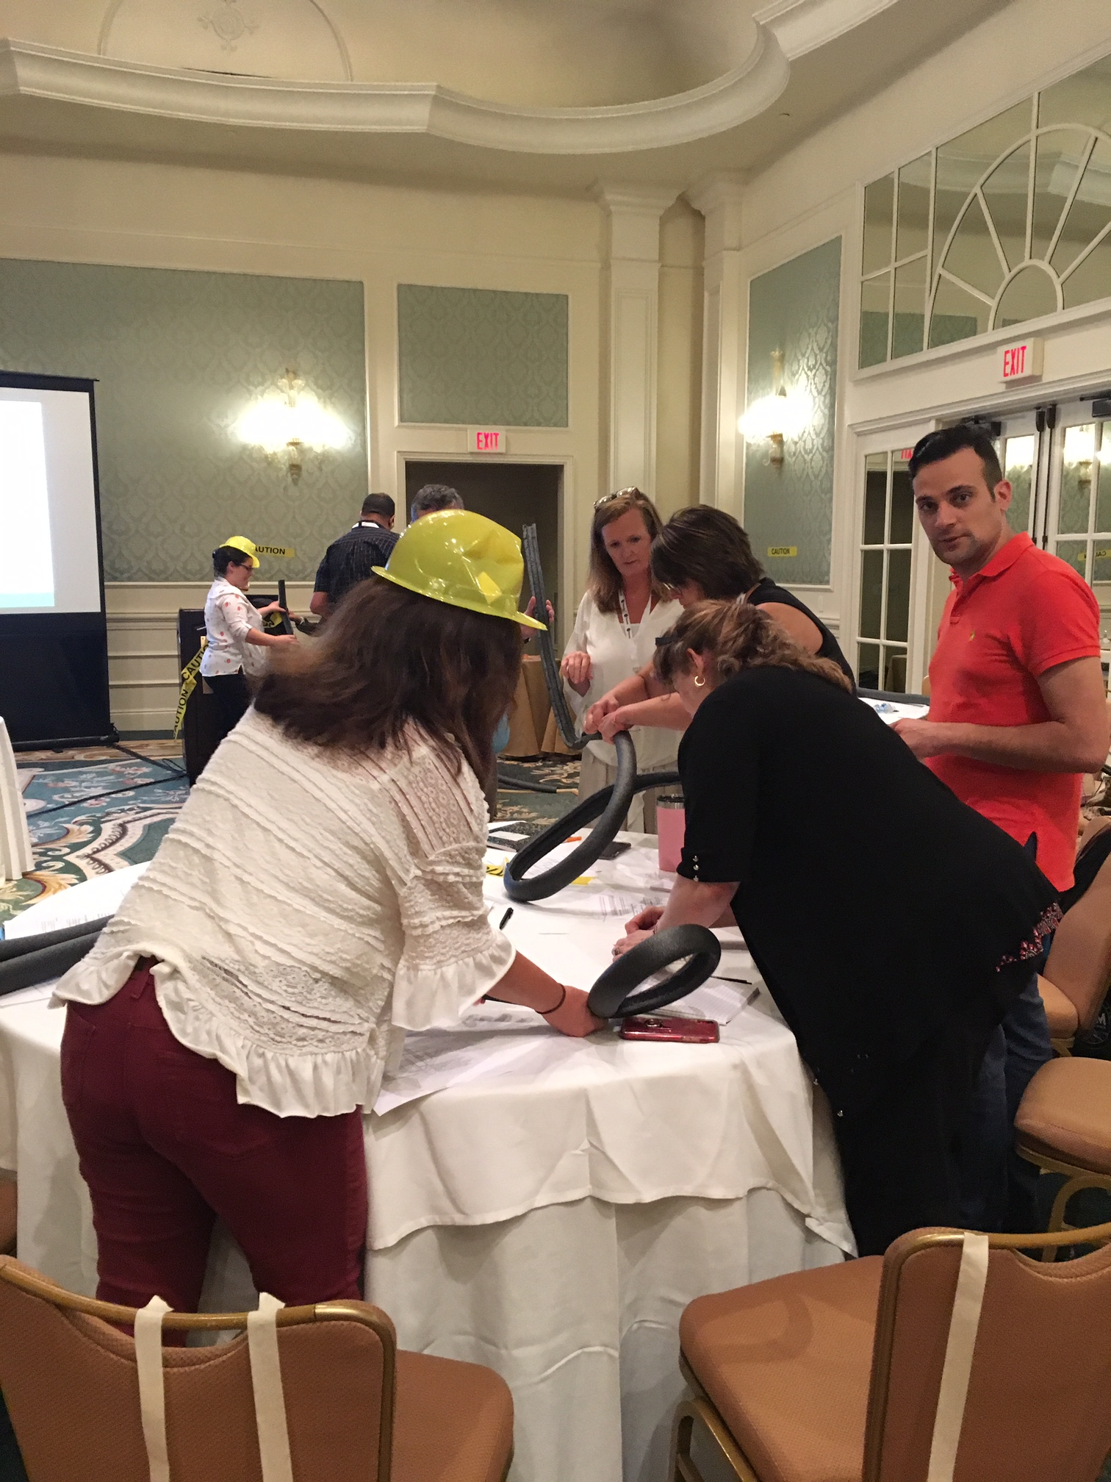
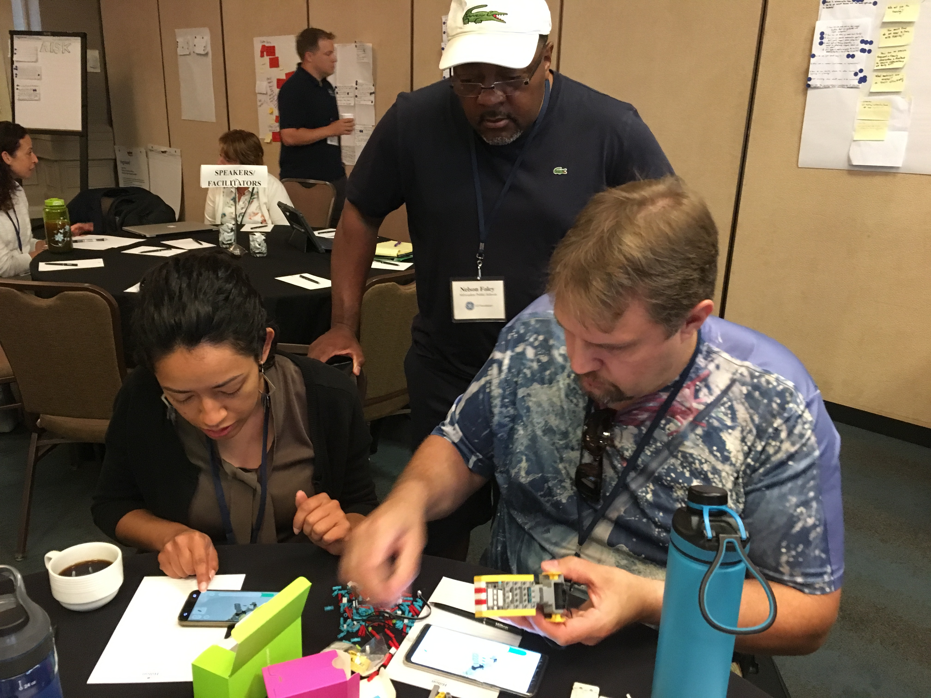
STEM LEADERSHIP ALLIANCE SUMMIT
July 9-13, 2023 STEM Leadership Alliance, Orlando, Florida
www.STEMLeadershipAlliance.org

Slide 15
Resources
https://www.challengesuccess.org/resources/covid-19-resources-for-remote-learning/
https://www.understood.org/en/school-learning/coronavirus-latest-updates
http://www.africanamericanhomeschoolmoms.com/freebies-2/
https://www.nextgenscience.org/parents

Slide 16
THANK YOU!
Salfernandez.shn@gmail.com
KelliListWells.klw@gmail.com for More resources: www.Stemhappensnetwork.com www.stemleadershipalliance.com

